Slide 2
Your Digital Agenda 2025
Online Appointment Booking
On-Site Customer Management
Data Protection and IT Security
This is what online appointment booking powered by cleverQ has to offer

Slide 3
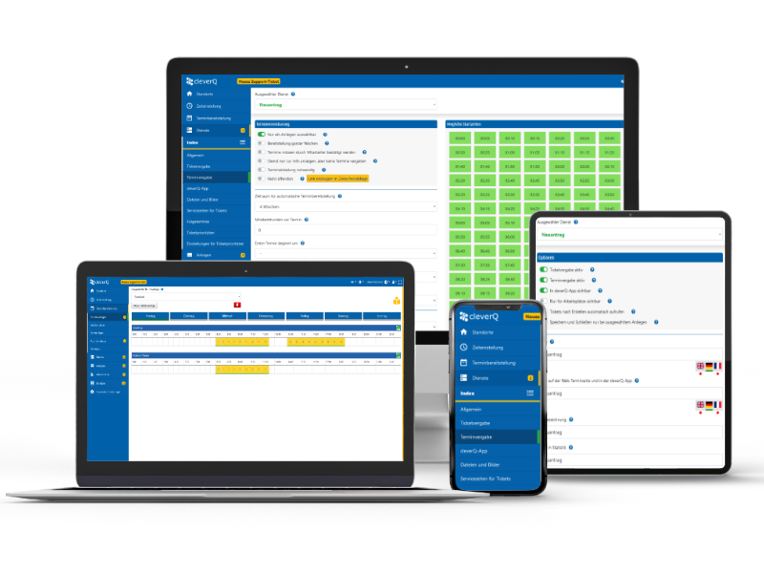
cleverQ online appointment booking system offers you all the features you need to present your services online and make them bookable.
✓ Define individual services
✓ Unlimited number of calendars & users
✓ User roles & permissions
✓ Appointment templates
✓ Weekly schedules
✓ Exceptions & public holidays
✓ Location management
✓ Provide appointments for video consultation
✓ Setting up the system environment according to your wishes
✓ Certified data protection SaaS with German hosters
✓ Digitize analog processes without affecting the existing IT infrastructure

Slide 4
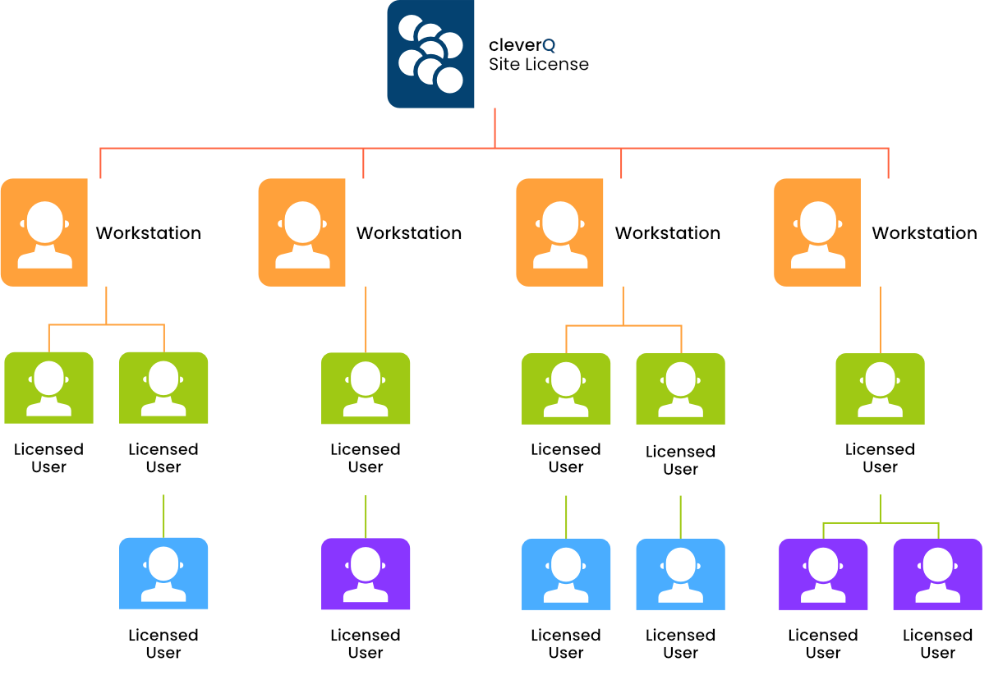
No hidden fees—just a single site license for unlimited calendars and users.
The key advantage of cleverQ lies in its fair and transparent licensing model. With just a single license, you gain the ability to create and manage unlimited users and calendars for each location or company.
The transparent pricing, based on the SaaS (Software as a Service) model, enables a cost-effective path to digitalization, delivering valuable solutions for both your employees and customers.

Slide 5
From booking to servicing - cleverQ is that simple.
Appointment Booking
Verification On Site
Queuing in Waiting Area
Service

Slide 6
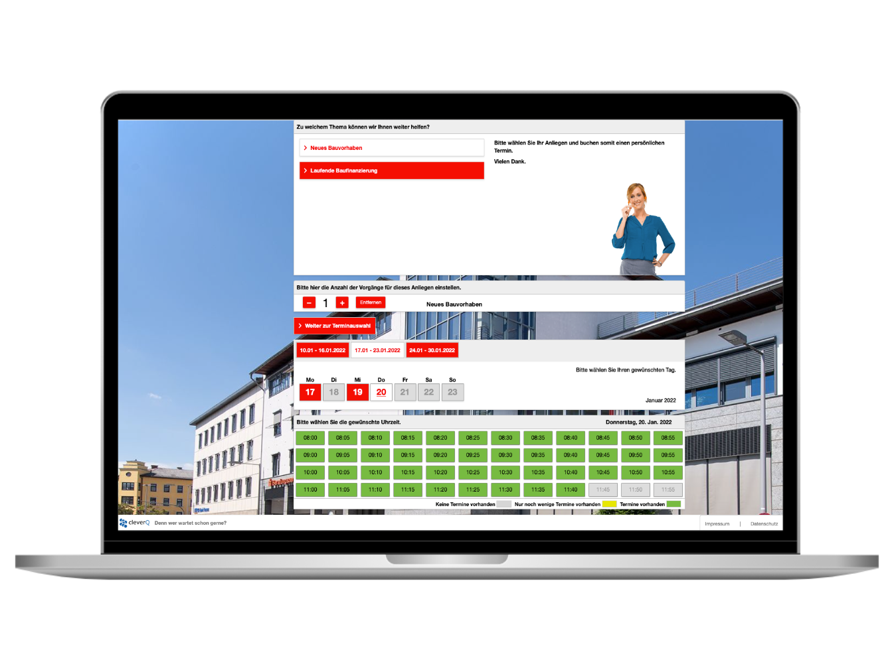
Appointment booking on your personal web appointment page
We create a personalized web booking page for your customers to easily schedule appointments.
After booking, they receive a confirmation email with all appointment details, including a QR code and/or reservation code.
This code allows customers to check in on-site, automatically join the queue, and be visible on your team’s workstations. It can also integrate with door controls for direct access to waiting areas.

Slide 7
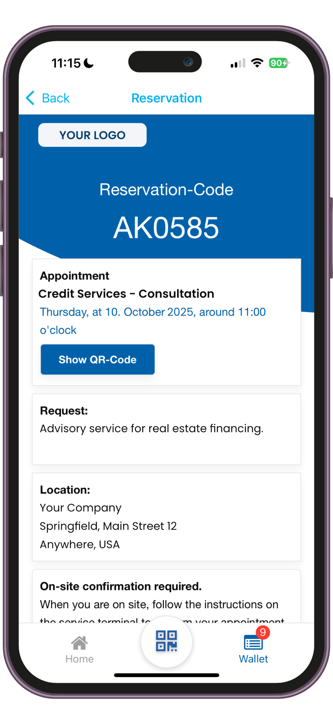
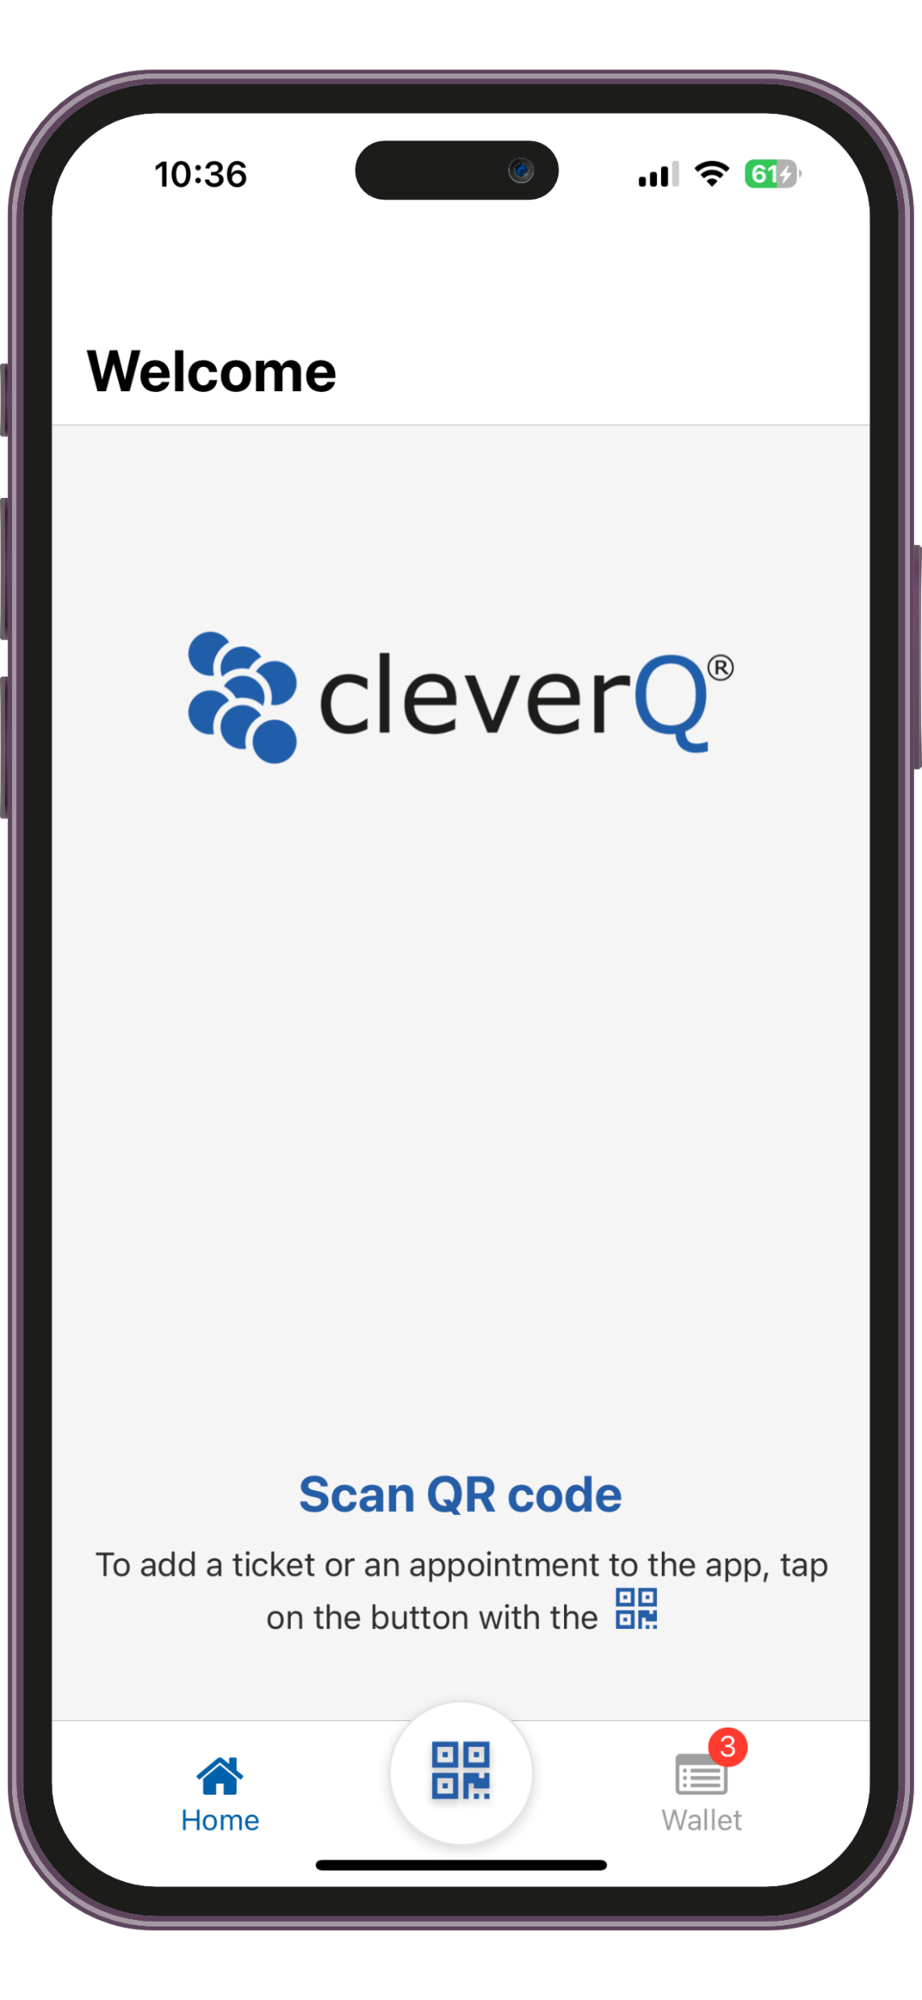
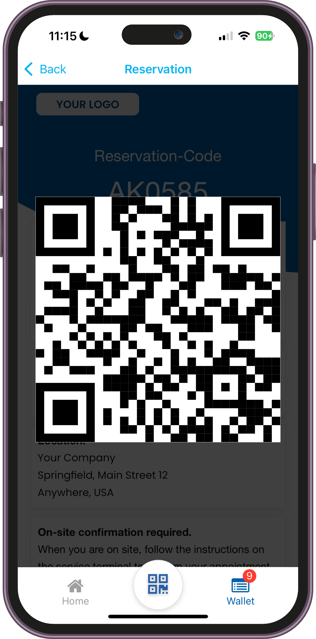
Appointment booking with the free cleverQ Digital Wallet App.
With the free cleverQ Digital Wallet App, customers can scan the QR codes on-site or from the email confirmation to transfer their appointments to the Digital Wallet.
They can also easily verify their appointment on-site using kiosk systems or with your staff.

Slide 8
Appointment booking by your employees
Your staff can book, edit and, if necessary, delete appointments independently.
This means that your customers can still make an appointment by phone, e-mail or on site.
You can also efficiently schedule walk-in customers with appointments, even when same-day availability is limited.
You can use all the advantages of a modern appointment booking system without having to abandon the traditional booking methods.

Slide 9
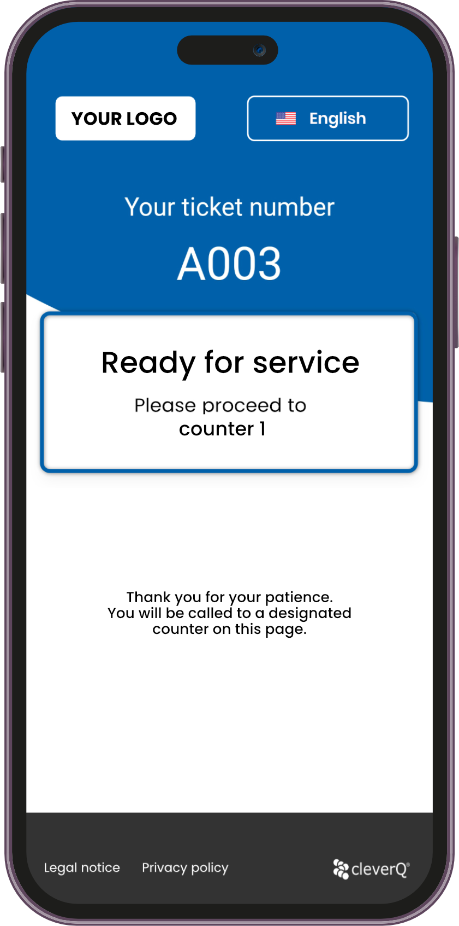
On-Site Customer Management
No matter how your customers book their appointments, on-site they have the option to check in: either via a self-service terminal or at the counter with your staff.
A service ticket is automatically generated from the QR code or reservation code, adding the customer to the queue.
Your team can then call customers via the service ticket or personally greet them in the waiting area.

Slide 10
Data protection and IT security
As a provider of SaaS (Software as a Service), the data protection and IT security of our customers and our own infrastructure is one of the most important challenges.
We ensure robust data security through multiple layers of protection. Partnering with leading hosting providers, such as Hetzner, guarantees that our digital services remain highly available, performant, and secure at all times. Additionally, we strictly adhere to GDPR compliance and maintain our ISO 27001 certification (Information Security Management Systems) through regular renewals, underscoring our commitment to safeguarding your data.

Slide 11
Digitalization in the financial industry is increasingly being shaped by the customer.
Therefore, now more than ever, useful and innovative services are needed which create real added value for your customers.

Slide 12
cleverQ Video consultation Provide your services to clients anytime, anywhere. Enhance accessibility for your customers and empower your team to work productively from any location.
Effortless Booking: Your customers can easily schedule video appointments at their convenience.
Seamless Integration: Compatible with leading platforms like Microsoft Teams, GoToMeeting, and Zoom.
Full Control: Independently manage, book, or cancel appointments with ease.
Automated Confirmation: Customers receive appointment details via email, including a direct link to the digital meeting room.
Time and Convenience: Save your customers long travel times, parking hassles, and unnecessary complications.

