Slide 1
Industry Solutions for Warehousing & Logistics
By integrating cleverQ into warehouse logistics, businesses can cut costs, improve productivity, and enhance overall supply chain efficiency through smart queue management and appointment scheduling.
www.cleverq.us | info@cleverq.us | 786-709-9550 851 Ne 1st Ave Miami | FL 33132-1842 | (Paramount Miami World Center)

Slide 2
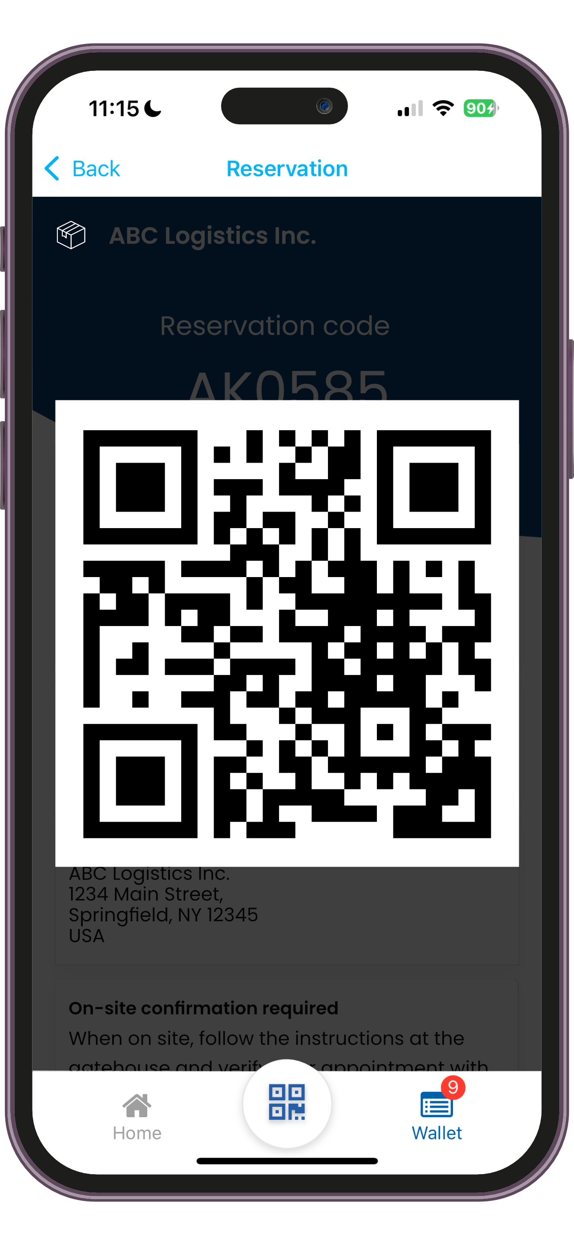
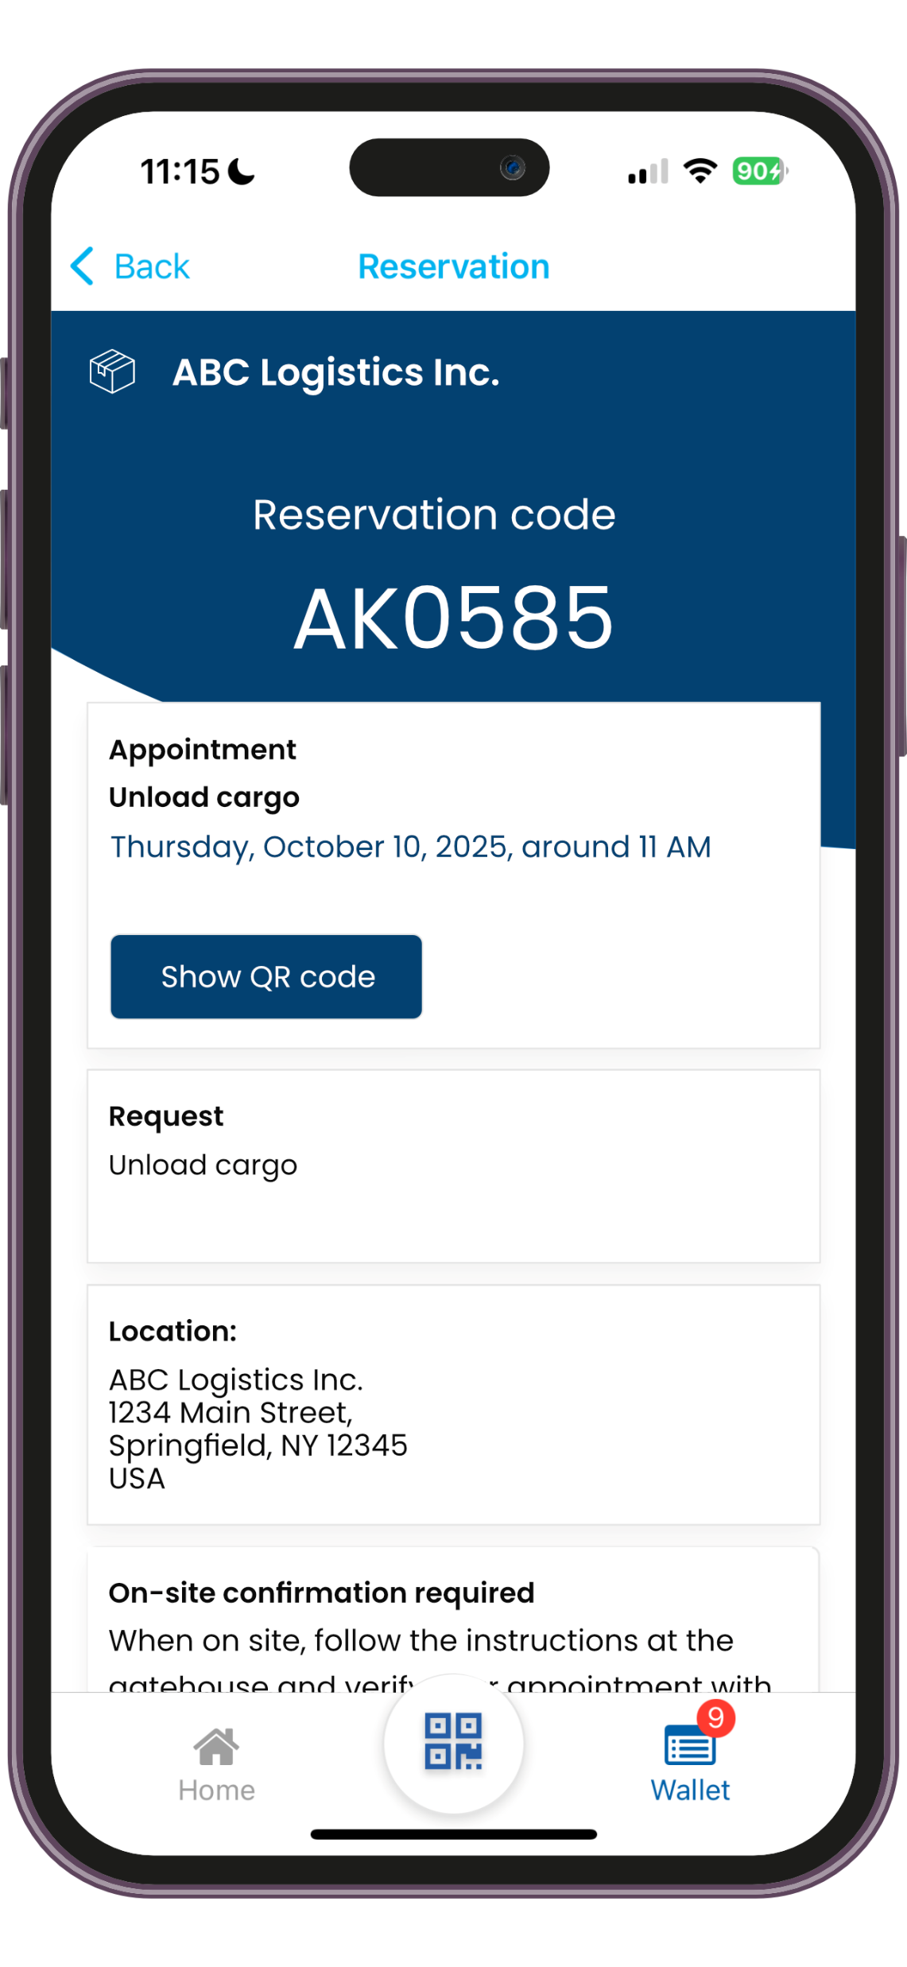
On-Site Arrival Management Appointment Booking
Dynamic Arrival Management
Suppliers, carriers, and vendors can book time slots before arrival to prevent bottlenecks at loading docks.
A unique QR code is generated for each appointment, which can be used for on-site verification, gate access, or entry to restricted areas such as designated parking spots.

Slide 3
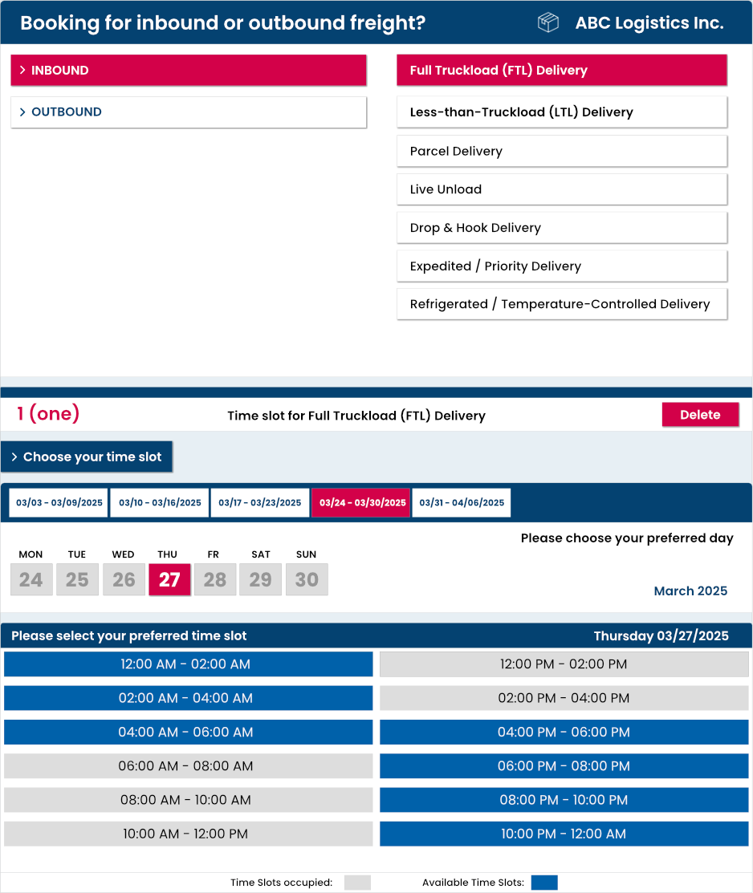
On-Site Arrival Management Appointment Booking
cleverQ Digital Wallet App Drivers can scan a QR code on-site to favorite your company and book future appointments from the digital wallet.
Appointment Web Page Alternatively, drivers can book appointments through a personalized online booking page that we set up for your company.

Slide 4
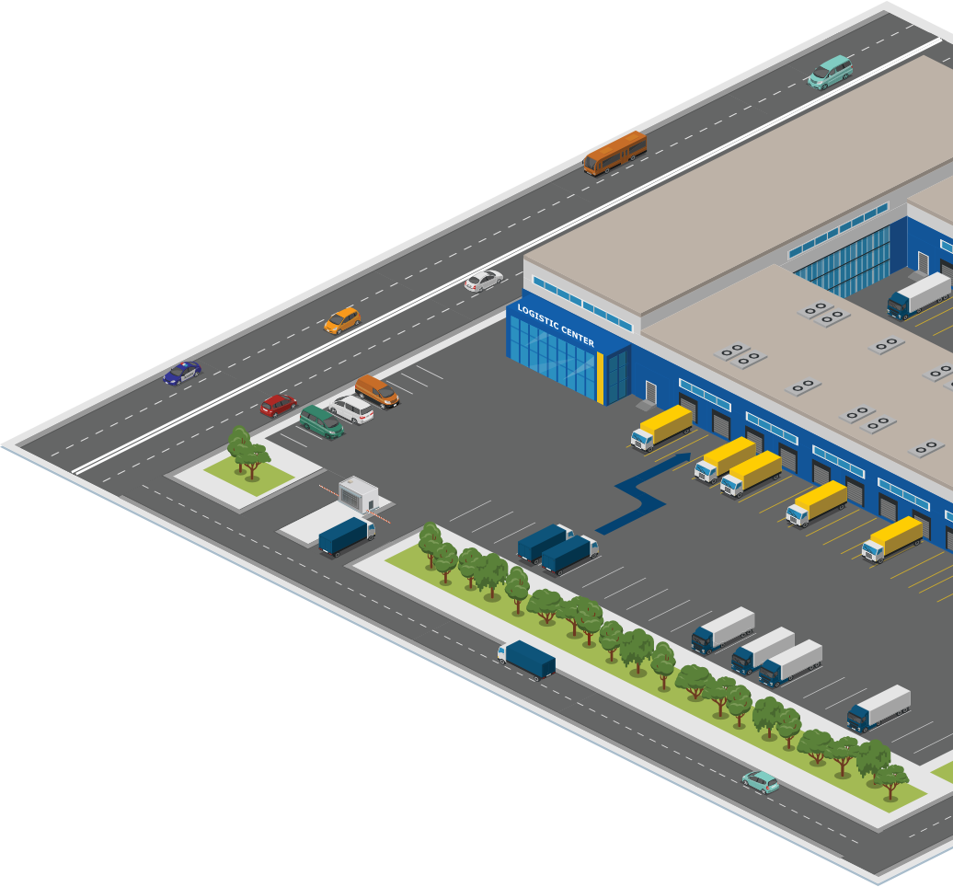
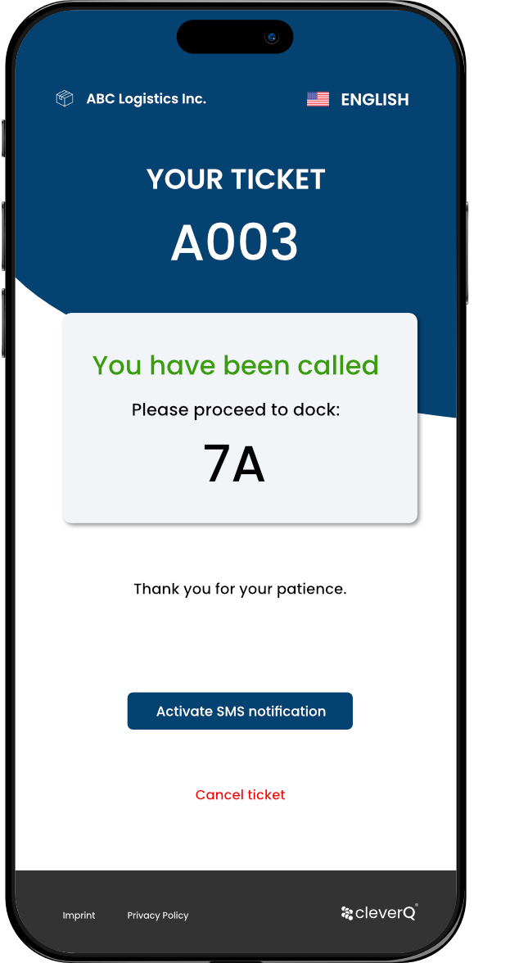
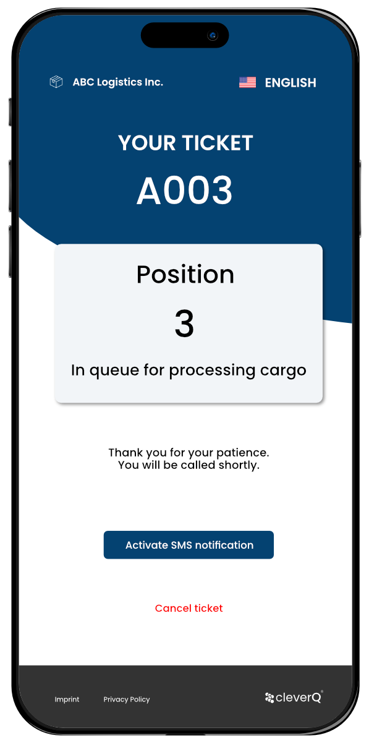
On-Site Arrival Management Smart Queuing
Dynamic On-Site Management
Provide digital waiting tickets on site via QR codes.
After scanning the QR code drivers are automatically placed in a digital queue with directions and further instructions.
On call up drivers receive a push message or SMS, providing all necessary information to locate the correct loading dock.

Slide 5
Workforce & Resource Optimization
Dynamic Staff Allocation: Assign personnel based on real-time demand, reducing idle labor costs.
Shift Management: Optimize employee schedules to align with peak warehouse activities.

Slide 6
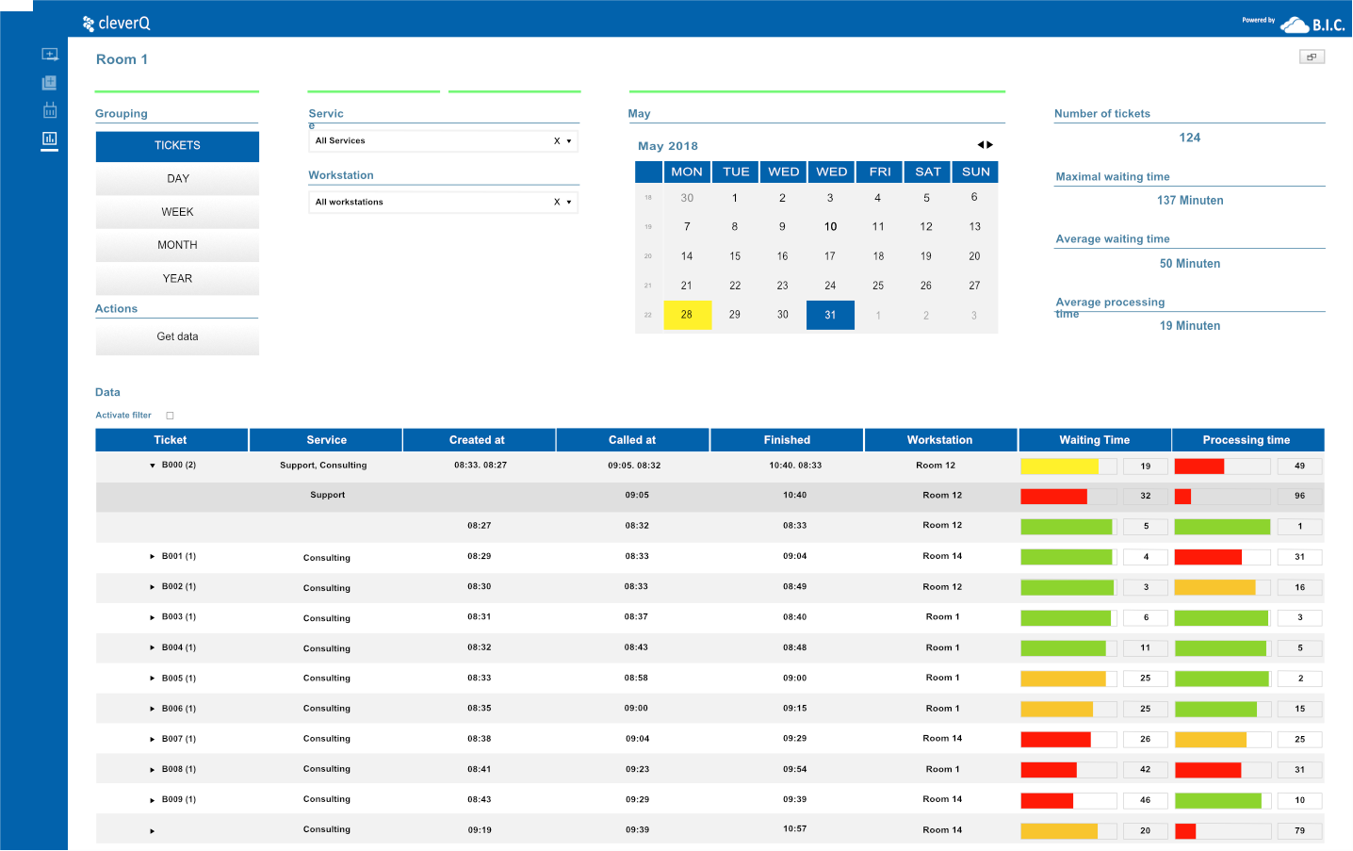
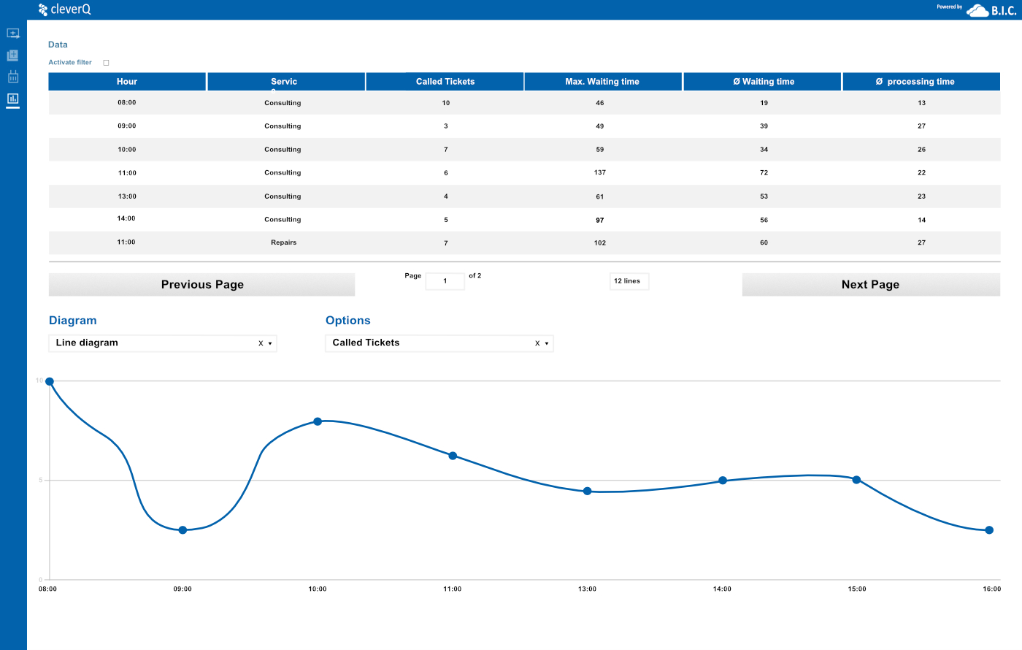
Real-time Visibility & Analytics
Live Monitoring: Track incoming and outgoing shipments with estimated wait times.
Performance Metrics: Generate insights on dock utilization, carrier punctuality, and operational bottlenecks.

Slide 7
Improved Compliance & Security
Digital Visitor Management: Log and verify visitor access (e.g., truck drivers, contractors) through self-service kiosks.
Automated Alerts: Notify security teams of unauthorized or delayed entries.

Slide 8
Industry Solutions for Warehousing & Logistics
Streamline Docking Processes, Yard Management and Warehouse Operations
cleverQ is a brand of the German software developer B.I.C. GmbH. For over 10 years, cleverQ has been one of the most successful systems in the DACH region for queuing and appointment management. Numerous customers from a wide range of industries already rely on cleverQ.
If you'd like to learn more about us or have any questions, feel free to visit our website or reach out to us directly:
www.cleverq.us | info@cleverq.us | 786-709-9550 851 Ne 1st Ave Miami | FL 33132-1842 | (Paramount Miami World Center)

