Slide 1
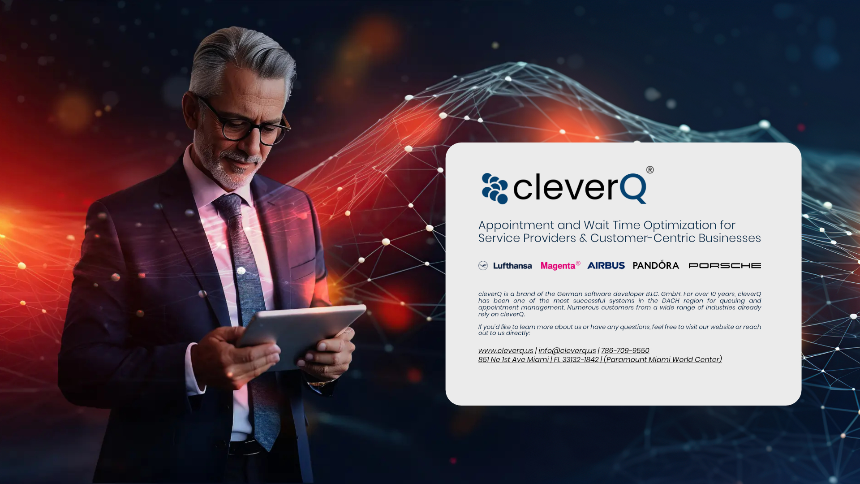

Slide 2
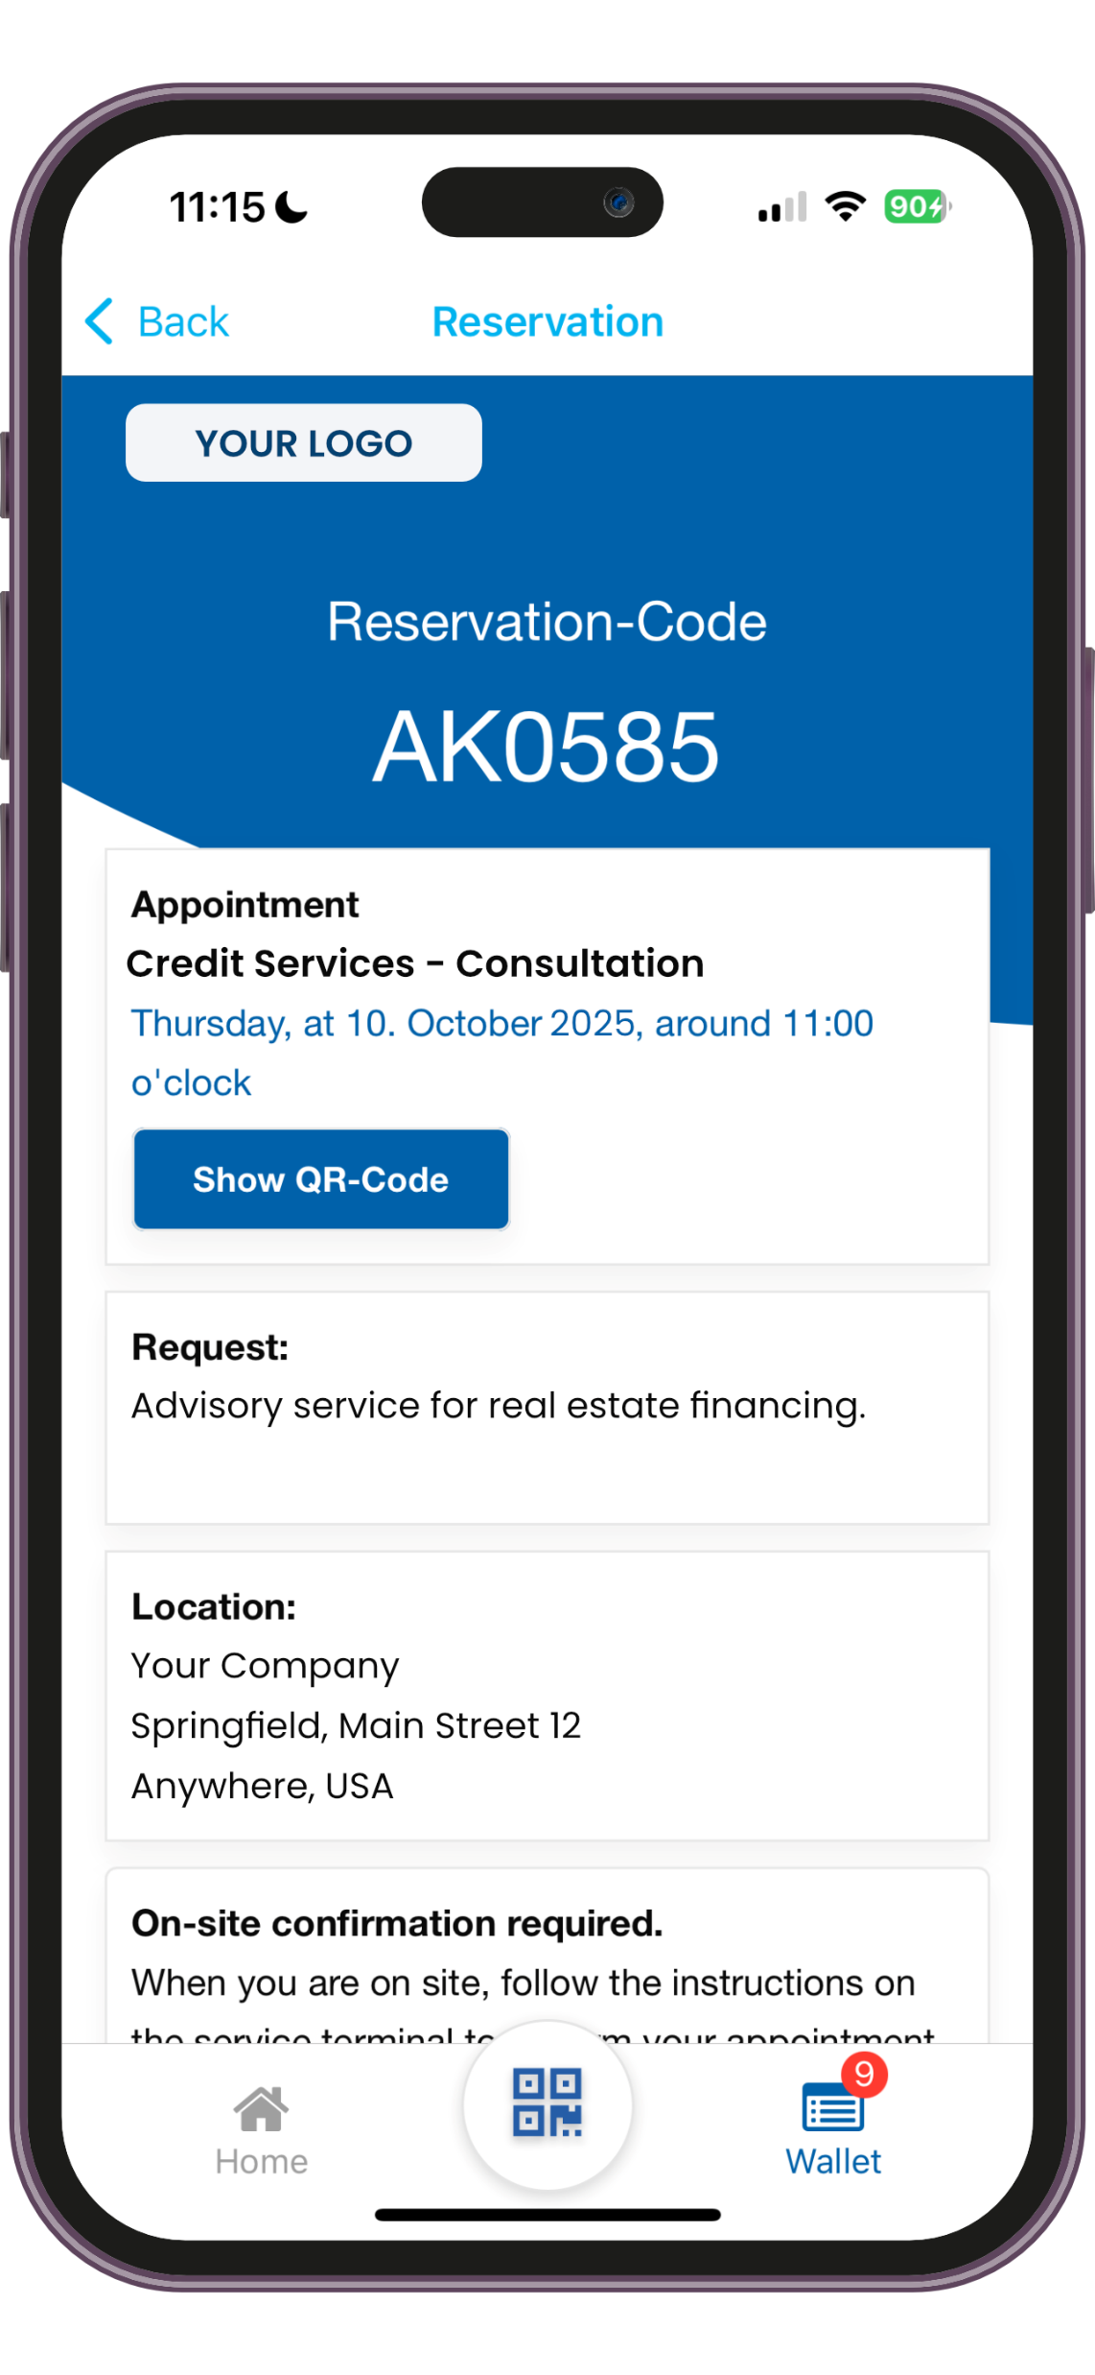
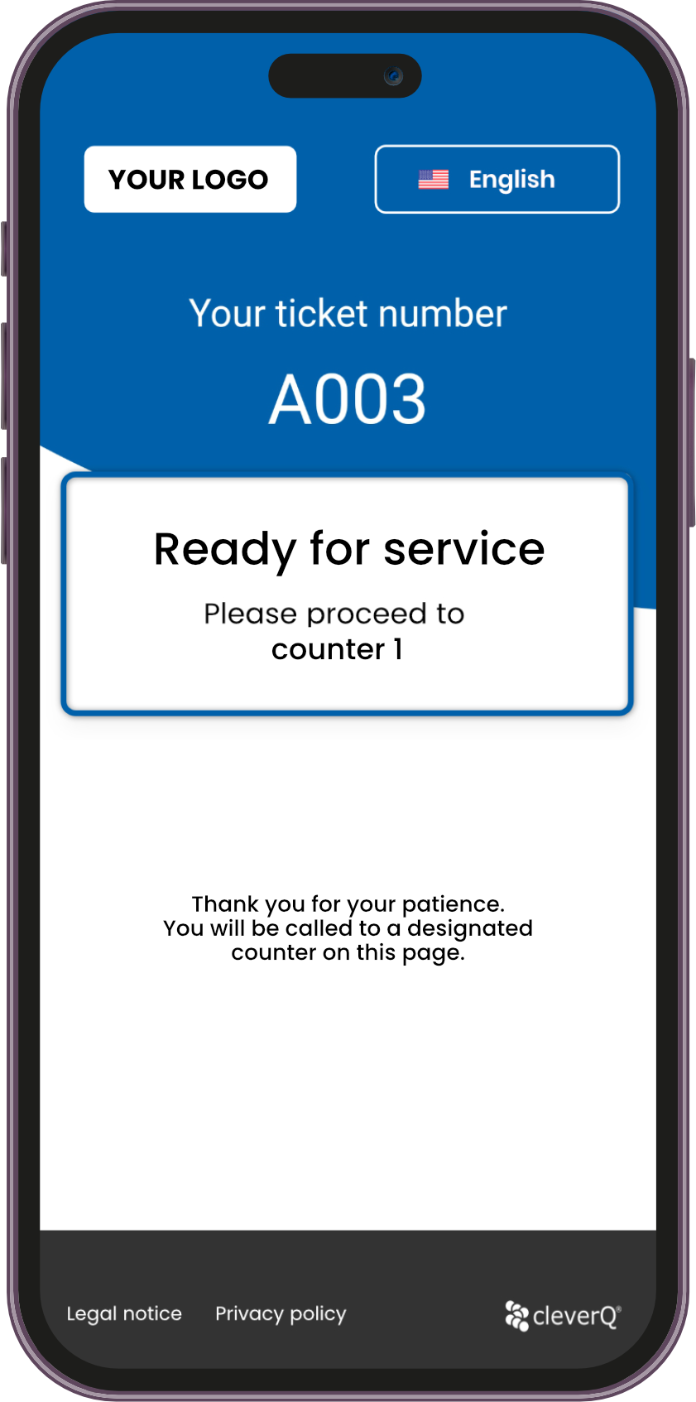
Streamlining and digitizing your operations for improved efficiency and structural innovation.
Optimization of waiting times
Customized solutions for online appointment booking and management
Professional on-site customer flow management
We help you create a modern and contemporary presence, both on-site and digitally
Enhancing teamwork and customer interactions through digital excellence with cleverQ.

Slide 3
Achieving flawless and customer-centric service optimization with cleverQ.
Discover the benefits of the cleverQ solution.
Experience the wide array of features cleverQ has to offer.

Slide 4
We connect service with customers .…becausae time matters!
Hybrid Queuing and Appointment Management Solution
(Managing walk-in customers and appointments through a unified platform)
Single-site license with unlimited workstations
GDPR-compliant
Enterprise-grade cybersecurity: Certified with ISO/IEC 27001:2013, 27017:2015, 27018:2014, and 9001:2015
SaaS Solution | Cloud-Based | No complex system integration required

Slide 5
Modern and clever customer processing
Excerpt from cleverQ Features:
Online Appointment Booking
Comprehensive Customer Information Before Appointments
Digital Waiting Tickets
Organized and Simple Call-Up of Waiting Customers
Digital Signage
In-Depth Statistics
Here’s how to set your customer service apart from the competition.
For more information visit our Website: www.cleverq.us
Wait Time Reduction & Queue Optimization
Easy integration in existing processes
Cross-device functionality and a free app for
Unlimited Site licenses
Save time for customers and employees alike
Eliminate the need for crowded waiting areas
Drive revenue growth by freeing customers to discover and purchase
Zero interference with your current IT setup
Effortless integration with MS Outlook and CRM platforms
Rapid, hassle-free SaaS implementation
Work across devices with ease
Complimentary Digital Wallet App for added convenience
No limits on workstations for managing customer queues—accessible via any web browser.

Slide 6
Modernize, digitize, and optimize your customer service.
See how customers from different industries are benefiting from cleverQ.
Government Authorities
"Digitalization is a key focus in politics, and we’re committed to setting the standard. Citizens demand quicker processes and no longer want to use vacation days for simple tasks like applying for an ID.“
Financial Institutions "While we’ve always relied on scheduled appointments, we now have the ability to handle both walk-ins and appointments seamlessly through one platform, showcasing a contemporary and professional presence."
Utilities Providers
"Speed and efficiency are critical for our customers, and timing is key. Now, we can optimize staff planning and deliver even better service to meet every customer’s needs.“
Hospitals & Medical
"With tailored patient flow and priority call features in the emergency room, we’ve nearly eliminated chaos in the waiting area.“

Slide 7
Modernize, digitize, and optimize your customer service.
See how customers from different industries are benefiting from cleverQ.
Transportation Services
"Travel can be stressful, and when issues arise, customers appreciate fast and organized service. cleverQ is the ideal solution for us to meet these needs seamlessly."
Retail
"Our top priority is making sure customers leave with what they planned to buy. With long waits being a thing of the past, we’ve implemented a solution to eliminate delays entirely."
Vaccination & Testing
"Peak times during vaccinations and testing are now much easier to handle, reducing stress for employees and customers alike. For us, planning is everything."
Logistics
"With vehicle management and access control via ticketing, we’ve eliminated parking overcrowding and drastically reduced theft on-site.“

