Slide 1
Streamlining Air and Sea Travel cleverQ’s Dual Impact on Staff and Travelers
www.cleverq.us | info@cleverq.us | 786-709-9550 851 Ne 1st Ave Miami | FL 33132-1842 | (Paramount Miami World Center)

Slide 2
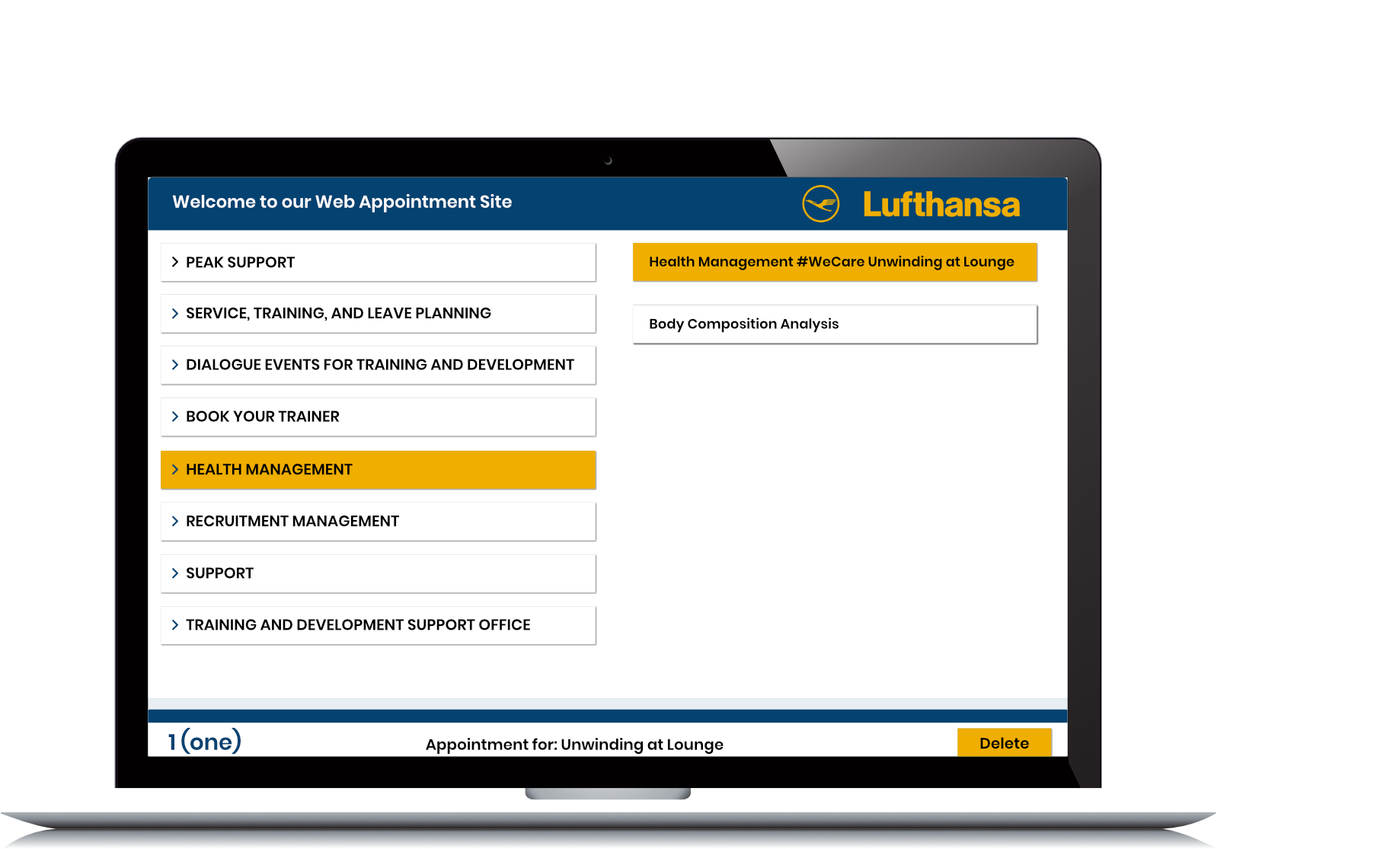
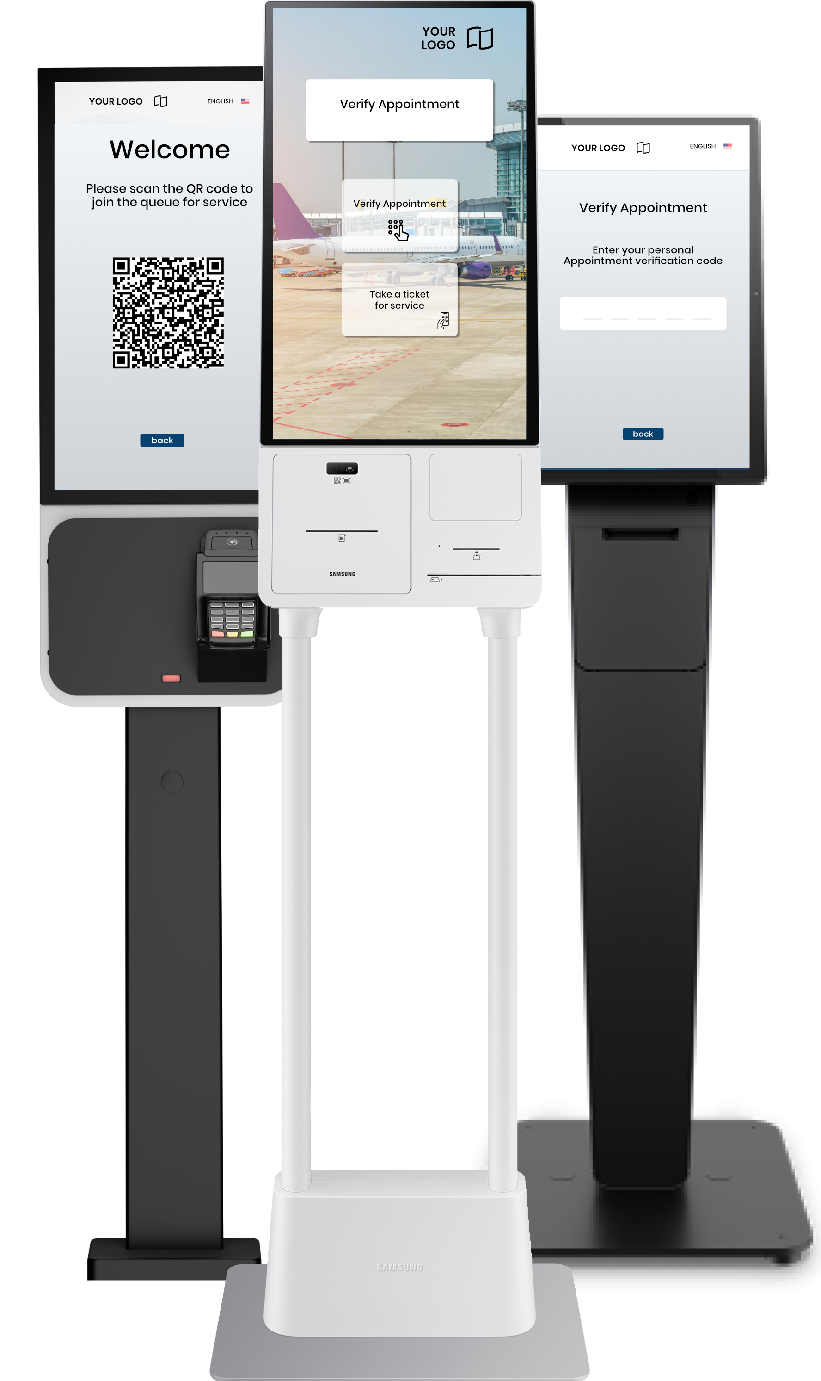
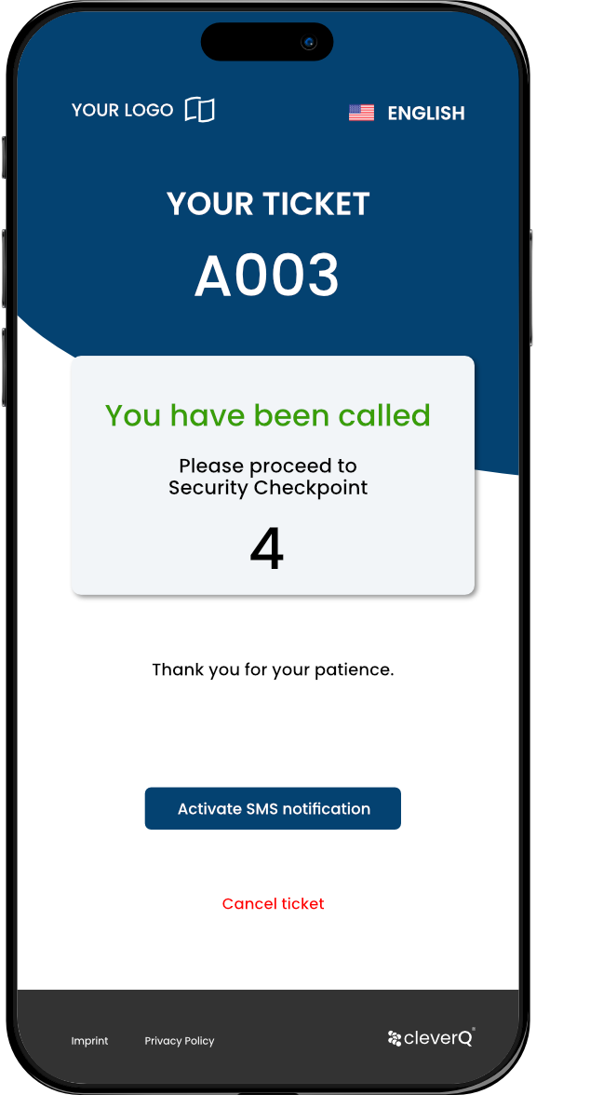
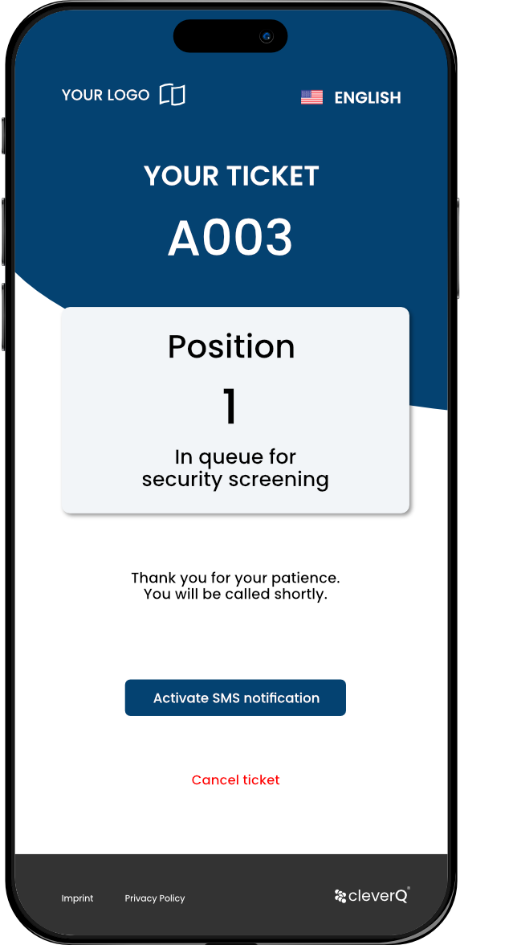
What is cleverQ
cleverQ is an innovative digital solution for appointment scheduling, queue management, and resource optimization.
In the transportation sector, cleverQ can help minimize waiting times, optimize passenger flow, and enhance personnel efficiency.

Slide 3
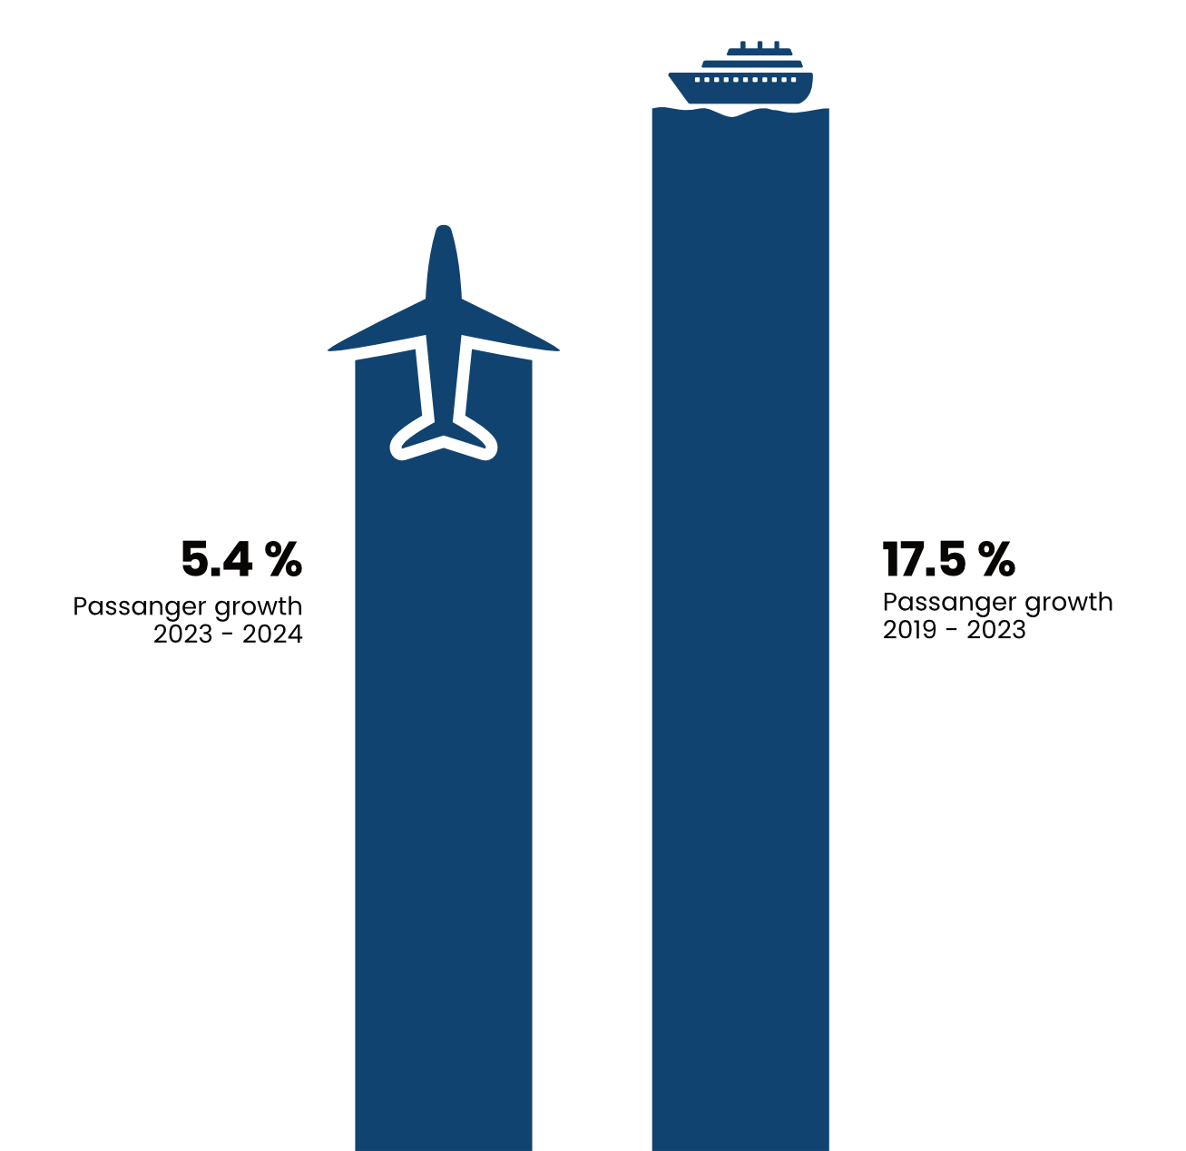
Market Potential & Relevance
Airports
According to IATA, passenger numbers are steadily increasing, requiring efficient processes.
Cruise Ships
The cruise industry is growing, with millions of passengers requiring streamlined boarding, check-in, and onboard services.
Notes:
Air Traffic 2024 in US: 83.3 million Cruise Ships Passenger North America 2024: 18.1 million

Slide 4
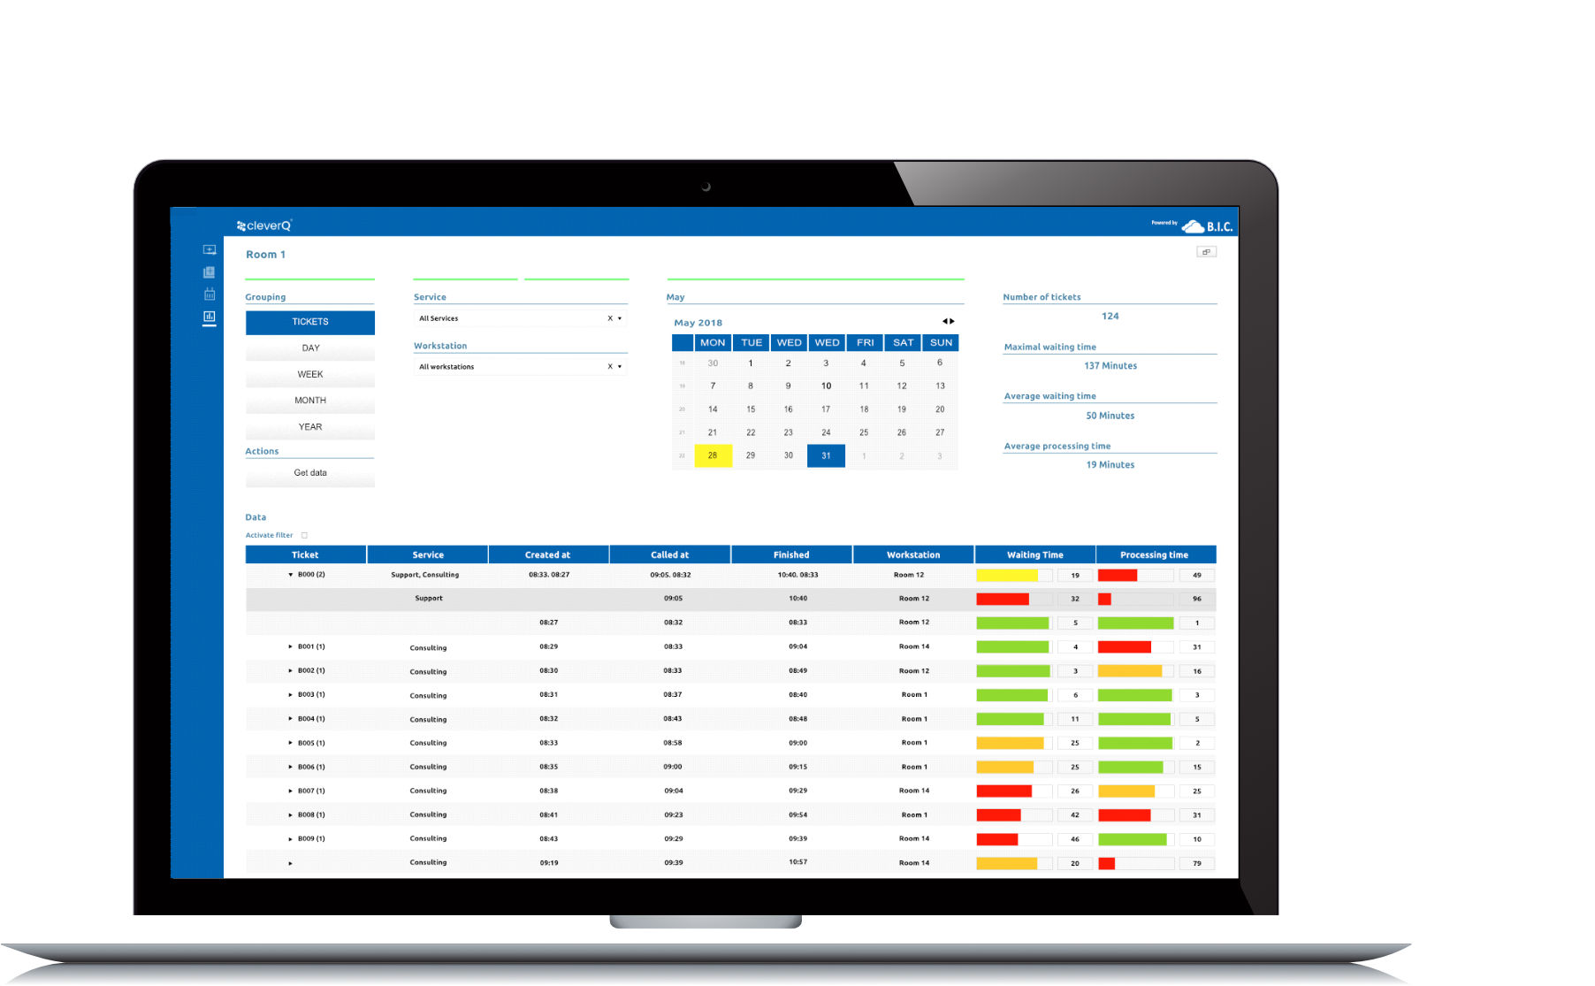
Key Applications for optimizing Airport Operations
Kiosk Software
Digital Queuing
Appointment Booking
Statistics & Business Intelligence

Slide 5
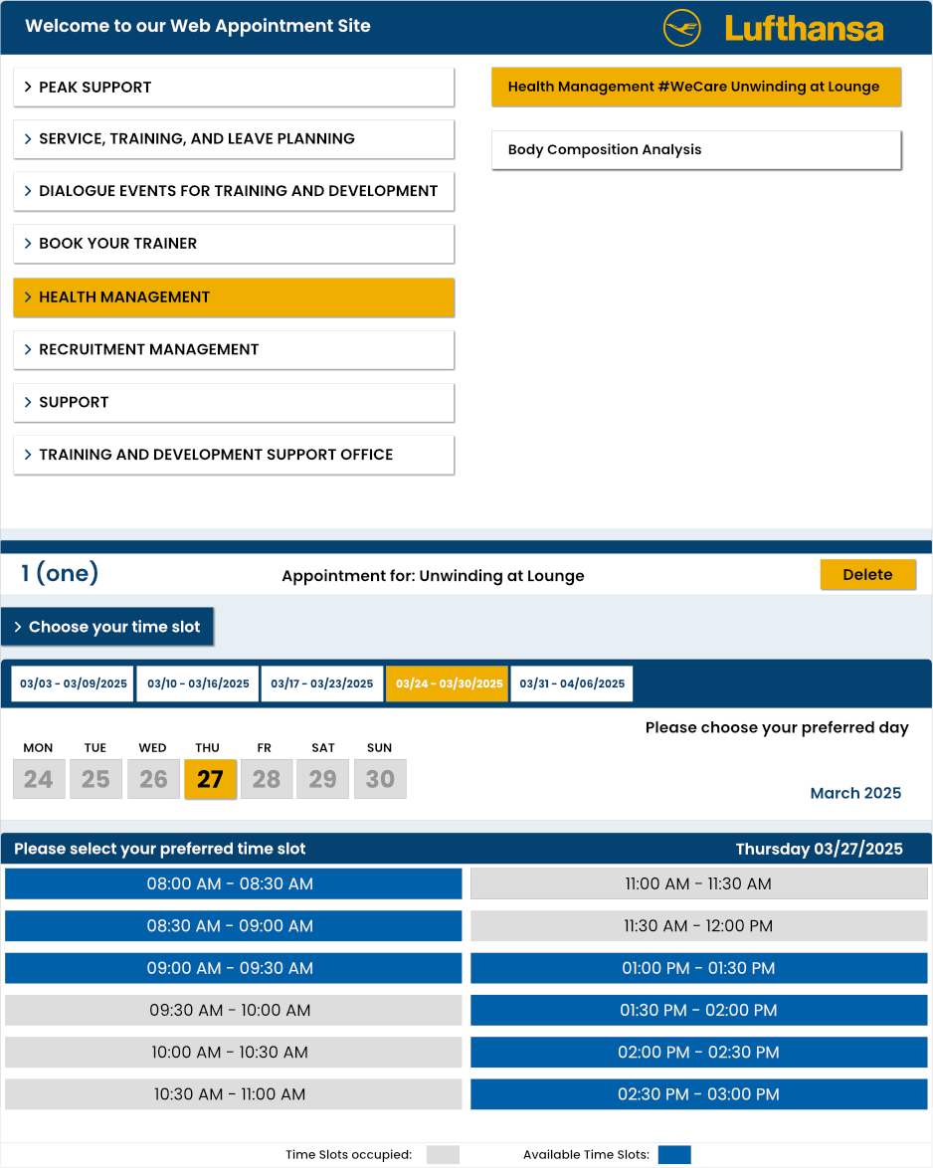
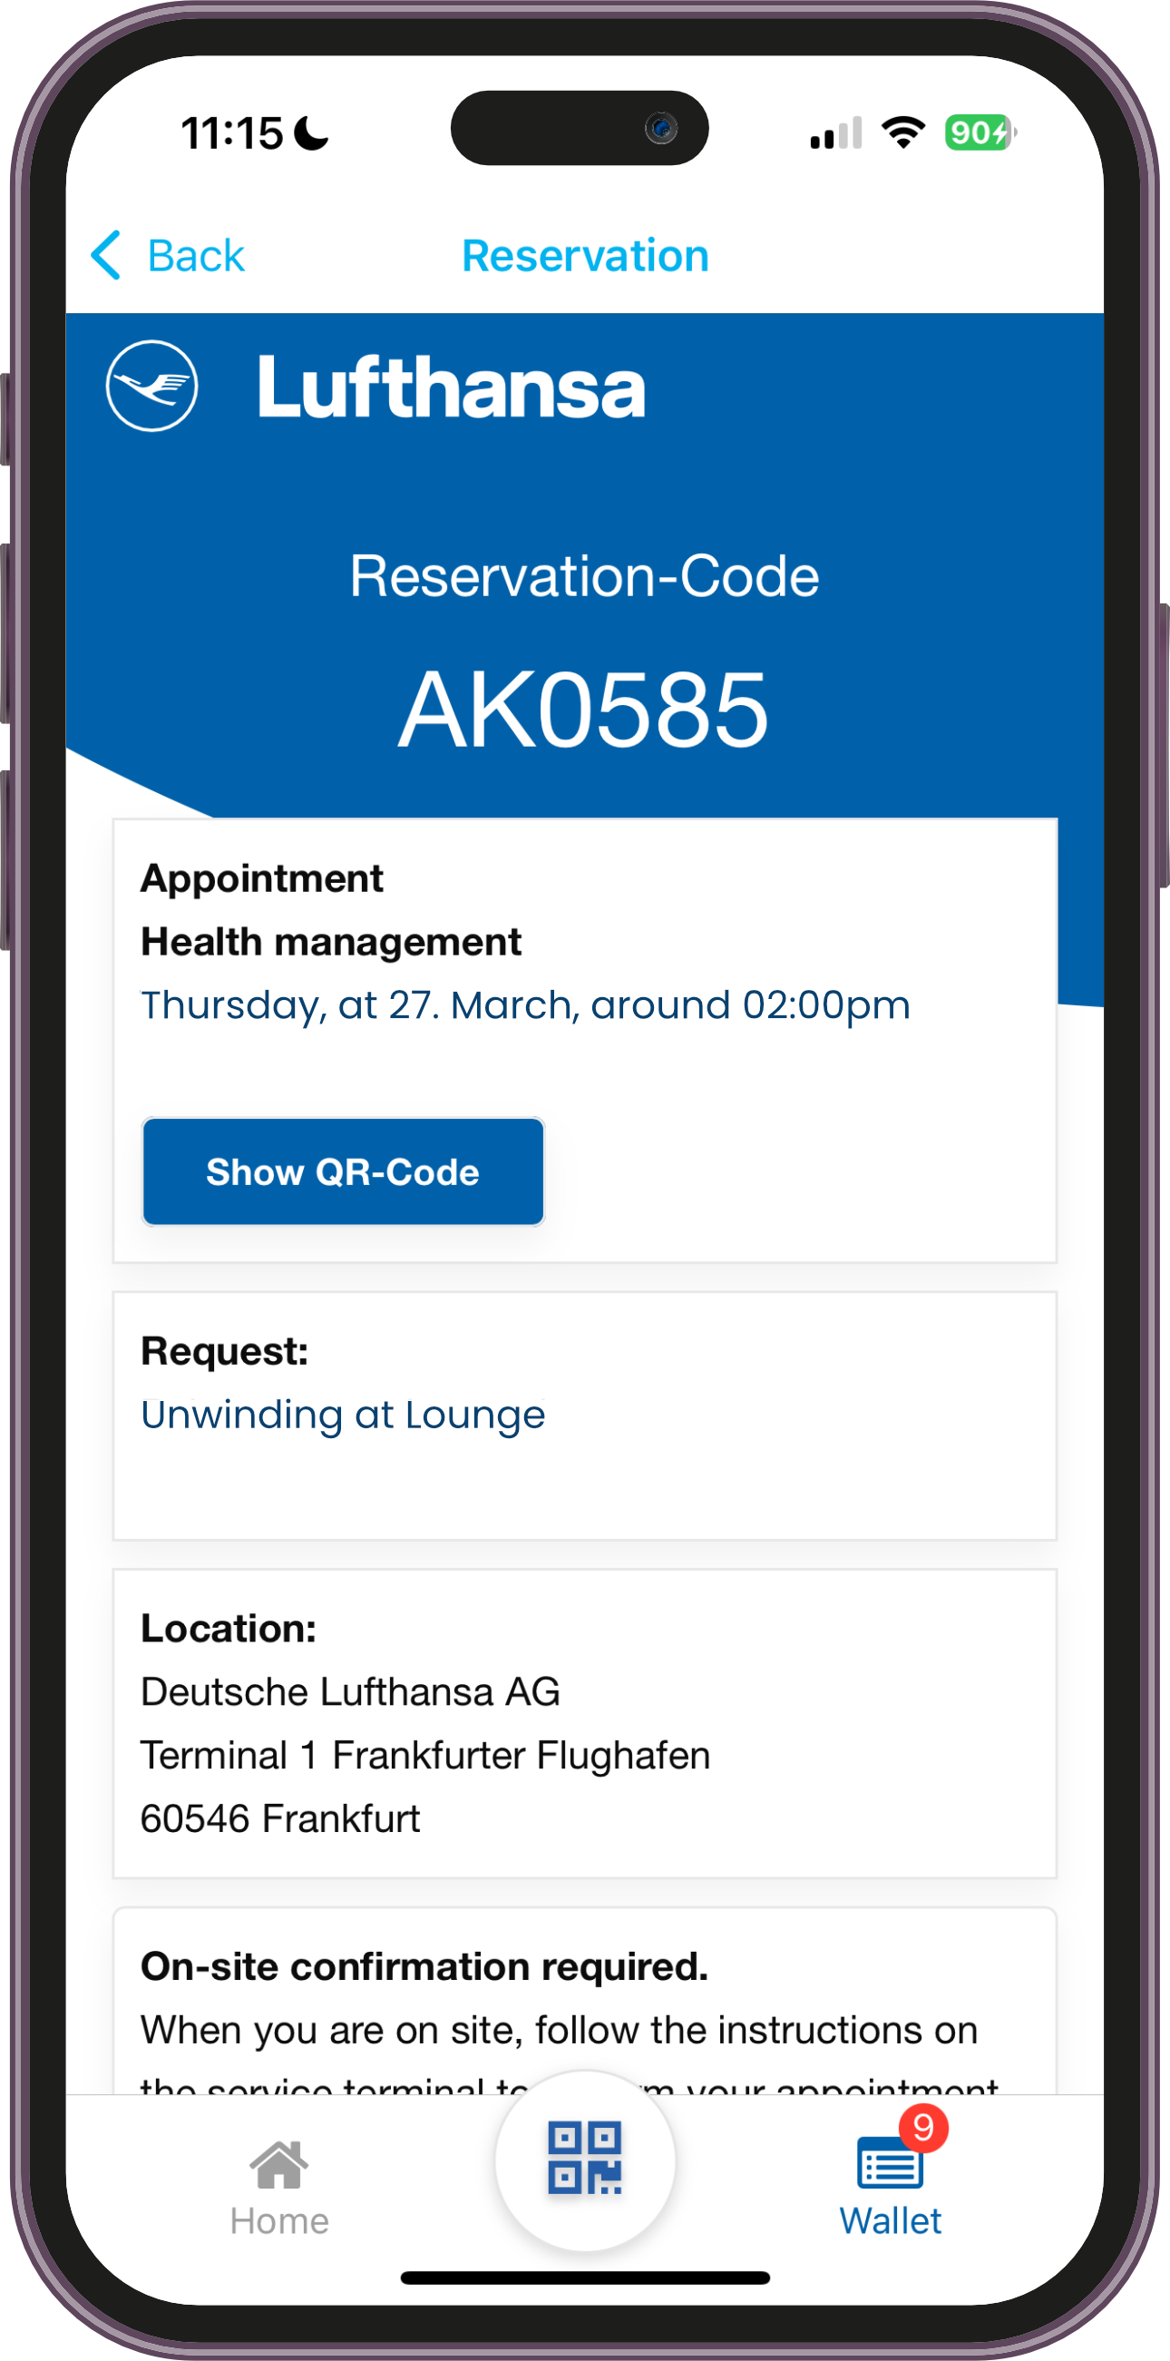
Application Areas in the Airport Sector | Internal Use
Improve efficiency, optimize resource utilization, and reduce employee waiting time for:
Employee Service Centers
Appointment booking for HR concerns (e.g., contracts, benefits, documents)
Reduced waiting times at internal service points

Slide 6
Application Areas in the Airport Sector | Internal Use
Improve efficiency, optimize resource utilization, and reduce employee waiting time for:
Canteen & Break Management
Regulated employee flow to prevent overcrowding in cafeterias
Real-time occupancy analytics for better planning

Slide 7
Application Areas in the Airport Sector | Internal Use
Improve efficiency, optimize resource utilization, and reduce employee waiting time for:
Employee Check-in
Digital queue management for security screening

Slide 8
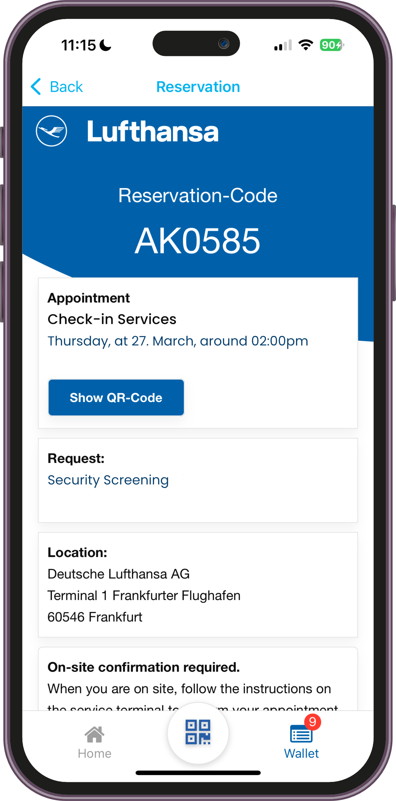
Application Areas in the Airport Sector | Public Use (Passengers)
Enhance customer experience, reduce waiting times, and optimize passenger flow for:
Check-in & Security Screening
Digital queueing for faster boarding
Real-time wait time display & appointment booking for security checks

Slide 9
Application Areas in the Airport Sector | Public Use (Passengers)
Enhance customer experience, reduce waiting times, and optimize passenger flow for:
Immigration & Customs Control
Virtual queue management for entry & customs clearance
Workforce optimization based on real-time demand

Slide 10
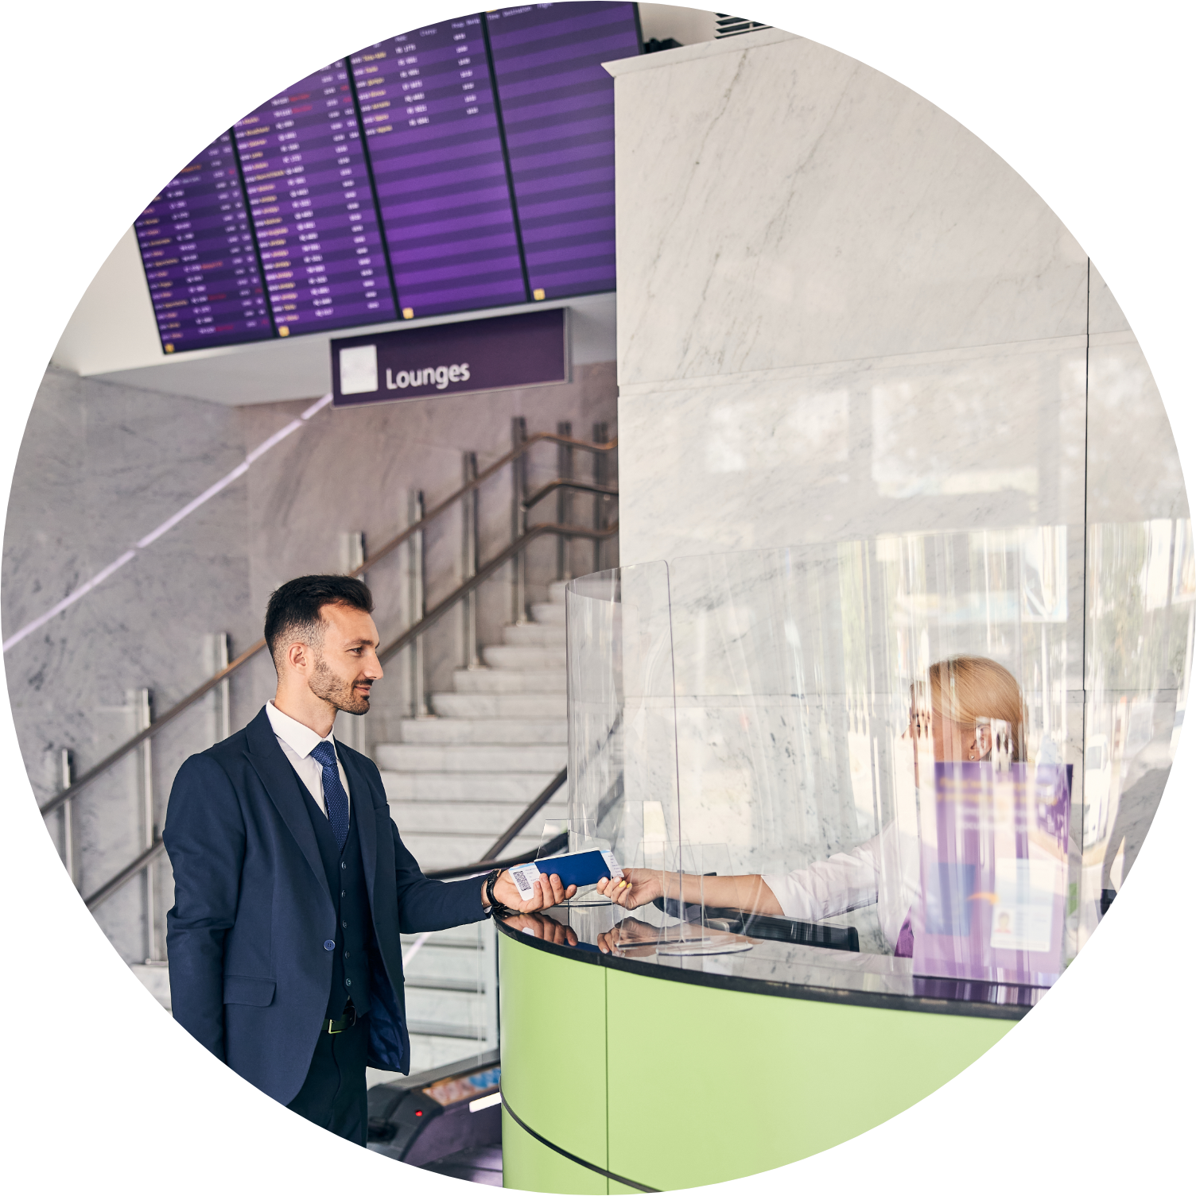
Application Areas in the Airport Sector | Public Use (Passengers)
Enhance customer experience, reduce waiting times, and optimize passenger flow for:
Lounges & Services
Automated appointments for VIP & business lounges
Digital booking for airport services (e.g., accessibility support, childcare)

Slide 11
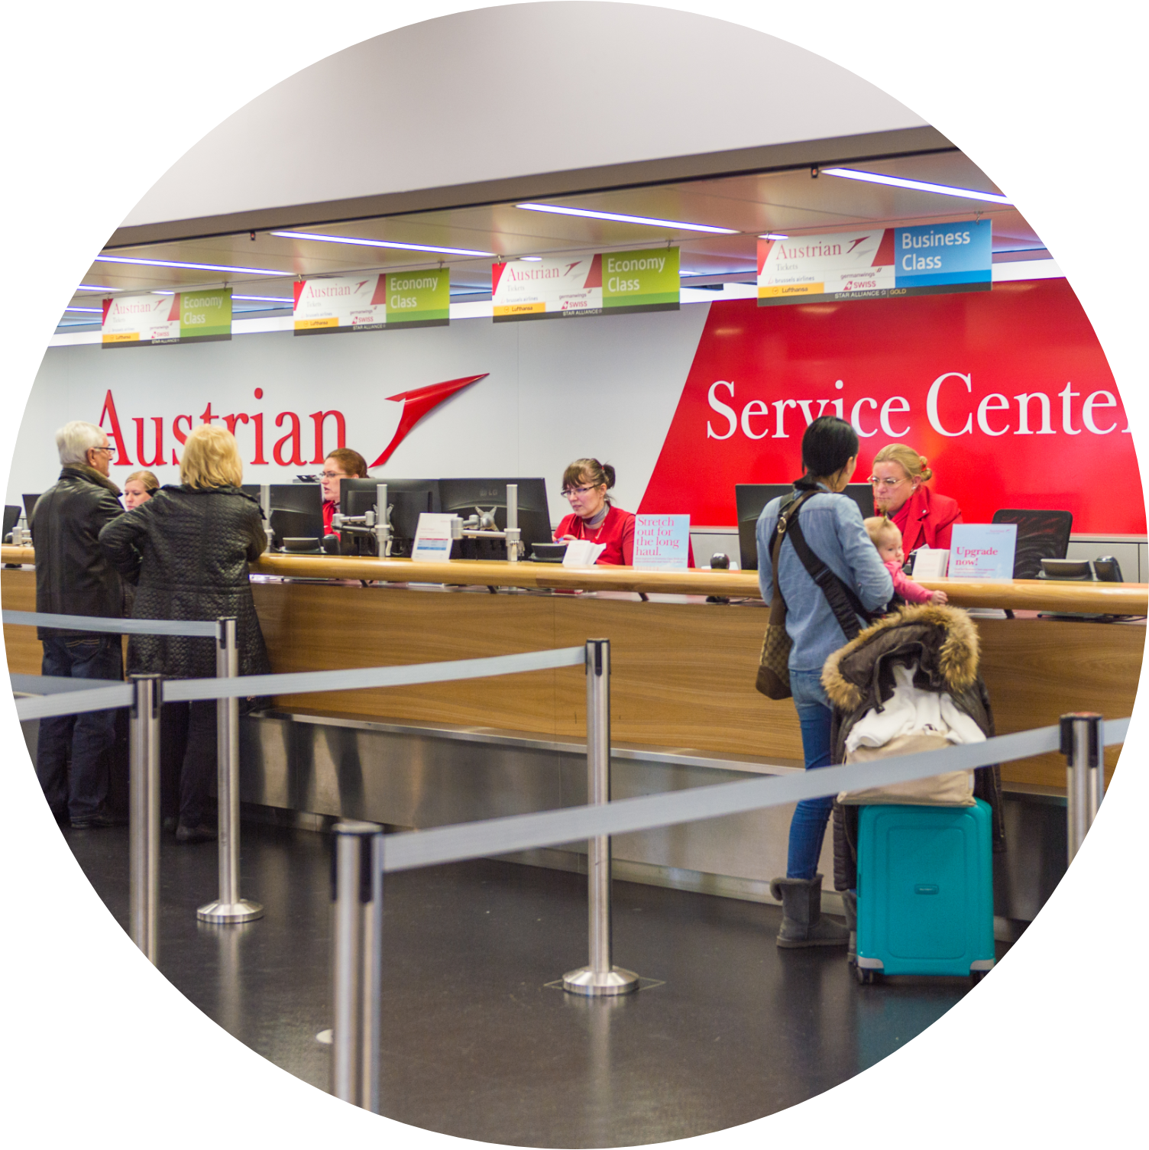
Application Areas in the Airport Sector | Public Use (Passengers)
Enhance customer experience, reduce waiting times, and optimize passenger flow for:
Airline Service Stations
Virtual Queues: Passengers join a digital queue and get notified when it's their turn.
Efficient Prioritization: Staff can prioritize urgent passengers (e.g., connections, special needs).
Digital Communication: Real-time updates on wait times, flights, and documents.
Data Optimization: cleverQ analyzes queues to improve staffing during disruptions.

Slide 12
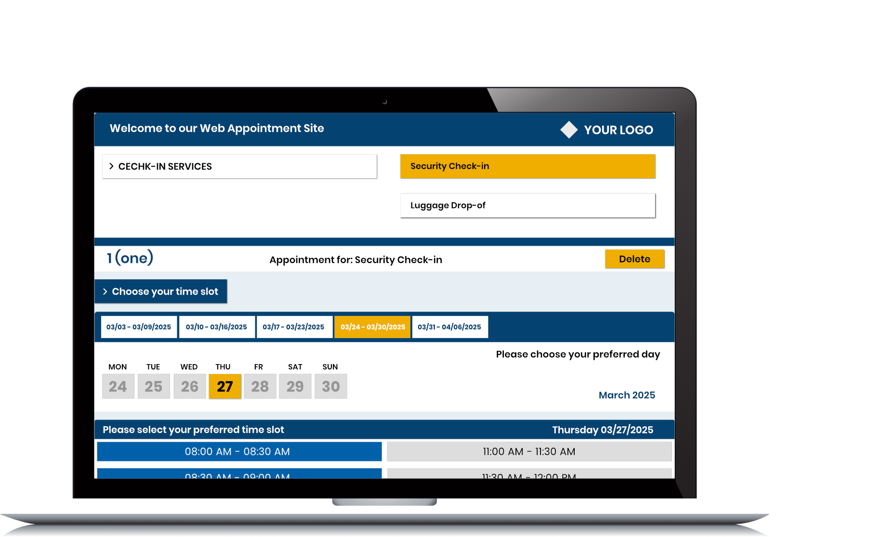
Key Applications for optimizing Check-in and Onboard Experience on Cruises
Kiosk Software
Digital Queuing
Appointment Booking
Statistics & Business Intelligence

Slide 13
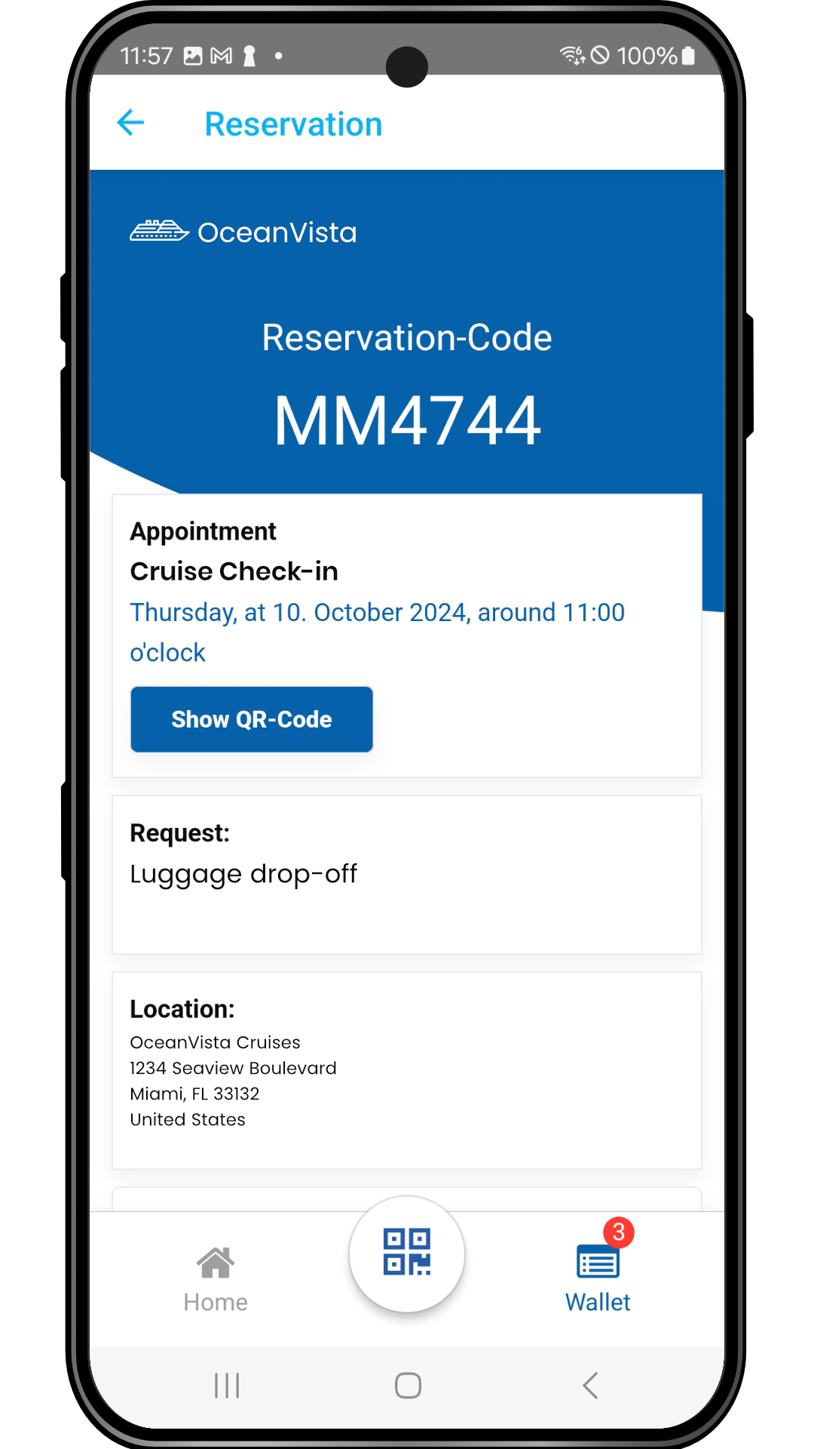
Boarding & Check-in
Digital Queueing for Embarkation & Customs Clearance
Avoid long wait times with scheduled boarding slots
Real-time wait time display for passengers
Baggage Handling & Security Screening
Automated appointment booking for luggage drop-off
Virtual queueing for security checks

Slide 14
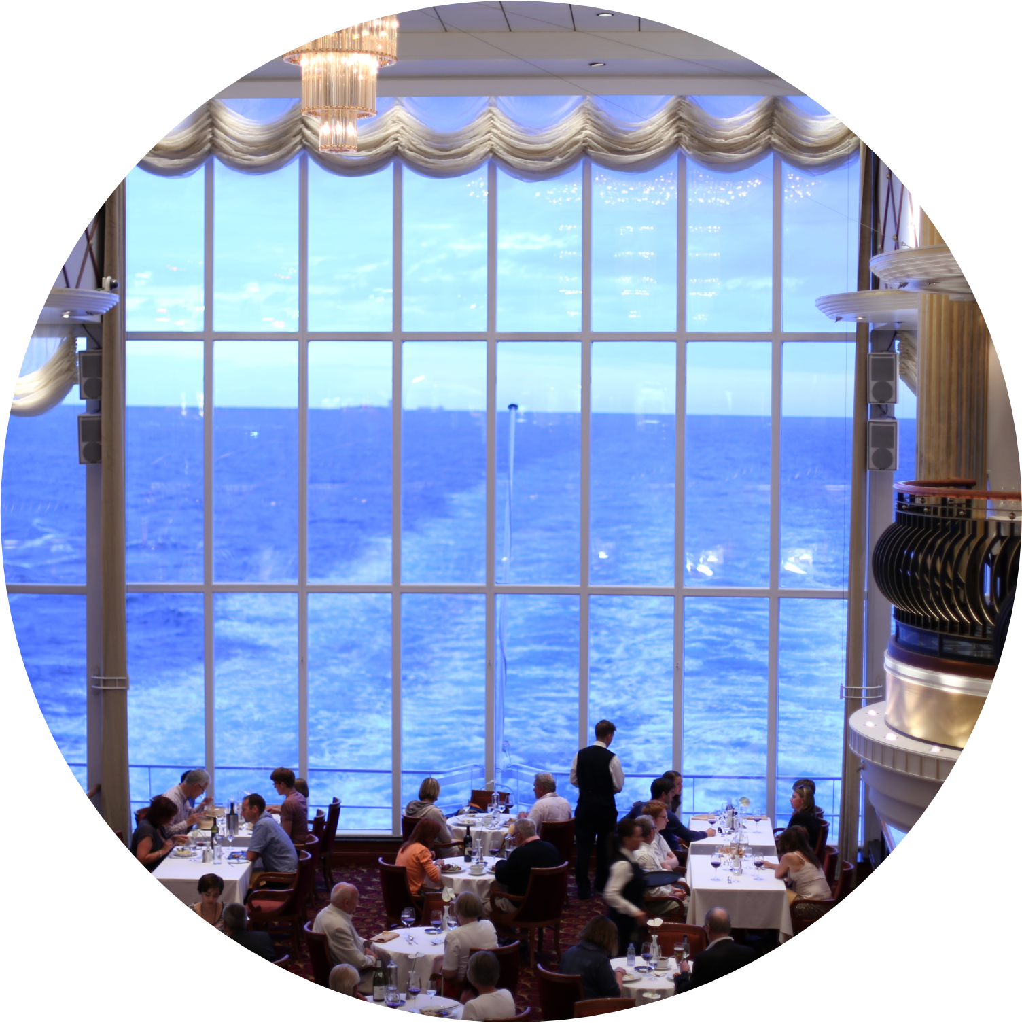
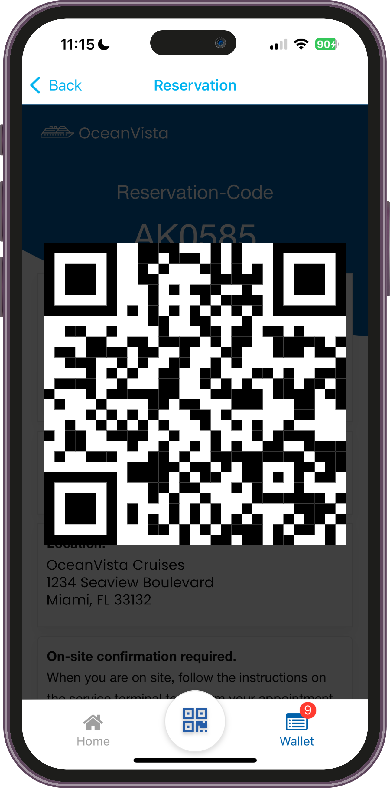
Onboard Experience
Restaurants & Buffets
Virtual queueing for dining areas to prevent overcrowding
Table reservations & waiting list management
Leisure Activities (Spa, Fitness, Entertainment)
Appointment booking for wellness & fitness centers
Queue management for shows & events
Shore Excursions
Digital organization of passenger flow for embarkation & disembarkation
Automated updates on delays

Slide 15
Economic Benefits & ROI for Airports & Cruise Operators
Benefit Business Impact
Reduced Waiting Times Increased customer satisfaction & better reviews
Streamlined Operations Cost savings through optimized workforce allocation
Digital Self-Service Options Fewer physical service points required
Scalability Suitable for both major & regional airports/cruise lines
Real-Time Analytics Improved decision-making through data insights
Notes:
Air Traffic 2024 in US: 83.3 million Cruise Ships Passenger North America 2024: 18.1 million

Slide 16
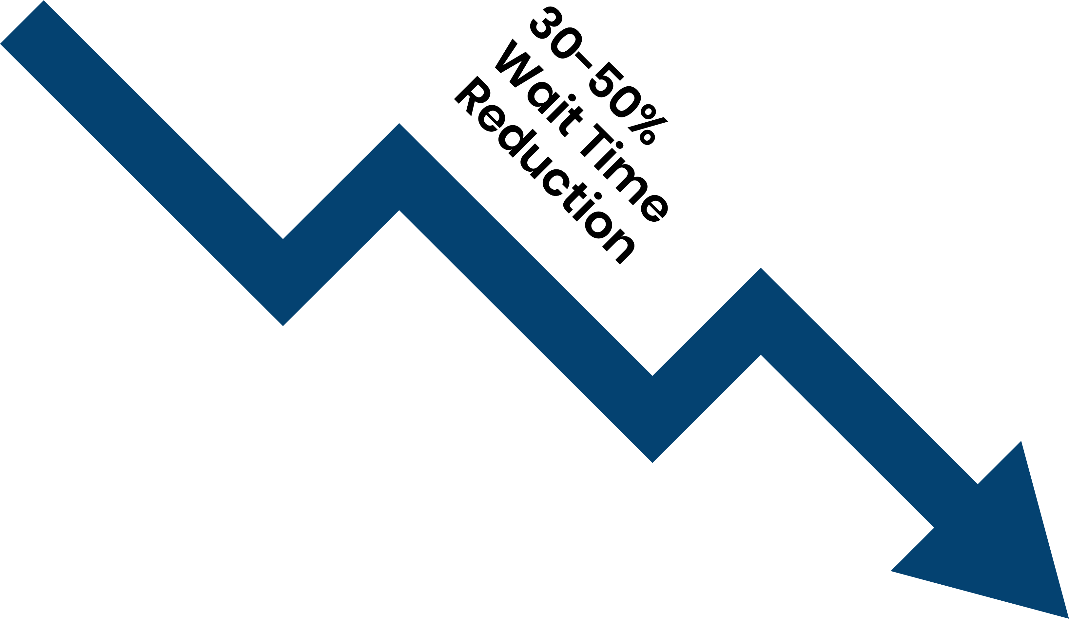
ROI Potential for Airports
30–50% reduction in waiting times
Increased passenger throughput
Higher duty-free sales
Notes:
Air Traffic 2024 in US: 83.3 million Cruise Ships Passenger North America 2024: 18.1 million

Slide 17
ROI Potential for Cruise Operators
Improved guest satisfaction
Higher rebooking rates
Notes:
Air Traffic 2024 in US: 83.3 million Cruise Ships Passenger North America 2024: 18.1 million

Slide 18
Streamlining Air and Sea Travel cleverQ’s Dual Impact on Staff and Travelers
CleverQ provides airports and cruise lines with a digital solution to streamline operations, reduce waiting times, and improve passenger experience.
By enabling appointment scheduling, virtual queue management, and self-service options, businesses can lower costs, enhance service quality, and improve overall efficiency.
www.cleverq.us | info@cleverq.us | 786-709-9550 851 Ne 1st Ave Miami | FL 33132-1842 | (Paramount Miami World Center)

