Slide 1
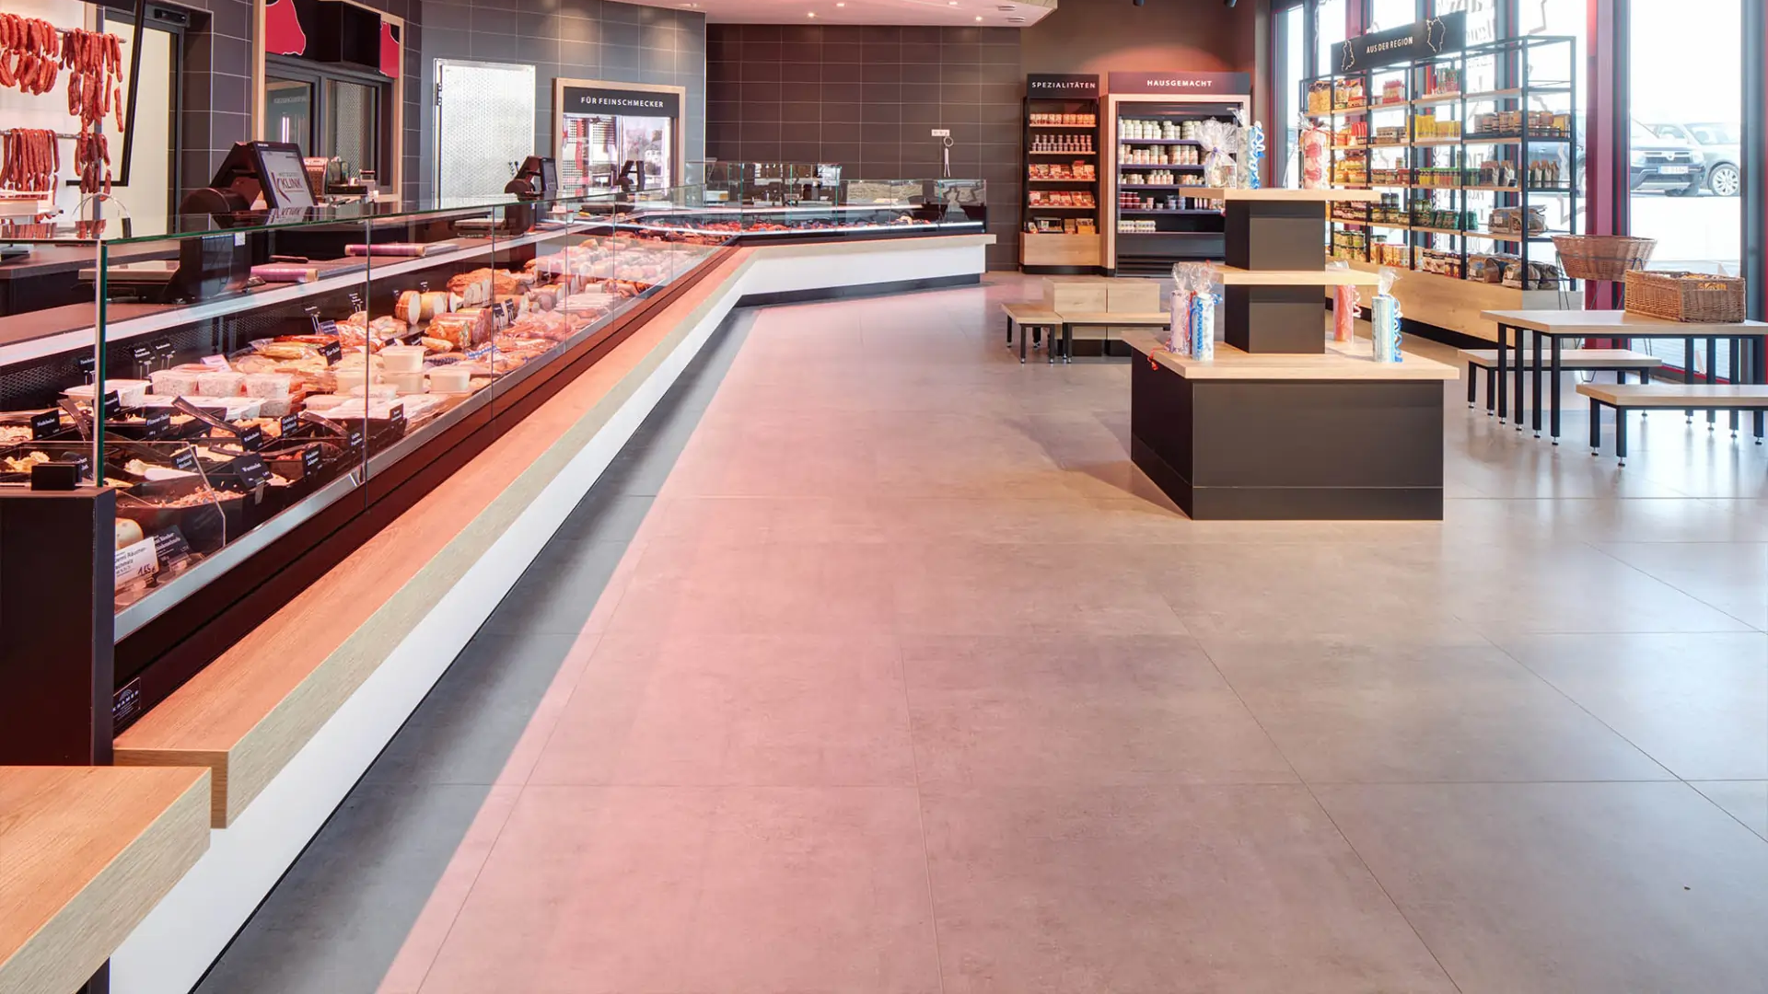
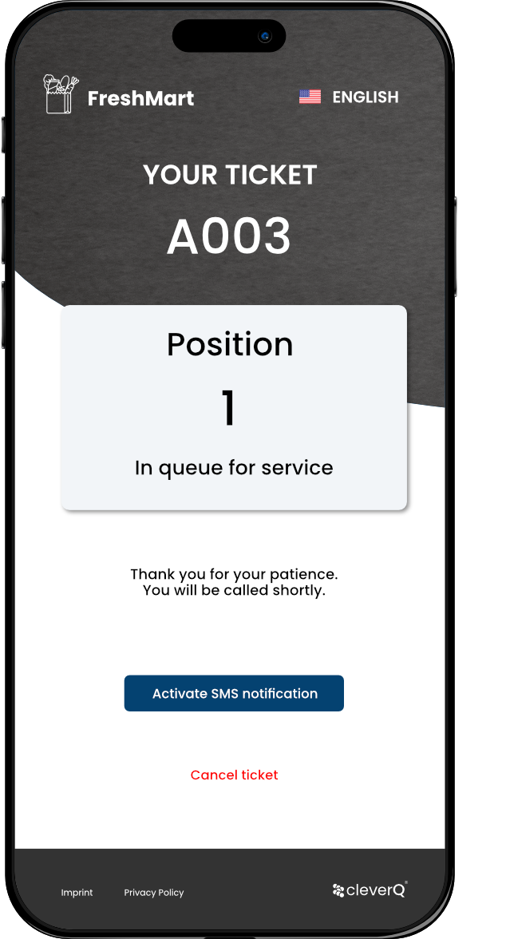
Maximize revenue, minimize wait times.
Industry Solutions for Retail & Deli Counters
www.cleverq.us | info@cleverq.us | 786-709-9550 851 Ne 1st Ave Miami | FL 33132-1842 | (Paramount Miami World Center)

Slide 2
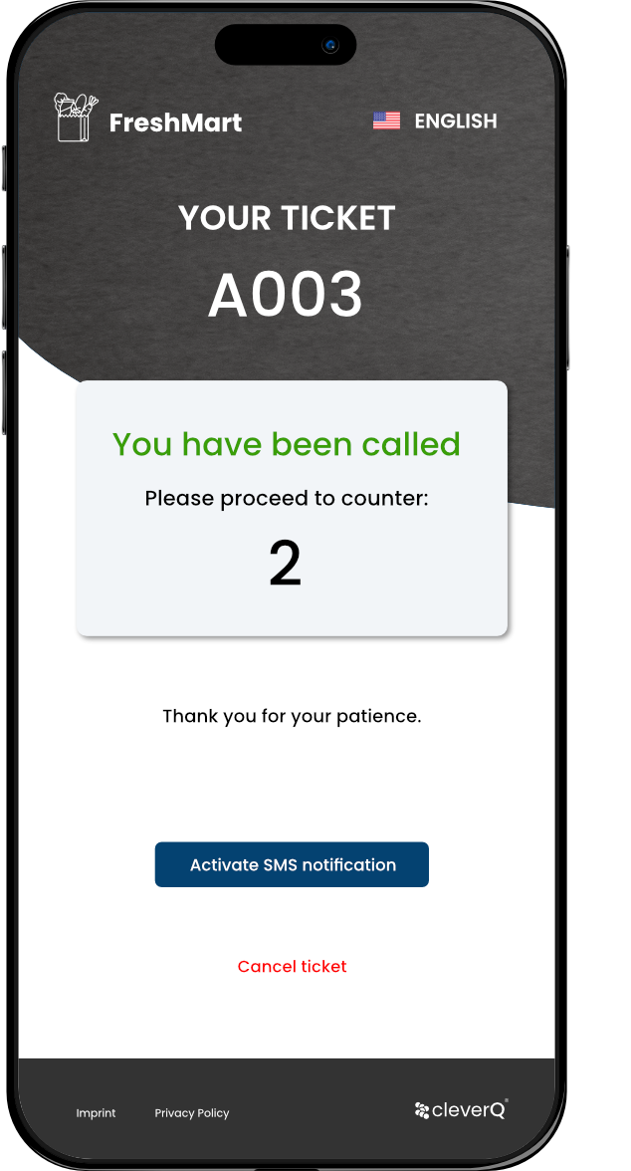
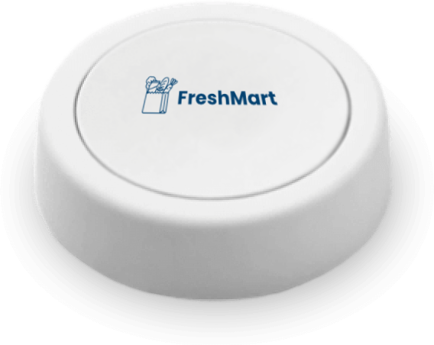
What we offer | Effortless Queuing Solutions for a Modern Shopping Experience
Queuing software for kiosk systems and cash registers
e-Tickets via QR-code for smartphones (Web App & Digital Wallet App)
Queuing Screens & Digital Signage
Queuing Buttons

Slide 3
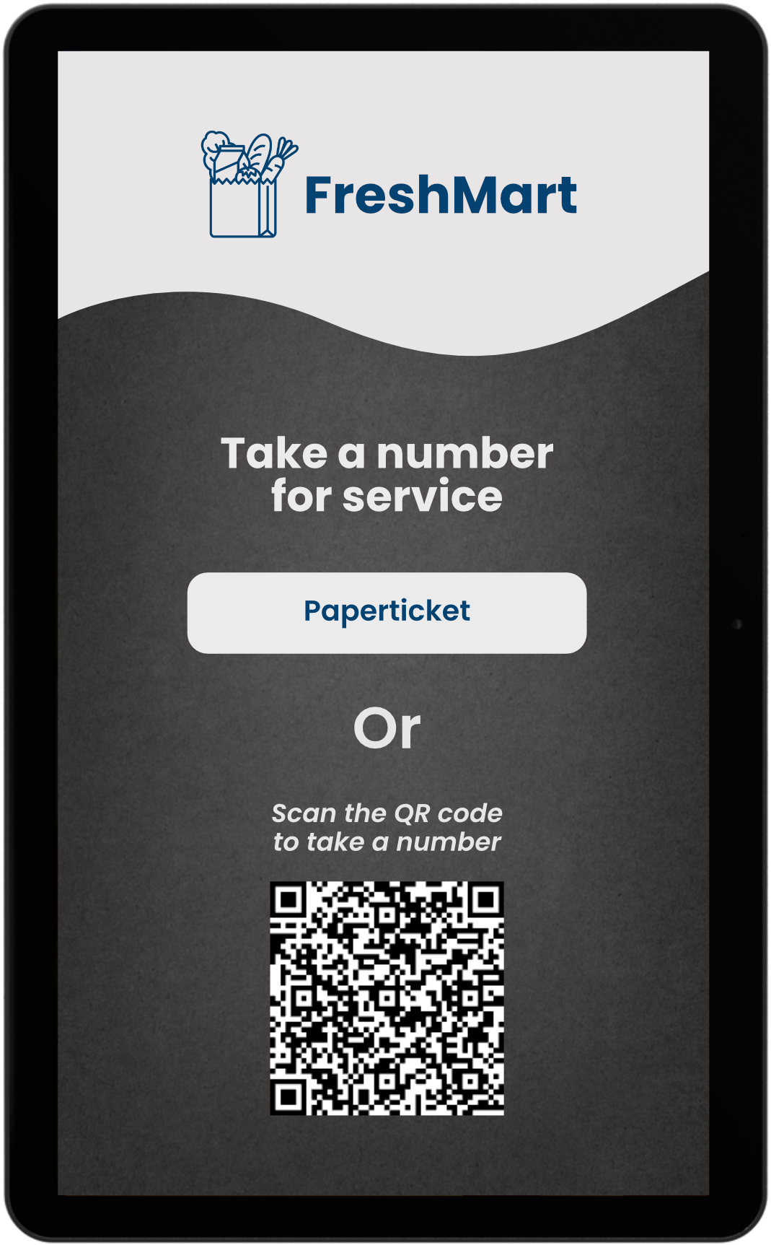
How it works | Software for Kiosks and Cash Registers
Place service kiosk infront of deli counter
Activate/deactivate queuing automatically or manually as needed
Paper ticket dispensing
e-Ticket reservation
Multilingual support

Slide 4
How it works | e-Tickets
Customers can skip the wait and continue shopping at their convenience.
Push notification or SMS message inform customers on the upcoming call up.
cleverQ e-Ticket runs as web app - no Installation needed.
Alternatively, the cleverQ Digital Wallet provides handy features like managing favorites and receiving push notifications.

Slide 5
How it works | Paper tickets
Customers holding paper tickets can browse the nearby offerings and keep an eye on their call-up status using the queuing monitors.
An audio signal also announces the call-up, ensuring that even distracted customers don’t miss their turn.

Slide 6
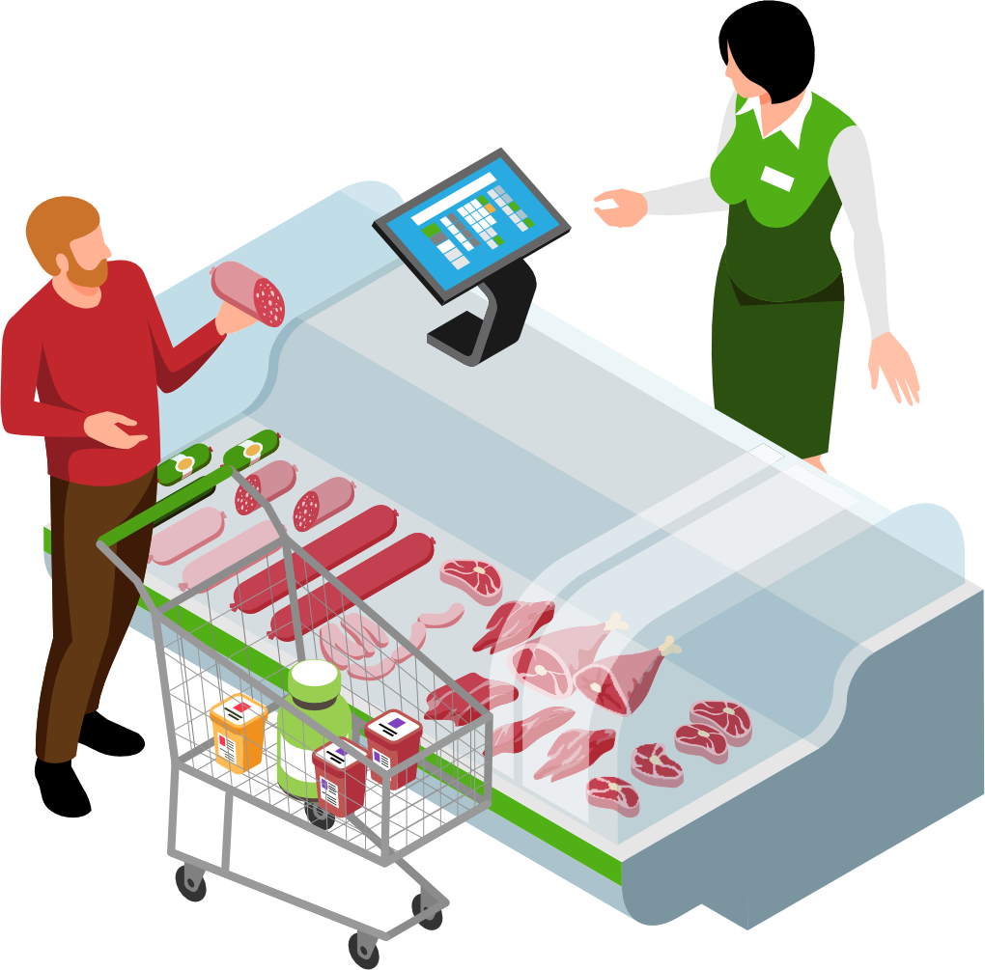
How it works | Call Up
With our queuing software employees can issue a call up via existing cash registers or use our queuing buttons for added convenience.

Slide 7
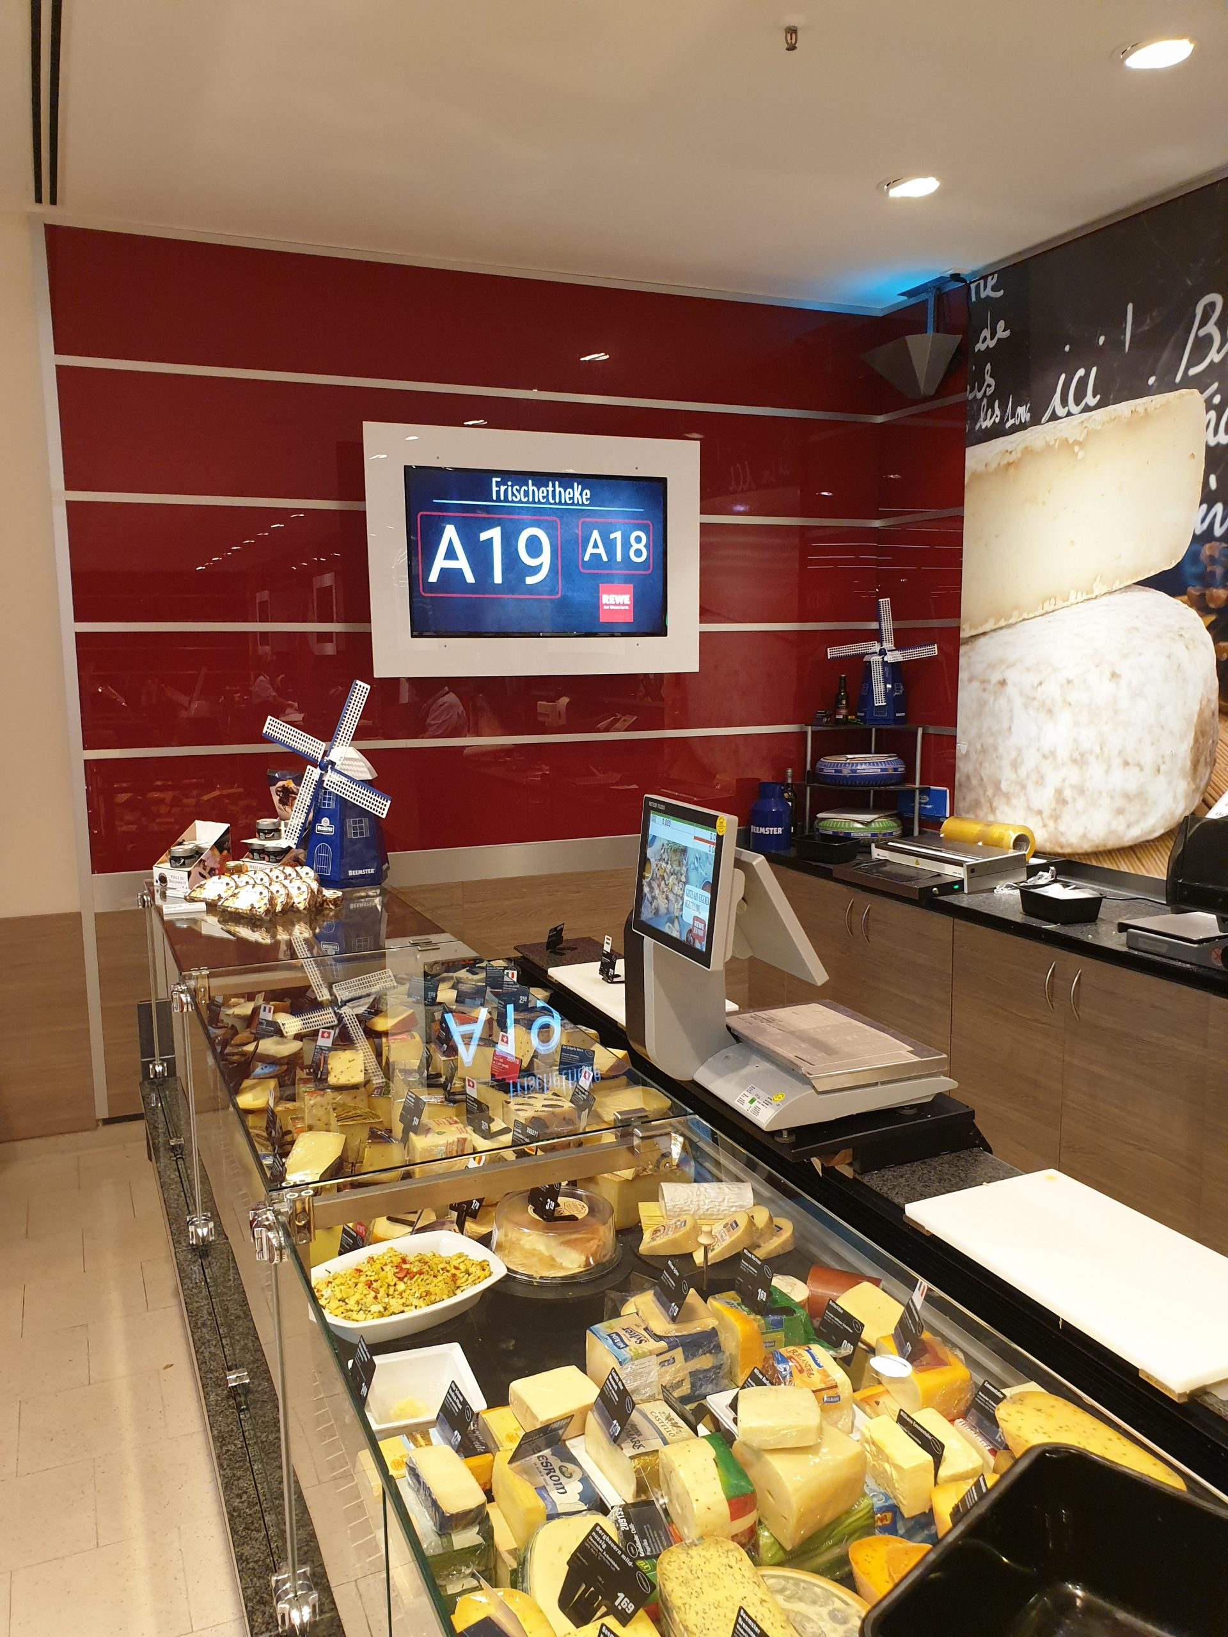
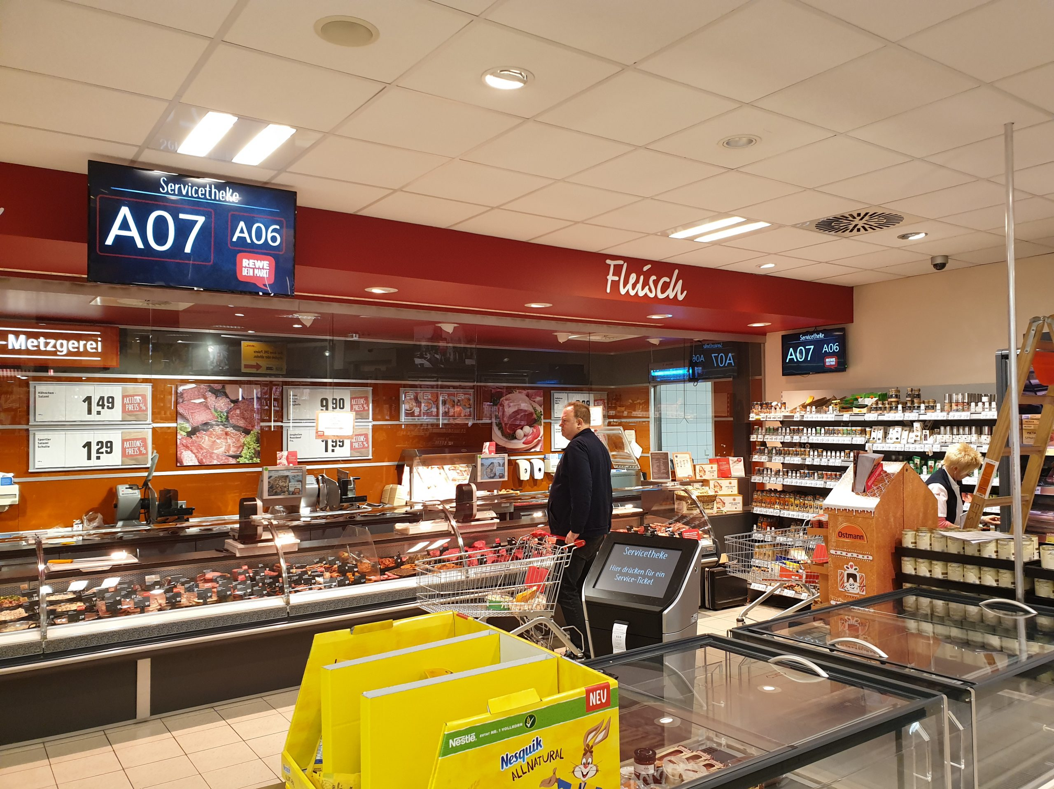
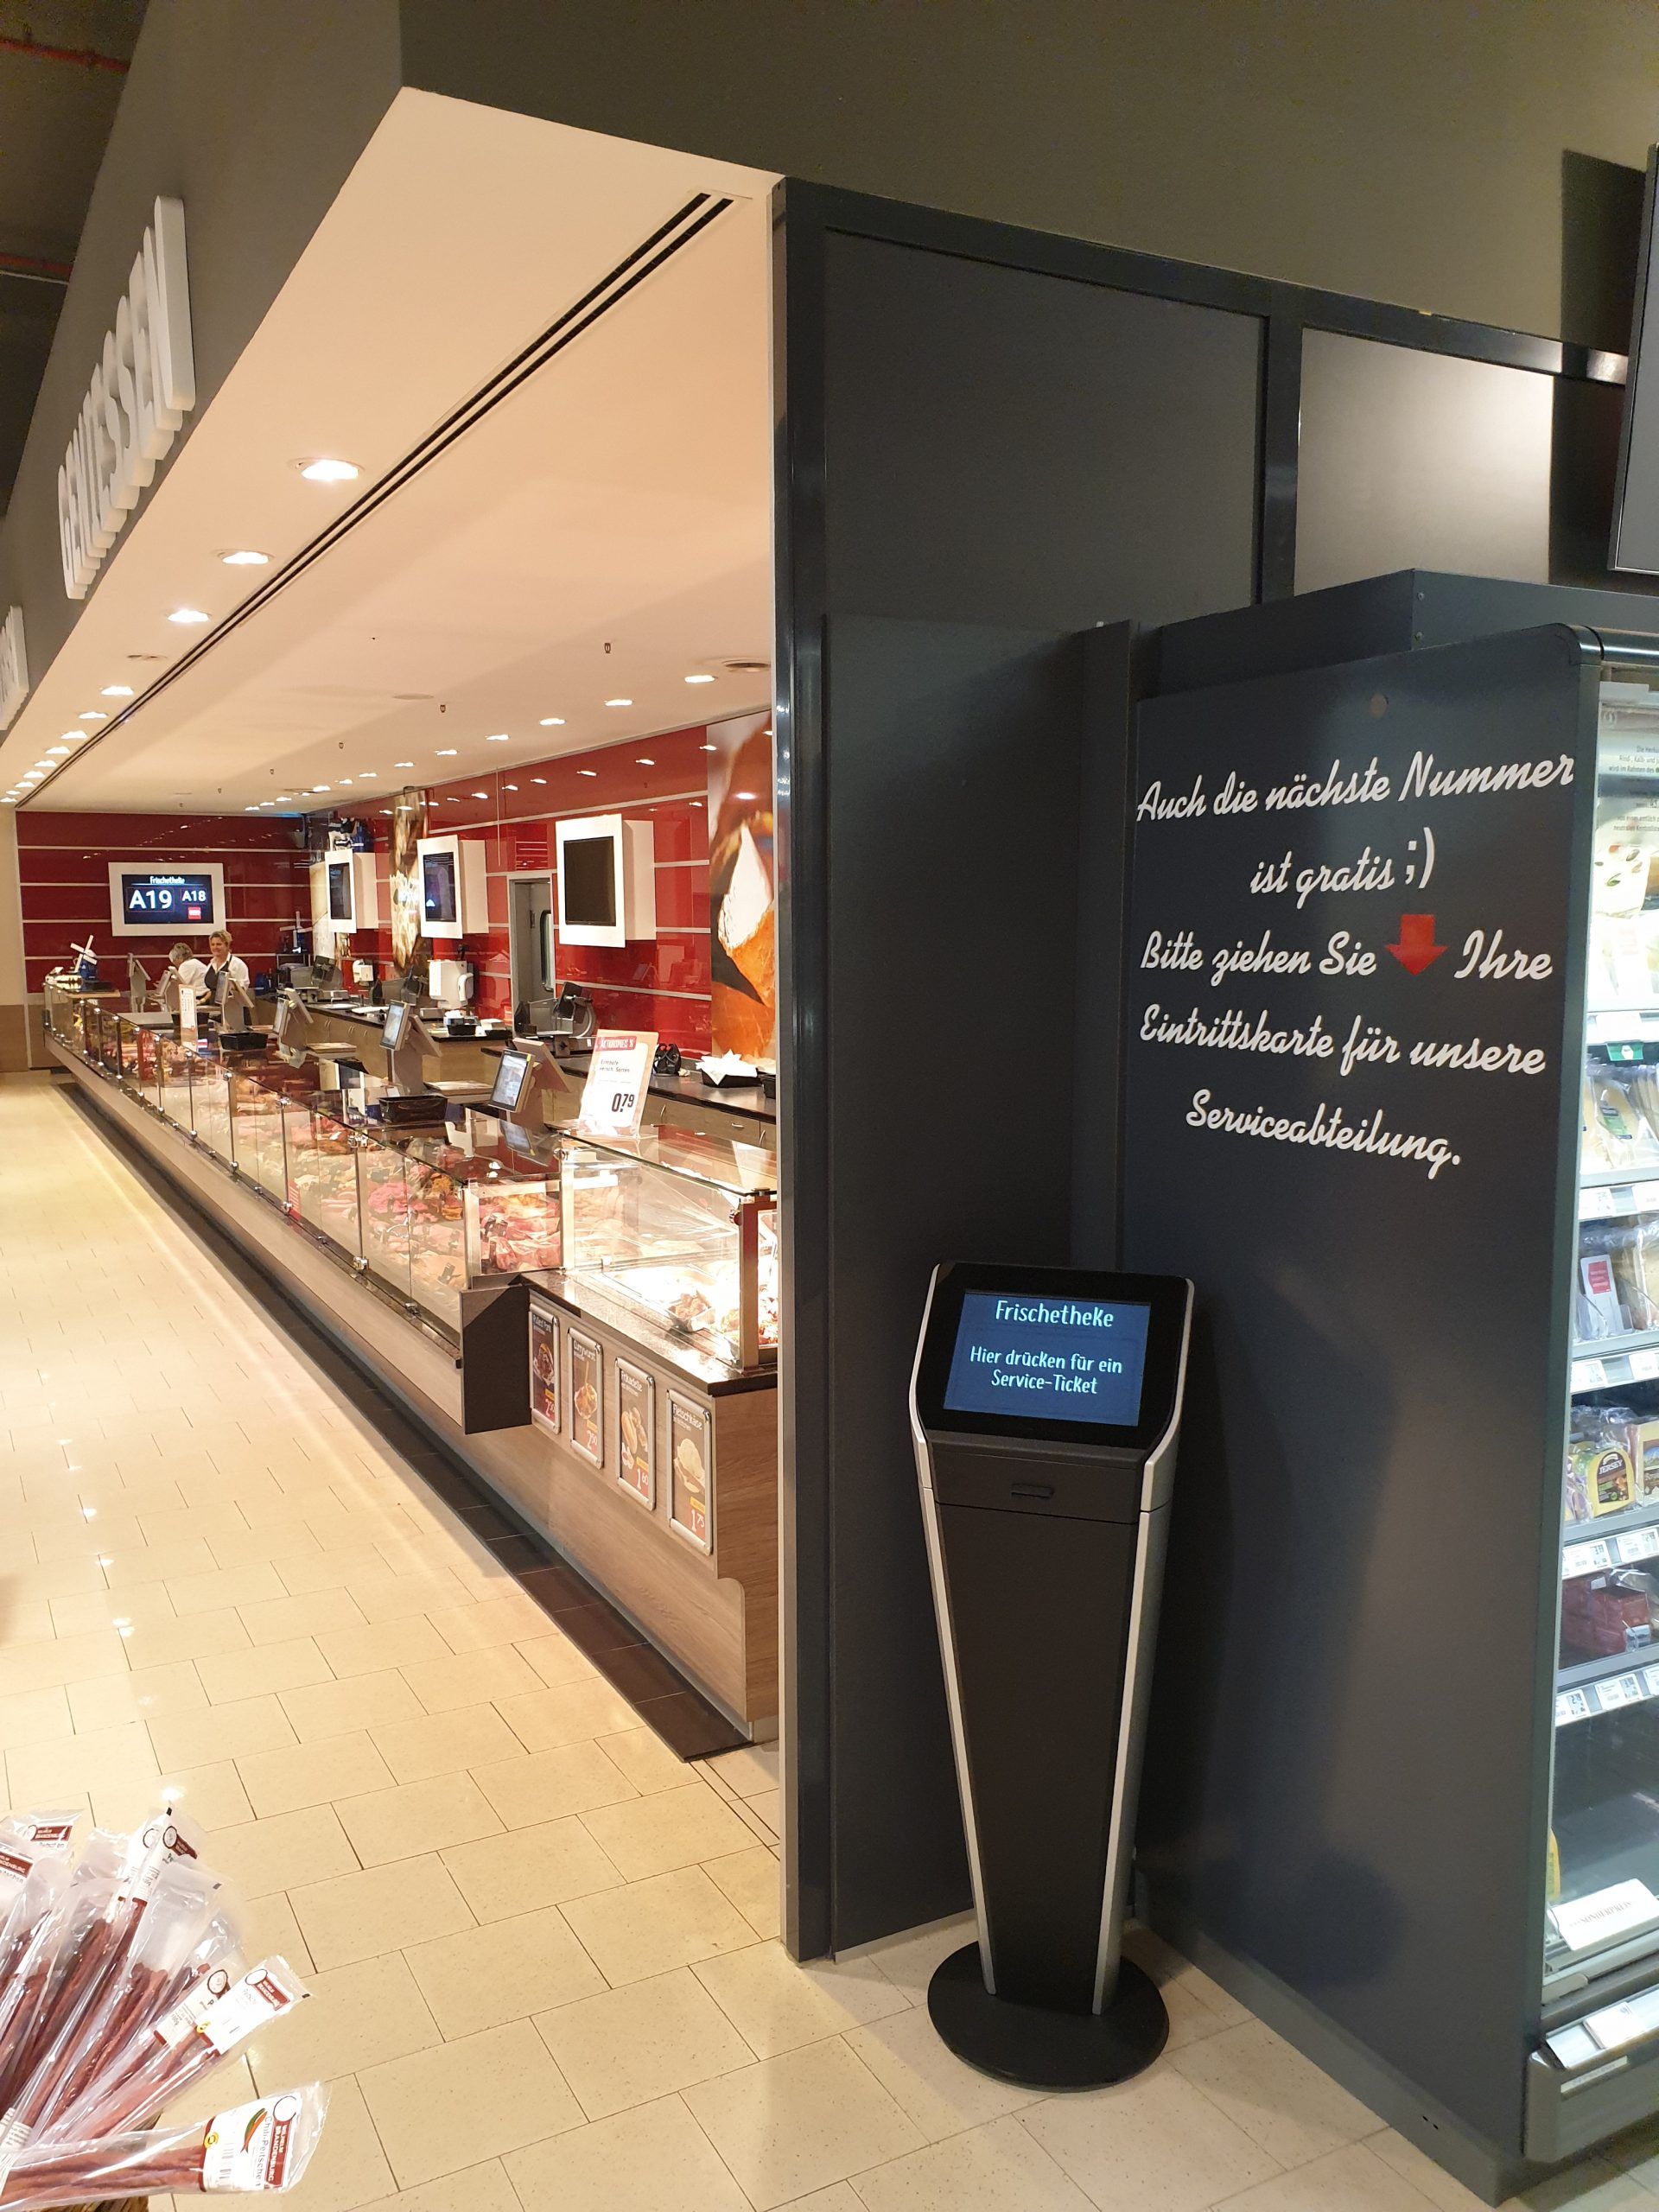
cleverQ Success Stories in Retail Streamlining Customer Flow and Elevating the Shopping Experience
cleverQ has proven successful in retail environments, with applications ranging from customer flow management for deli counters to enhancing the overall shopping experience.

Slide 8
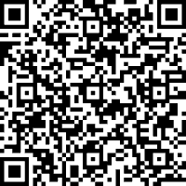
Queue smarter with cleverQ
Your competitive edge, tailored to your industry.
Try for yourself
Eliminate Long Wait Times
Dissolve Long Queues
Let Customers Keep Shopping Instead of Standing in Line
Organized Call-Forwarding via Digital Wallet or Web App
Queuing software Seamlessly Integrated with Existing POS Systems
Ticket Distribution with Modern Kiosk Systems
Centralized Control of Call Displays and Digital Signage
Unlimited Licenses for Workstations per Branch

Slide 9
Data protection and IT security
As a provider of SaaS (Software as a Service), the data protection and IT security of our customers and our own infrastructure is one of the most important challenges.
We ensure robust data security through multiple layers of protection. Partnering with leading hosting providers, such as Hetzner, guarantees that our digital services remain highly available, performant, and secure at all times. Additionally, we strictly adhere to GDPR compliance and maintain our ISO 27001 certification (Information Security Management Systems) through regular renewals, underscoring our commitment to safeguarding your data.

Slide 10
Industry Solutions for Retail & Deli.
cleverQ is a brand of the German software developer B.I.C. GmbH. For over 10 years, cleverQ has been one of the most successful systems in the DACH region for queuing and appointment management. Numerous customers from a wide range of industries already rely on cleverQ.
If you'd like to learn more about us or have any questions, feel free to visit our website or reach out to us directly:
www.cleverq.us | info@cleverq.us | 786-709-9550 851 Ne 1st Ave Miami | FL 33132-1842 | (Paramount Miami World Center)

