Slide 1
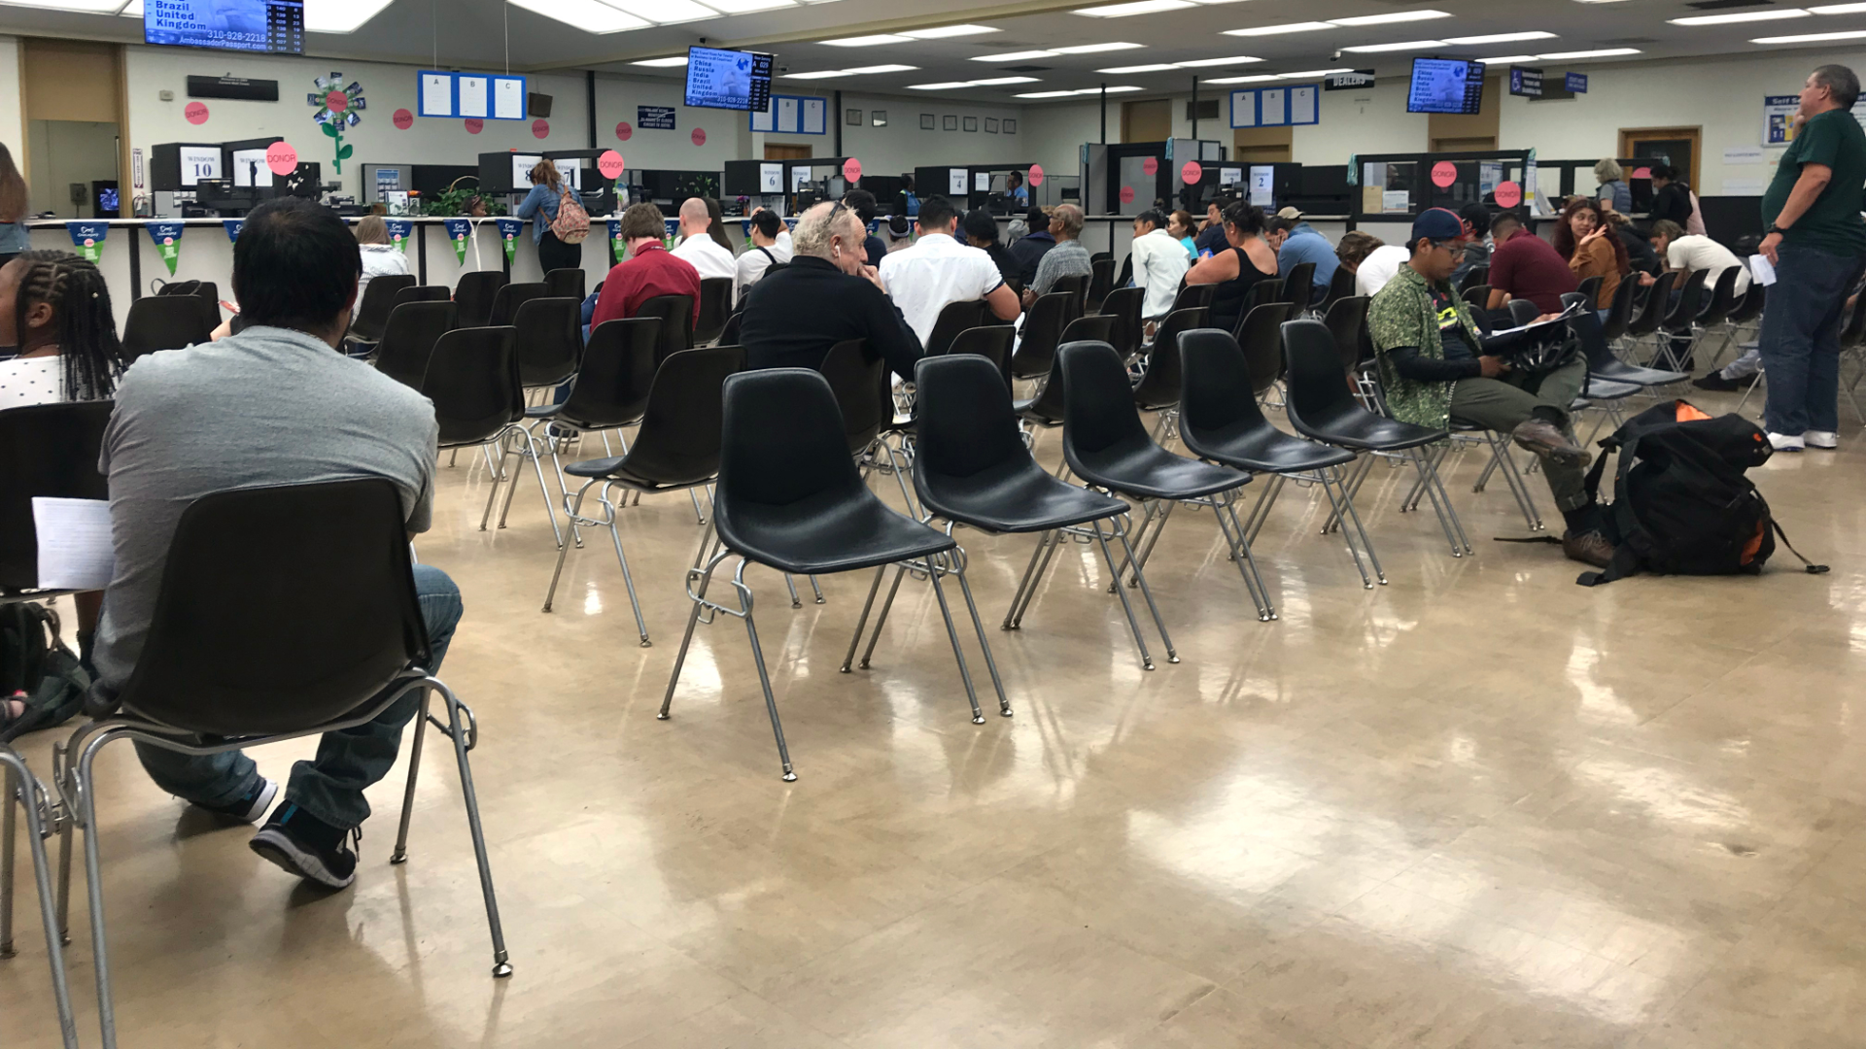
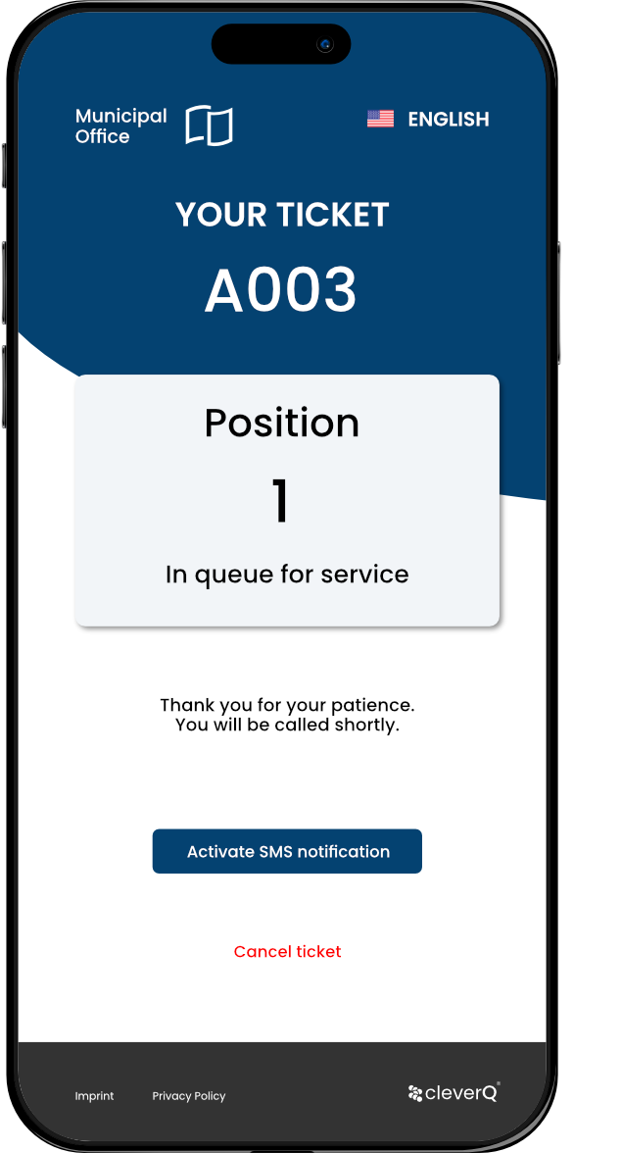
Industry solutions for Public Services
Optimizing services & reducing workload
www.cleverq.us | info@cleverq.us | 786-709-9550 851 Ne 1st Ave Miami | FL 33132-1842 | (Paramount Miami World Center)

Slide 2
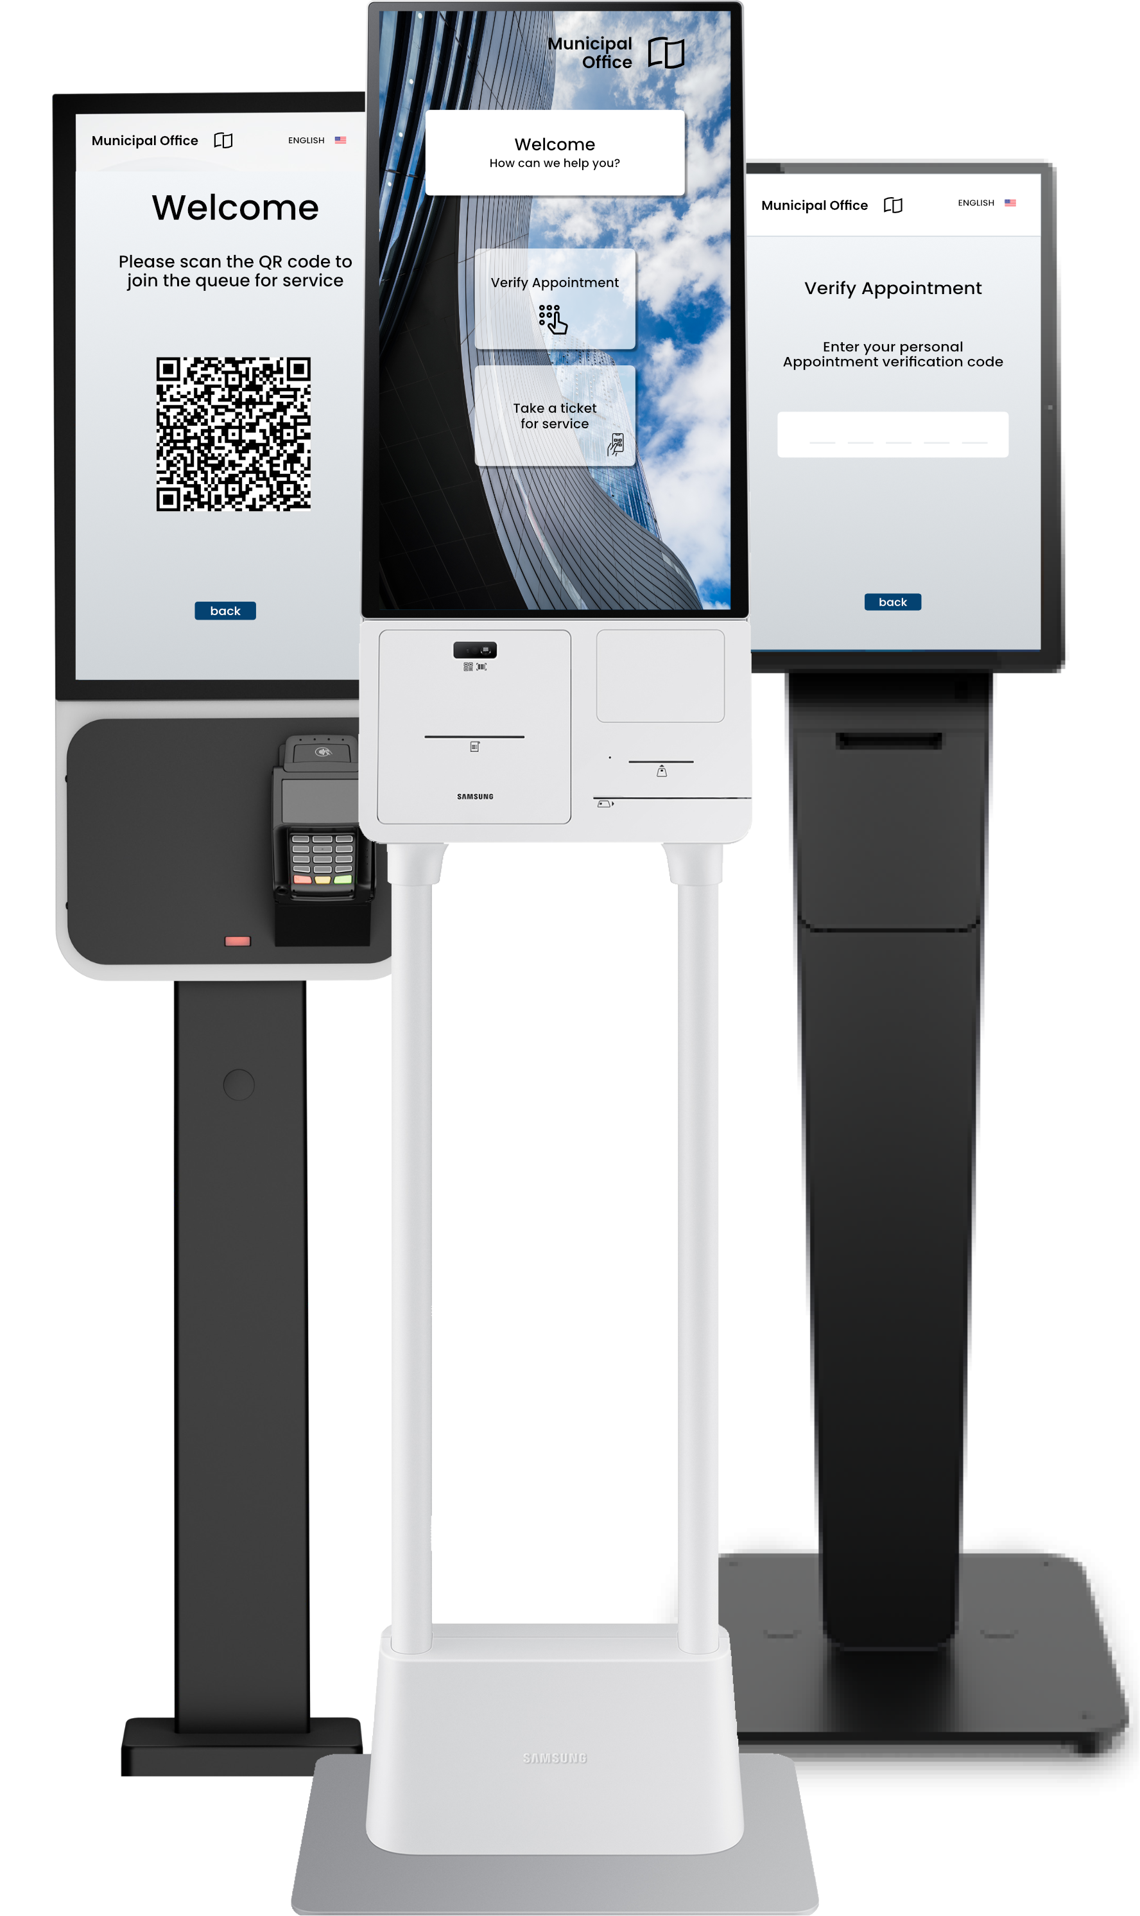
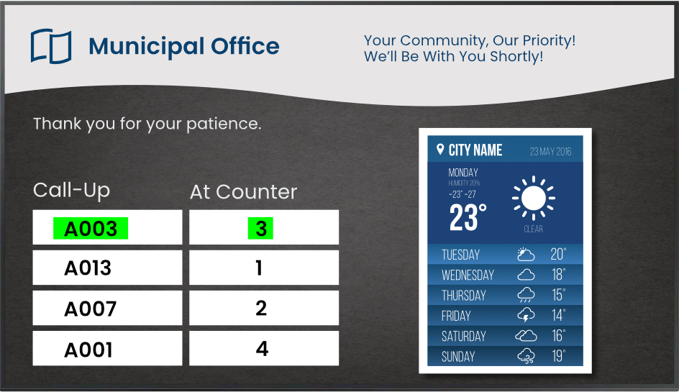
What we offer | Professional Queuing and Appointment Booking SaaS
Queuing Software for Kiosk Systems
On-Site Appointment Management and Online Appointment Booking
e-Tickets via QR Code for Smartphones
(Web App & Digital Wallet App)
Queuing Screens & Digital Signage
Analytics & Business Intelligence
Security Applications

Slide 3
How it works | Software for Kiosks
Use cleverQ software as a stand-alone application or as an API on existing kiosk systems.
Activate/deactivate queuing automatically or manually as needed.
Paper ticket dispensing.
e-Ticket reservation.
Appointment booking & verification.
Multilingual support.

Slide 4
How it works | e-Tickets
Citizens can bypass long waits in crowded waiting rooms.
Push notifications or SMS inform citizens of upcoming call-ups.
cleverQ e-Ticket runs as a web app—no installation needed.
Alternatively, the cleverQ Digital Wallet provides handy features like managing favorites and receiving push notifications.

Slide 5
How it works | Paper tickets
Citizens holding paper tickets can monitor their call-up status using queuing monitors.
An audio signal announces the call-up, ensuring even distracted citizens don’t miss their turn.

Slide 6
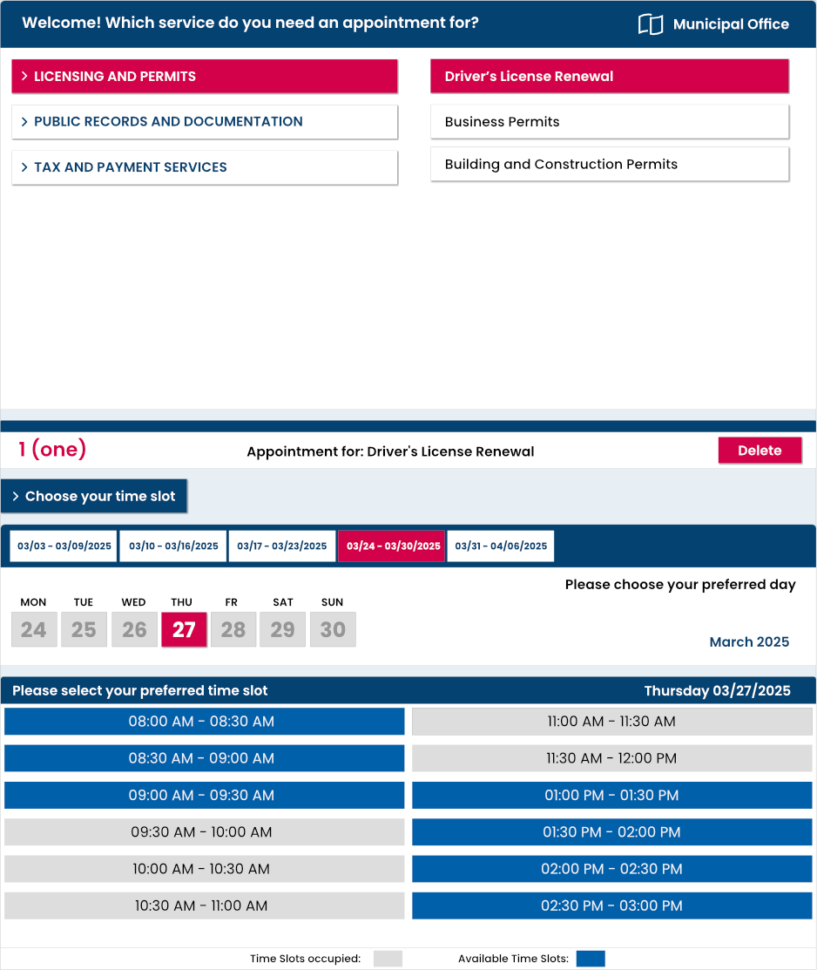
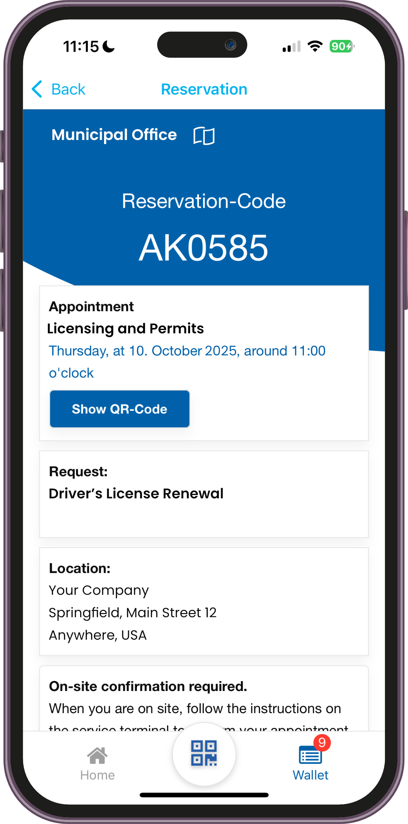
How it works Online Appointment Booking
cleverQ Digital Wallet App Citizens can scan a QR code on-site to favorite your company and book future appointments from the digital wallet.
Appointment Web Page Citizens can book appointments through a personalized online booking page that we set up for your company.

Slide 7
How it works | On Site Appointment Verification
Citizens can conveniently verify their pre-booked appointments on-site using the self-service kiosks.
Alternatively, appointments can also be verified by staff members as usual.
Once verified, Citizens will be automatically placed in the digital queue with priority for expedited service.

Slide 8
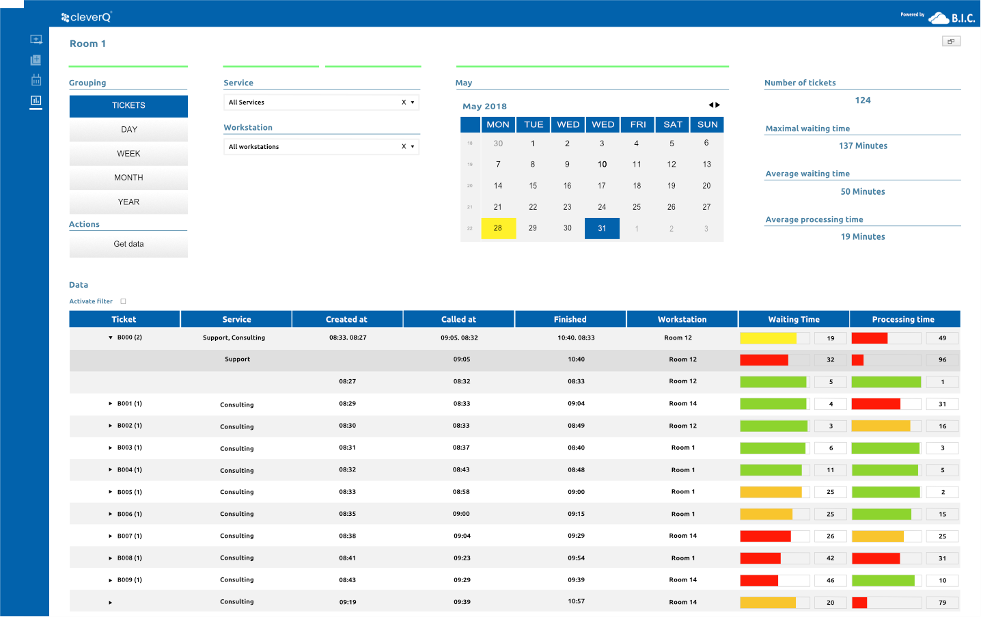
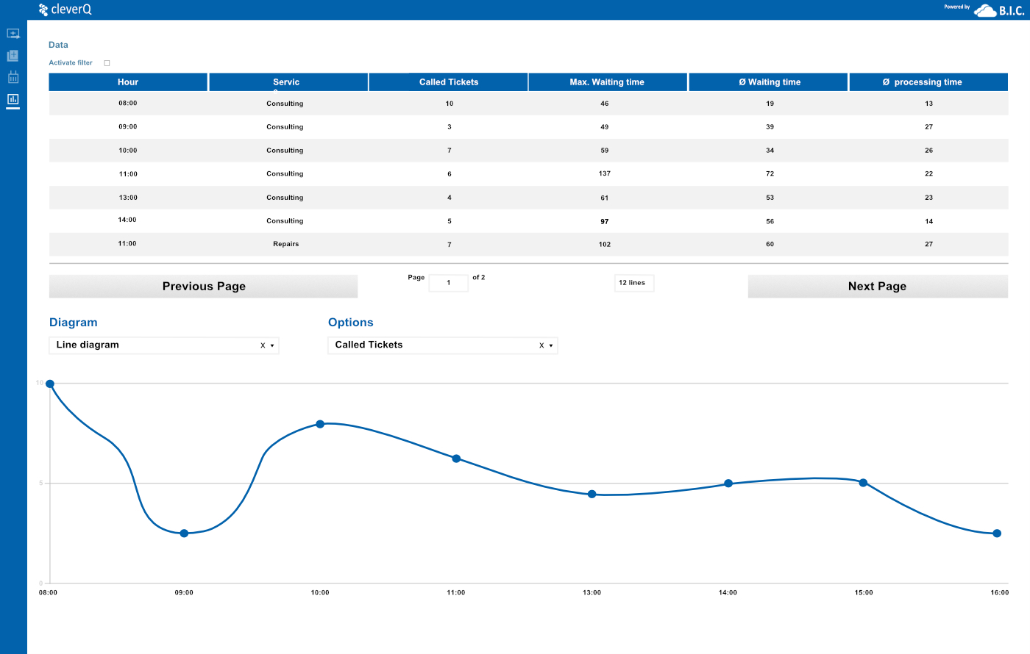
Decisions powered by data
By leveraging real-time and historical data from cleverQ appointment scheduling and queue management systems, you can make informed decisions to optimize operations e.g.: Staff shortages: Reduce appointment slots.
Anticipating high demand: Activate queuing system to manage citizens flow efficiently and maintain high service Quality.

Slide 9
Business Intelligence (BI) for Public services
cleverQ solves key challenges in public administration:
Long wait times & overcrowding: Data-driven insights help predict peak hours, allowing for better staff and resource allocation.
Inefficient appointment scheduling: BI analytics identify high-demand services, enabling agencies to adjust appointment availability proactively.
Lack of transparency & oversight: Real-time dashboards provide a clear view of visitor flow, wait times, and service demand, helping officials address bottlenecks efficiently.

Slide 10
Business Intelligence (BI) for Public services
Unoptimized workforce planning:
Historical data and predictive analytics support better staffing decisions, reducing unnecessary idle time or service delays.
Low citizen satisfaction: By minimizing wait times and improving service efficiency, cleverQ enhances the customer experience, leading to higher public satisfaction.
Bottom line: cleverQ BI empowers Public Services to leverage real-time data for smarter decision-making, improved citizen services, and streamlined operations.

Slide 11
Reduce workload on employees
By outsourcing and automating check-in and booking operations with cleverQ, you can significantly reduce the workload on your staff, enhance overall service throughput, and maintain high service quality standards.

Slide 12
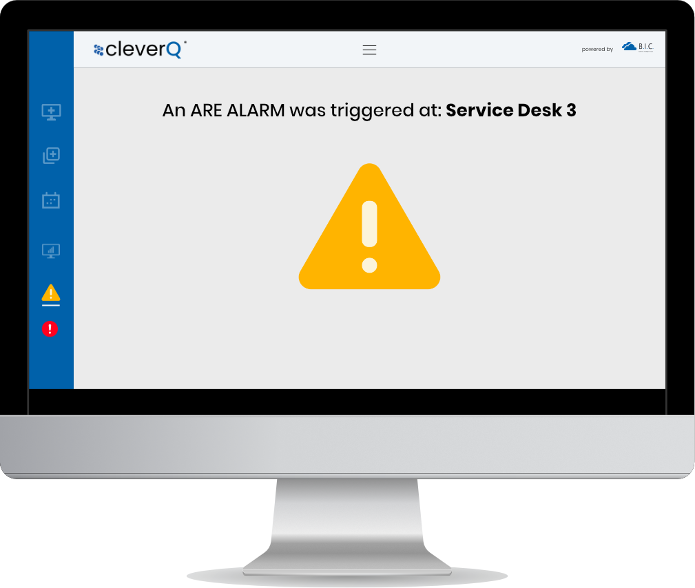
Improve Security
With cleverQ, you can professionally address threatening and violent behavior, enabling you to request cross-location assistance in seconds.
The system offers two distinct alarm types, allowing you to choose the most appropriate response based on the situation at hand. Whether it’s a low-priority alert for minor disturbances or a high-priority alarm for urgent threats, cleverQ ensures a swift and coordinated response to maintain safety and order.

Slide 13
All-in-One Platform
Queuing
Appointments
Security
Statistics
cleverQ is your single, centralized SaaS solution for managing queuing, appointments, statistics, and security appliances.
By consolidating all these features into one intuitive platform, cleverQ eliminates complexity, reduces costs, and ensures seamless integration across your operations.

Slide 14
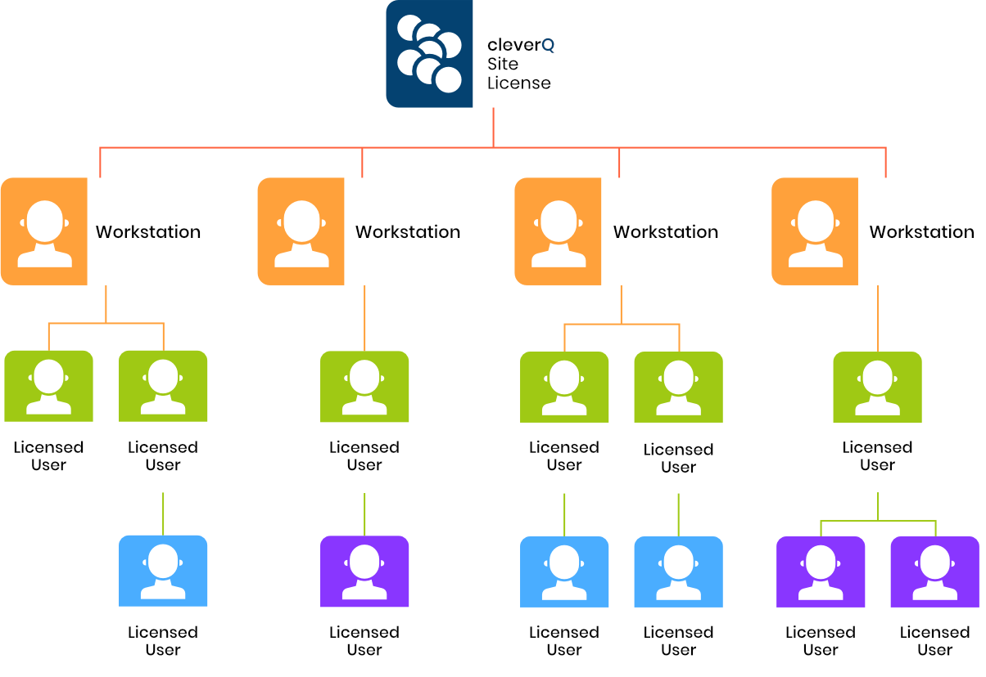
Flexible Solutions for Every Community
cleverQ adapts effortlessly to any environment, from big cities to small communities.
Its flexible licensing model allows unlimited workstations per location or department, ensuring cost efficiency and easy scalability.

Slide 15
Industry solutions for Public Services
Optimizing services & reducing workload
www.cleverq.us | info@cleverq.us | 786-709-9550 851 Ne 1st Ave Miami | FL 33132-1842 | (Paramount Miami World Center)

