Slide 1



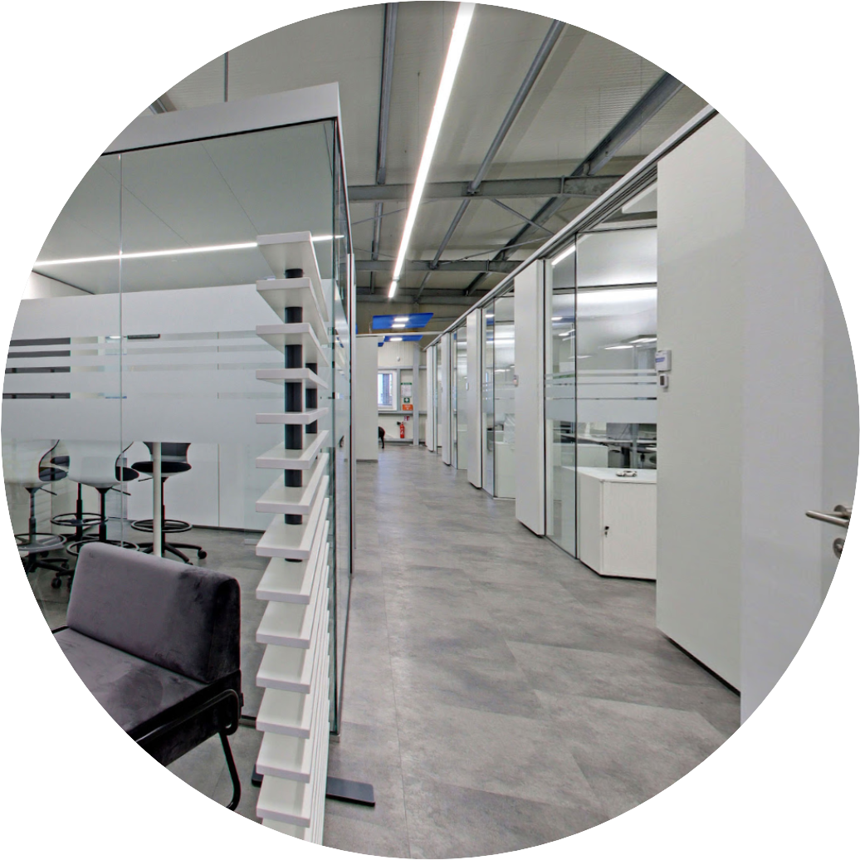




Global presence, local expertise
H.Q. Germany
851 Ne 1st Ave Miami
FL 33132-1842
Paramount Miami World Center
443 346 377 3
info@cleverq.us
www.cleverq.us

Slide 2
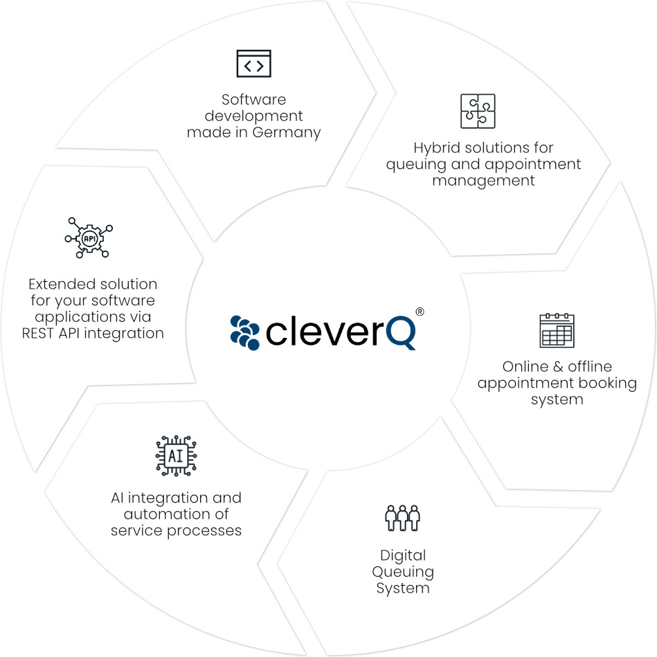
B.I.C. GmbH
Your partner for
software innovation
B.I.C. GmbH, a pioneering German company, specializes in developing and delivering cutting-edge software solutions.
Since our establishment in 2015, we have successfully introduced cleverQ®, one of the most efficient and widely adopted systems for queue and appointment management.

Slide 3


B.I.C. GmbH
Your partner for
software Innovation
Our innovative solutions have gained a strong foothold in the DACH region and across international markets including Sweden, Denmark, Austria, Switzerland, Luxembourg, Dubai and the USA

Slide 4

B.I.C. GmbH
Your partner for
software innovation
B.I.C GmbH
17 Employees
Dubai Office
1 Employee
cleverQ Inc.
2 Employees
B.I.C. GmbH employs 17 FTE team members
including 1 Managing Director,
2 in Sales, 1 in Administration,
4 in Customer Support / Project Management,
and 9 Software Developers
Our U.S. subsidiary, cleverQ Inc. in Miami, currently has 2 FTE employees focused on business development.
In addition, our Dubai office is represented by
1 FTE employee supporting regional activities.

Slide 5
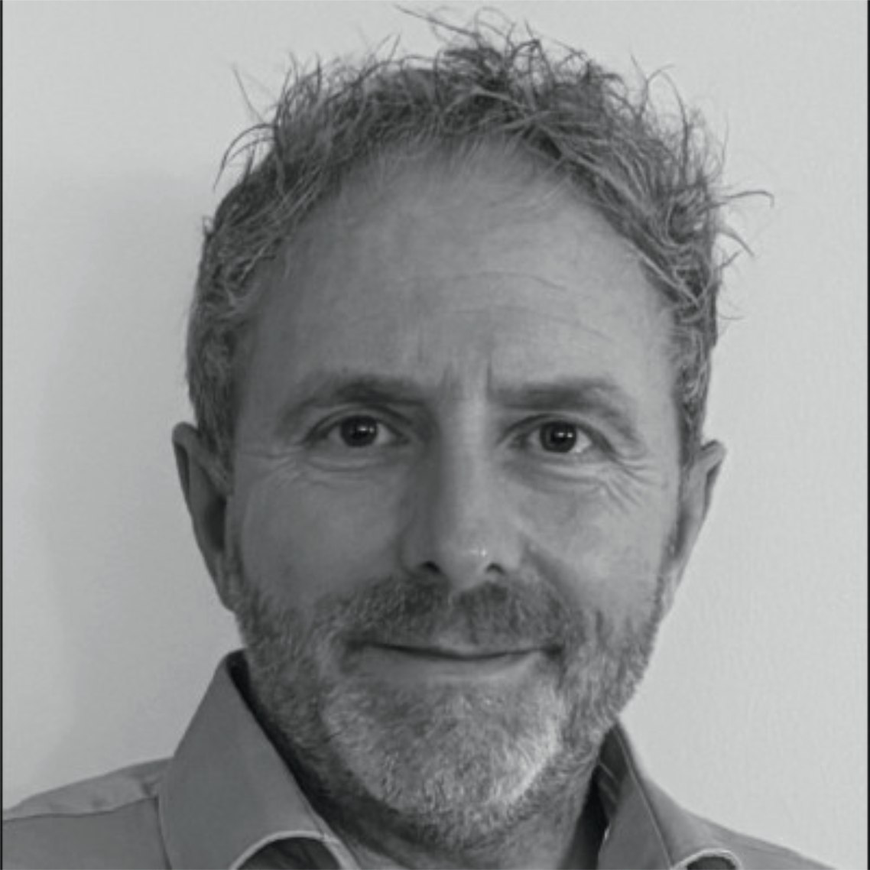
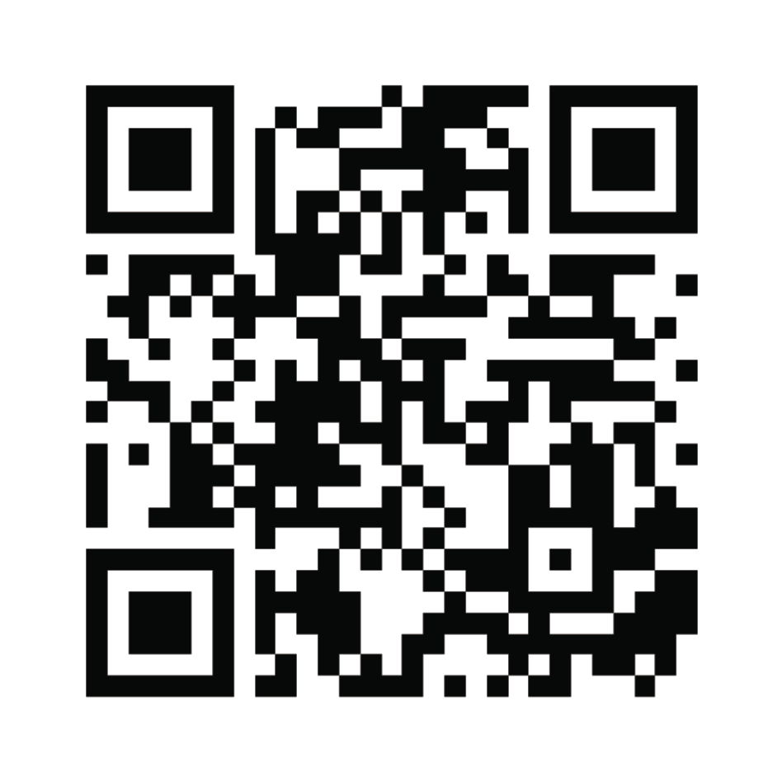
Dirk Ostermann
Founder & CEO
Dirk Ostermann, founder of cleverQ, leads the company’s growth in digital queue and appointment management.
With a focus on innovation and international expansion, he has positioned cleverQ as a leader in process optimization.
SCAN MY BUSINESS CARD
Dirk Ostermann | Founder & CEO of B.I.C. GmbH & cleverQ Inc.
dos@bic.com.de | (443) 347 3773 | www.bic.com.de | www.cleverq.us

Slide 6




Finances
Growth & Forecast
180 + Customers
(06 – 2025)
350 + Subscriptions
(06 – 2025)
2.0 M €
Revenue in 2025 (Forecast)
25 % Growth Rate
1.6 M €
Revenue in 2025 (Forecast)
1.2 M €
Revenue in 2024

Slide 7

Ownership Structure
B.I.C. GmbH
B.I.C. GmbH is held by six active shareholders, all of whom are directly involved in the company's operations. The shareholder roles are distributed as follows:
1 CEO
1 Sales representative for the DACH region
4 Software Developers
In addition, cleverQ Inc., our U.S. subsidiary based in Miami, is 100% owned by B.I.C. GmbH, ensuring full strategic alignment between the European headquarters and the North American market.

Slide 8
Milestones
2016
B.I.C. invests in MEM-O-MATIC, a top German queuing system provider, followed by customer migration to cleverQ.
2017
Launch of the cleverQ production environment and trademark registration.
2018
ADAC Weser-Ems places first orders (The beginning of a long-term cooperation).
2019
Danish Agency for International Recruitment and Integration (SIRI) places long-term contracts for all sites in Denmark.
2020
Schleswig-Holstein’s finance ministries use cleverQ for all sites.New central Germany office (Ratingen, NRW) now live.
2021
The healthcare and finance sectors are growing strongly.
2022
Strategic global partnerships with leading hardware manufacturers such as Samsung.
2024
Internationalization with partners in different regions & countries.
Establishing cleverQ Inc. in the USA
2025
Reaching registered ISV Status at Zebra, Microtouch and CTS.
Joined associations like BlueStar and RSPA as active members to drive strong US market penetration.
Opened strategic Partnership wit Future Wave in Dubai.
Forecast
Positioning cleverQ as a value-added service partner, empowering strategic alliances with an integrated services approach to drive global market expansion.

Slide 9
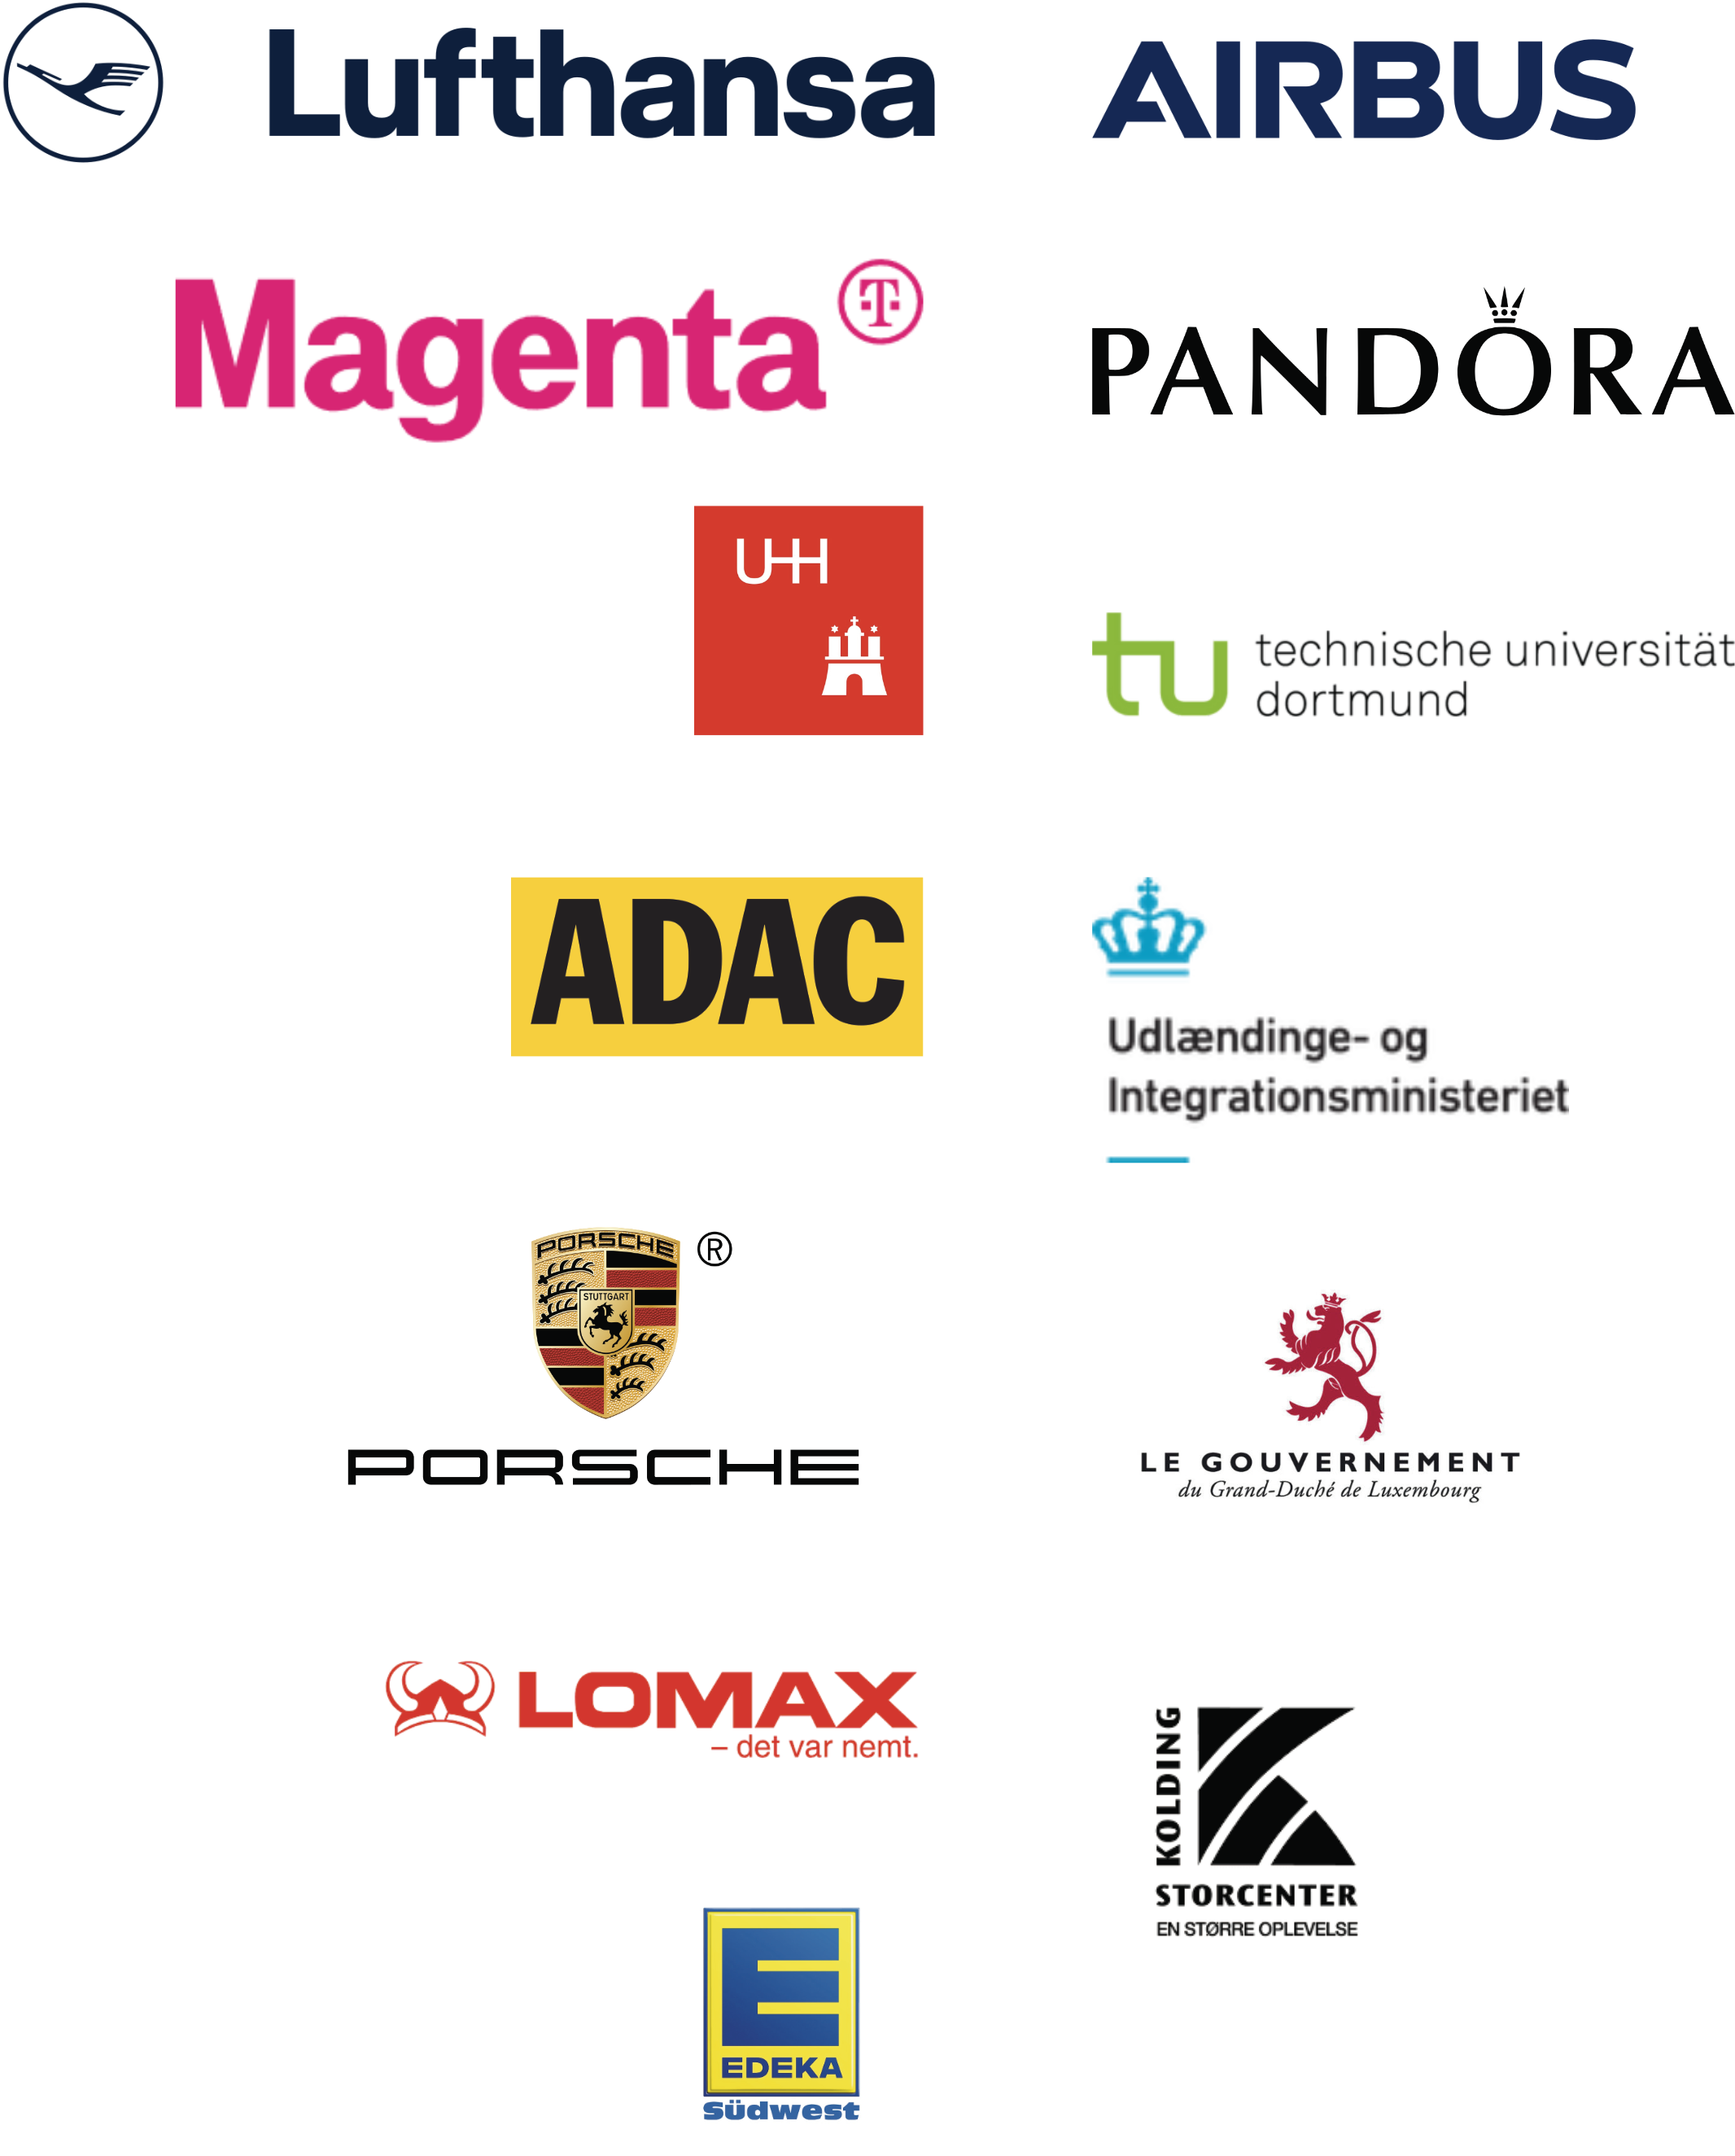
A selection of our worldwide customers

Slide 10



Lufthansa
Lufthansa's main locations in Frankfurt and Munich use our solution to coordinate their own staff at the locations.
Lufthansa employees can book appointments via web or app to access services with different internal departments.
The next step will be an expansion in customer traffic, where passengers will be able to scan a QR code and then wait in a virtual queue instead of standing in a queue for hours, e.g. for flight cancellations.
Staff coordination across locations
Appointment booking
Coming soon
Smart Queuing

Slide 11

Airbus
Airbus uses a variety of cleverQ solutions, ranging from queue management, appointment booking and security appliances to data analysis.
Real time queue management
Priority handling
Appointment booking
Real time Visitor flow monitoring
Mobile Alerts
Feedback surveys
Visitor data reports
cleverQ is integrated in existing Airbus Systems

Slide 12
Airbus | Real-Time Queue Management
Reducing waiting times: cleverQ can display real-time wait times and update visitors on their queue status via their mobile devices or display screens on the premises. This transparency helps manage expectations and improves visitor satisfaction.
Priority Handling: Special guests or groups can be prioritized in the system to ensure they receive prompt attention, which is crucial for high-profile meetings or VIP treatments.
Real time queue management
Priority handling
Appointment booking
Real time Visitor flow monitoring
Mobile Alerts
Feedback surveys
Visitor data reports
cleverQ is integrated in existing Airbus Systems

Slide 13
Airbus | Scheduling and Resource Allocation
Appointment Scheduling: Visitors can schedule their visits in advance using cleverQ. This helps Airbus manage the number of visitors at any given time, optimizing resource allocation like security staff and guides.
Capacity Management: The system can help manage and limit the number of visitors on site to adhere to safety regulations and operational capacities.
Real time queue management
Priority handling
Appointment booking
Real time Visitor flow monitoring
Mobile Alerts
Feedback surveys
Visitor data reports
cleverQ is integrated in existing Airbus Systems

Slide 14
Airbus | Enhanced Security
Real-Time Monitoring: Security teams can monitor visitor flow in real-time, enhancing the ability to respond to any potential security issues swiftly.
Real time queue management
Priority handling
Appointment booking
Real time Visitor flow monitoring
Mobile Alerts
Feedback surveys
Visitor data reports
cleverQ is integrated in existing Airbus Systems

Slide 15
Airbus | Improved Visitor Experience
Mobile Alerts: Visitors can receive notifications about their appointment status, any changes in scheduling, or promotional messages directly on their mobile devices.
Feedback Collection: After the visit, cleverQ can be used to gather feedback from visitors through digital surveys, helping Airbus to continually improve the visitor experience.
Real time queue management
Priority handling
Appointment booking
Real time Visitor flow monitoring
Mobile Alerts
Feedback surveys
Visitor data reports
cleverQ is integrated in existing Airbus Systems

Slide 16
Airbus | Compliance and Reporting
Data Analytics: Generate reports on visitor data to analyze patterns, peak times, and other metrics, aiding in strategic planning and compliance with industry regulations.
Record Keeping: Maintain digital records of all visits, which are useful for security audits and compliance checks.
Real time queue management
Priority handling
Appointment booking
Real time Visitor flow monitoring
Mobile Alerts
Feedback surveys
Visitor data reports
cleverQ is integrated in existing Airbus Systems

Slide 17
Airbus | Implementation Considerations
Integration with Existing Systems: Ensure that cleverQ seamlessly integrates with Airbus’s existing security and IT infrastructure to leverage full capabilities.
Real time queue management
Priority handling
Appointment booking
Real time Visitor flow monitoring
Mobile Alerts
Feedback surveys
Visitor data reports
cleverQ is integrated in existing Airbus Systems

Slide 18

MAGENTA / T-Mobile
Magenta uses our solution at a total of 70 locations throughout Austria to manage customer traffic and increase customer satisfaction.
70 locations throughout Austria
Smart Queuing
Appointment booking
Data analytics

Slide 19
MAGENTA / T-Mobile
Customers have the convenience of booking appointments for various services, while walk-in customers can easily obtain a service ticket on-site at a kiosk, either in paper form or digitally via a QR code.
The staff seamlessly manage the flow by always calling the next customer, with cleverQ automatically prioritizing both appointments and walk-ins.
For customers, this system offers the advantage of a stress-free experience, allowing them to explore other products in the store or make the most of their waiting time, perhaps by enjoying a relaxed coffee at the nearby café instead of standing in line.
The staff on-site benefit as well, as they can work efficiently without stress, ensuring no customer feels overlooked.
Moreover, Magenta Management can conduct comprehensive evaluations across all locations, enhancing personnel planning and optimizing resource allocation.
70 locations throughout Austria
Smart Queuing
Appointment booking
Data analytics

Slide 20

Sparkasse (one of the biggest banks in Germany)
The Sparkassen are leveraging our solution in over 40 locations across Germany to effectively manage customer flow and enhance customer satisfaction.
40 locations across Germany
50 additional locations planed for 2025/2026
Smart Queuing
Appointment booking
Data analytics

Slide 21
Sparkasse (one of the biggest banks in Germany)
Customers can conveniently book appointments for various services, while walk-in customers can obtain a service ticket at a kiosk, either in paper form or digitally via a QR code. The staff then call the next customer in line, with cleverQ automatically prioritizing both appointments and walk-ins.
For customers, this system offers a stress-free experience, allowing them to either stay within the bank and explore other products or make use of the waiting time to engage in other activities, such as enjoying a relaxed coffee at the nearby café instead of standing in line.
The on-site staff also benefit by being able to work efficiently and without stress, ensuring that no customer feels disadvantaged.
Moreover, management can perform comprehensive evaluations across all locations, optimizing personnel planning and improving overall operations.
40 locations across Germany
50 additional locations planed for 2025/2026
Smart Queuing
Appointment booking
Data analytics

Slide 22





Hospitals
By integrating cleverQ, hospitals can greatly enhance patient management by streamlining the appointment and check-in processes, improving communication with patients, and optimizing resource allocation.
This results in higher patient satisfaction, better resource management, and overall improved operational efficiency.
Implementing such a system enables hospitals to meet the growing demands for better patient care and more efficient operations in today’s healthcare environment.
More than 30 hospitals are using cleverQ to improve internal processes and increase patient satisfaction.

Slide 23

Government / Tax Offices
All tax offices in northern Germany provide citizens the opportunity to schedule appointments with advisors for tax law consultations, either on-site or via video call.
Additionally, citizens can obtain a paper or digital ticket at an on-site kiosk to receive assistance.
This approach has significantly improved staff coordination, allowing citizens to address their concerns with the authority's staff without the frustration of long waits.

Slide 24

Our goal in the USA
We are eager to expand our reach by partnering with distributors and their resellers to sell our software solution.
Whether as a comprehensive appointment and queuing system or as a complementary addition to existing kiosk software, our solution is ready to enhance and streamline operations.
We want to position cleverQ as a value-added service partner, empowering strategic alliances with an integrated services approach to drive global market expansion.
Keep moving
FORWARD
With a focus on the following markets:
Security industry, Retail, Restaurants, QSR, Health care, Government, Banking.

Slide 25
Global presence, local expertise
H.Q. Germany
851 Ne 1st Ave Miami
FL 33132-1842
Paramount Miami World Center
443 346 377 3
info@cleverq.us
www.cleverq.us

