Slide 1
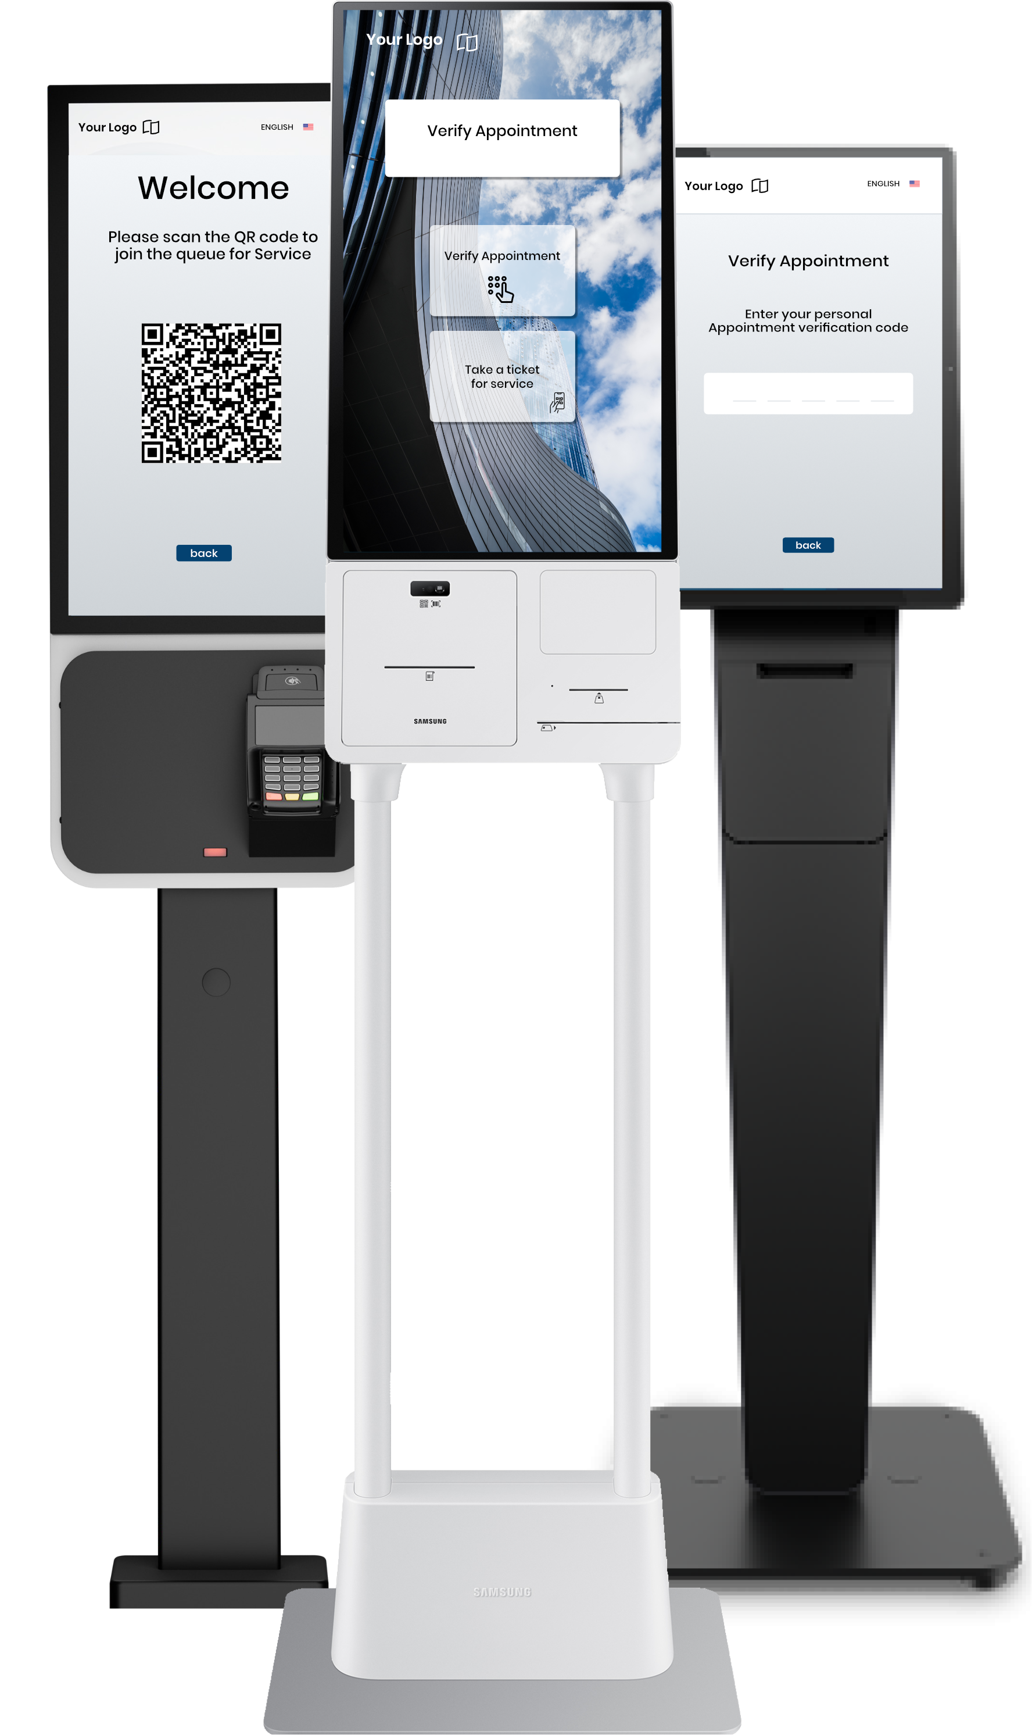
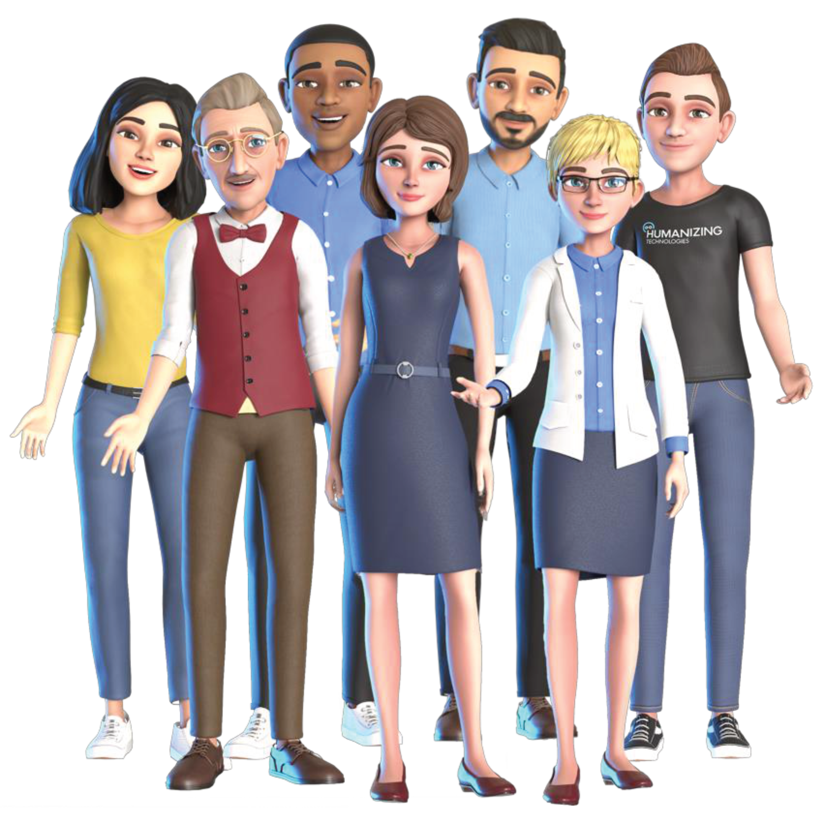
Avatar
AI powered avatars for modern Self Service Kiosk Systems
Transforming Self-Service with Human-Like AI Connections

Slide 2
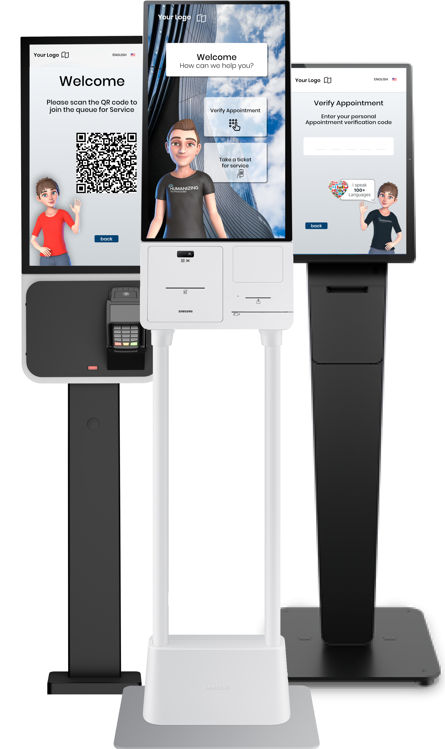
Strategic technology collaboration between cleverQ and Humanizing
The two German companies, B.I.C. GmbH and Humanizing Technologies GmbH have entered a strategic technology partnership to enable intelligent, digitalized service processes across various industries.
This collaboration combines a powerful appointment and queue management system / customer journey with AI-driven communication and automation.

Slide 3
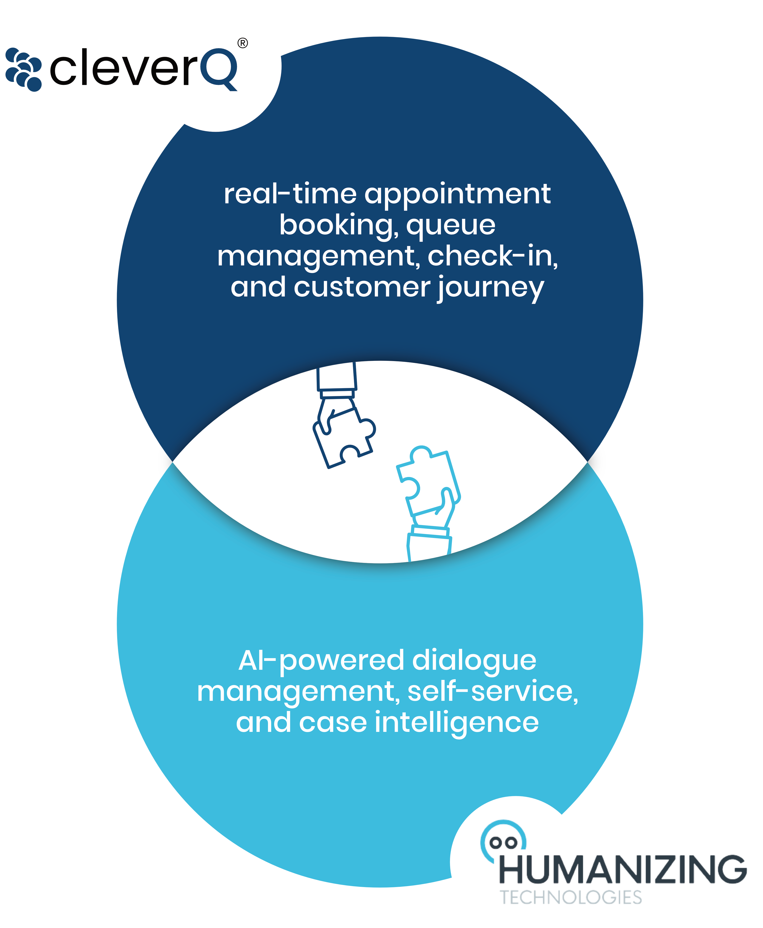
Joint Mission and Goals
By combining our core technologies, we aim to create intelligent, end-to-end service solutions that bring lasting value to both organizations and their customers.
Digitize and streamline service processes to improve operational efficiency
Reduce waiting time and eliminate unnecessary delays
Enhance the overall customer and visitor experience through intuitive, guided interactions
Enable better utilization of staff resources by automating repetitive and low-value tasks

Slide 4
Industry applications of our partnership
The combination of cleverQ and Humanzing unlocks a wide range of use cases across various industries. Wherever visitor flows need to be efficiently managed, waiting times reduced, and service processes intelligently automated, this solution delivers real value. The following overview highlights key sectors and typical application scenarios.

Slide 5
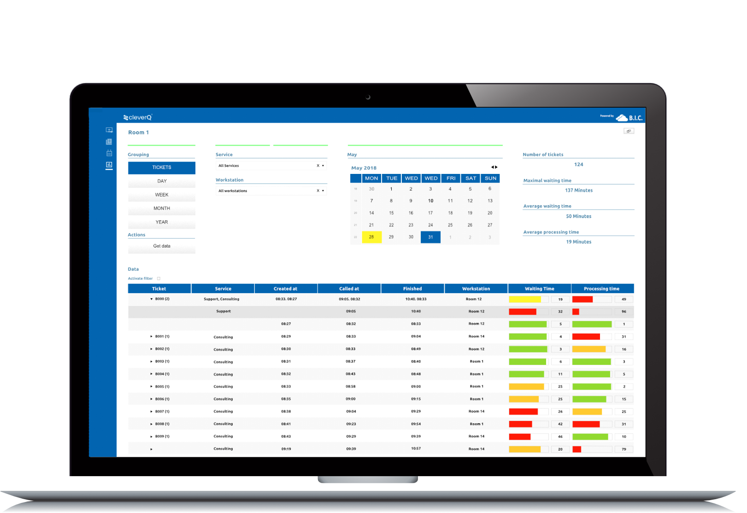
Technological Benefits
Our technology offers a range of benefits designed to streamline operations and enhance efficiency. Built with scalability and compliance in mind, our solution integrates seamlessly into your existing systems while significantly reducing manual workload and support demands.
Scalable via cloud
Data protection compliant & multi-tenant capable (GDPR “Made in Germany”)
Easy integration into existing IT systems
Reduces manual processes and support effort

Slide 6
Benefits for customers
The avatar delivers a natural, human-like interaction that increases engagement and makes digital self-service feel more personal and approachable.
Provides intuitive guidance and real-time assistance, simplifying complex processes and reducing customer frustration.
Offers consistent and friendly support 24/7, improving overall satisfaction and experience.

Slide 7
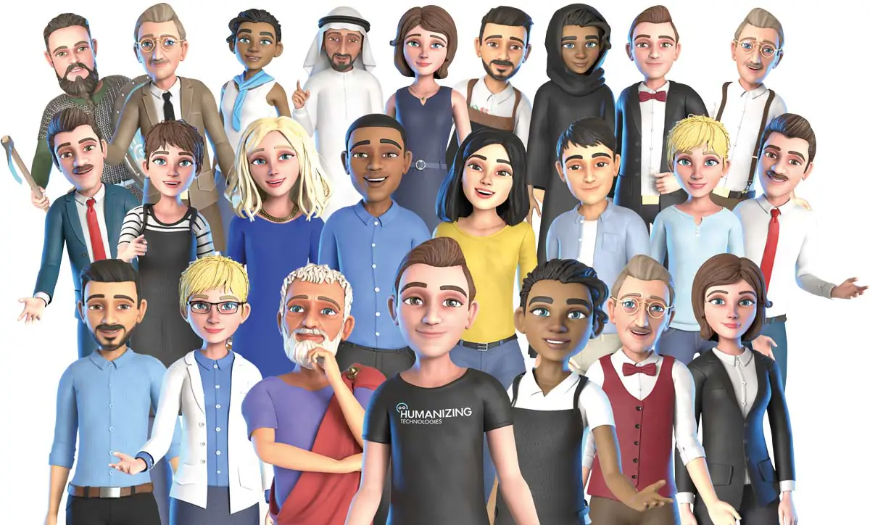
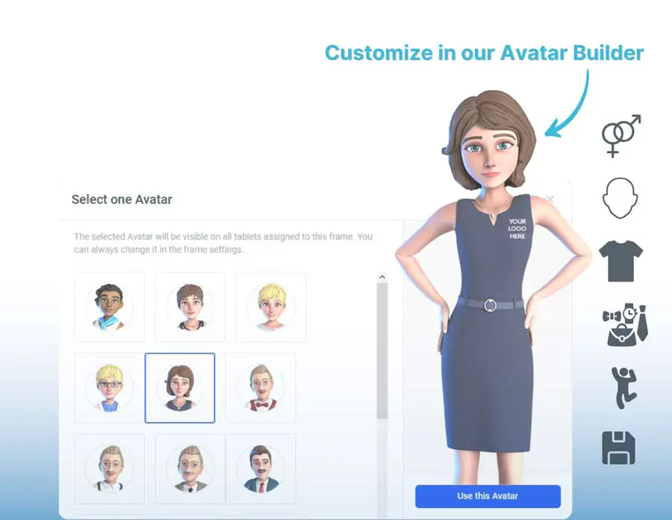
Humanizing Avatars
Humanizing’s stylized, comic-inspired avatars build trust and emotional connections. The Avatar Builder enables customization (skin tone, hairstyle, clothing, branding) and supports 100+ languages with real-time, multi-source data processing.
AI-powered avatars for kiosk systems leave a lasting impression on customers, enhancing brand recognition and creating a competitive edge. Their innovative design and customization options serve as a unique selling point, setting brands apart in the market.

Slide 8
Features & benefits overview
Scalable, cost-efficient, and flexible
Hardware-independent – browser-based
Embodiment of AI & brand identity
Accessibility features (speech-to-text, text-to-speech)
Powerful automation
Knowledge base integration
Personalized avatars
Easy integration
GDPR compliant
Increase customer loyalty
Relieve staff workload
Maintain consistent service quality
Multilingual and multitasking capability
Speak 100+ languages
Available 24/7 with no sick days
Continuously learn thanks to AI
Reduce personnel workload
Highly scalable
Usable both on-site and mobile
Web app compatible
Low to no maintenance costs
Interactive service agents

Slide 9
Avatar
The collaboration between cleverQ and Humanizing represents a future-forward vision: digital processes that simplify rather than complicate—easing the burden for organizations and their customers, guests, or citizens alike.
B.I.C. GmbH
Am Farmböddel 7a
D- 24623 Großenaspe
www.cleverq.de
info@cleverq.de
+49 (0)4327 25398 30

