Slide 1


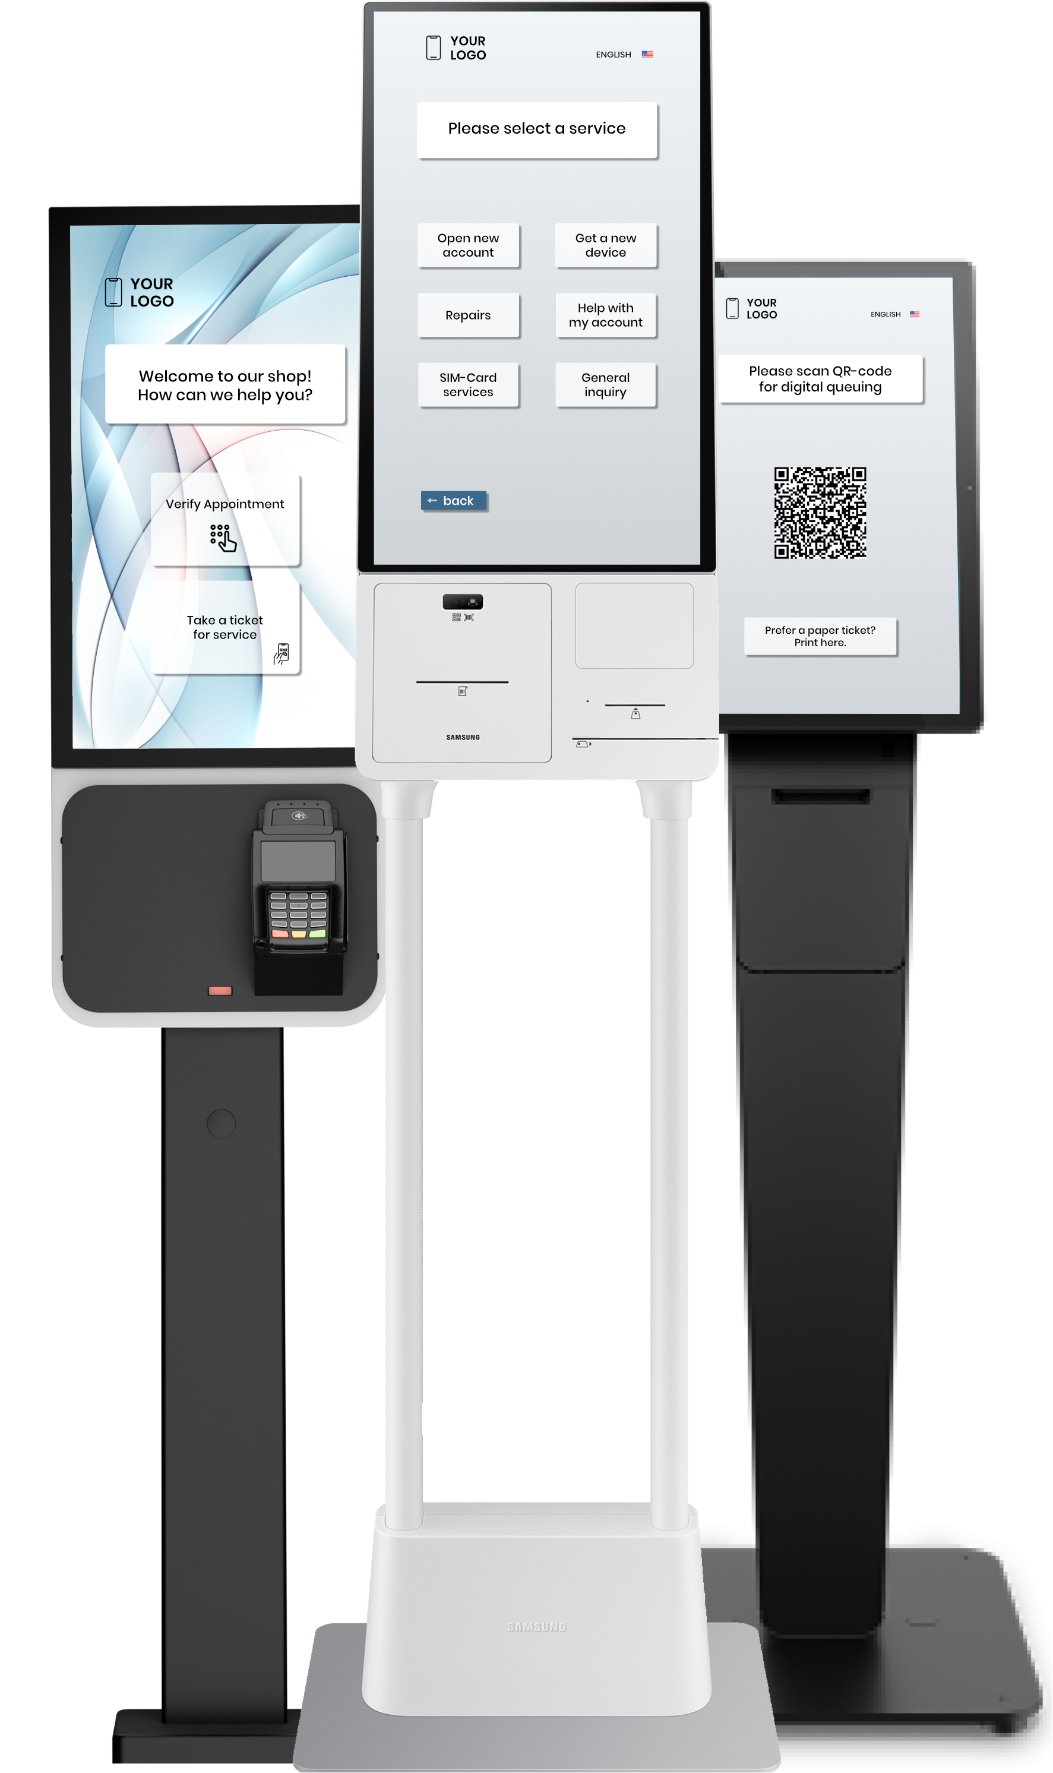
Customer Journey in Telecom Retail
Digital tools for smarter customer flow, reduced wait times, and improved in-store service experience.
B.I.C. GmbH
Am Farmböddel 7a
D- 24623 Großenaspe
www.cleverq.de
info@cleverq.de
+49 (0)4327 25398 30
cleverQ Inc.
851 Ne 1st Ave Miami, FL 33132-1842
(Paramount Miami World Center)
www.cleverq.us
info@cleverq.us
786-709-9550

Slide 2
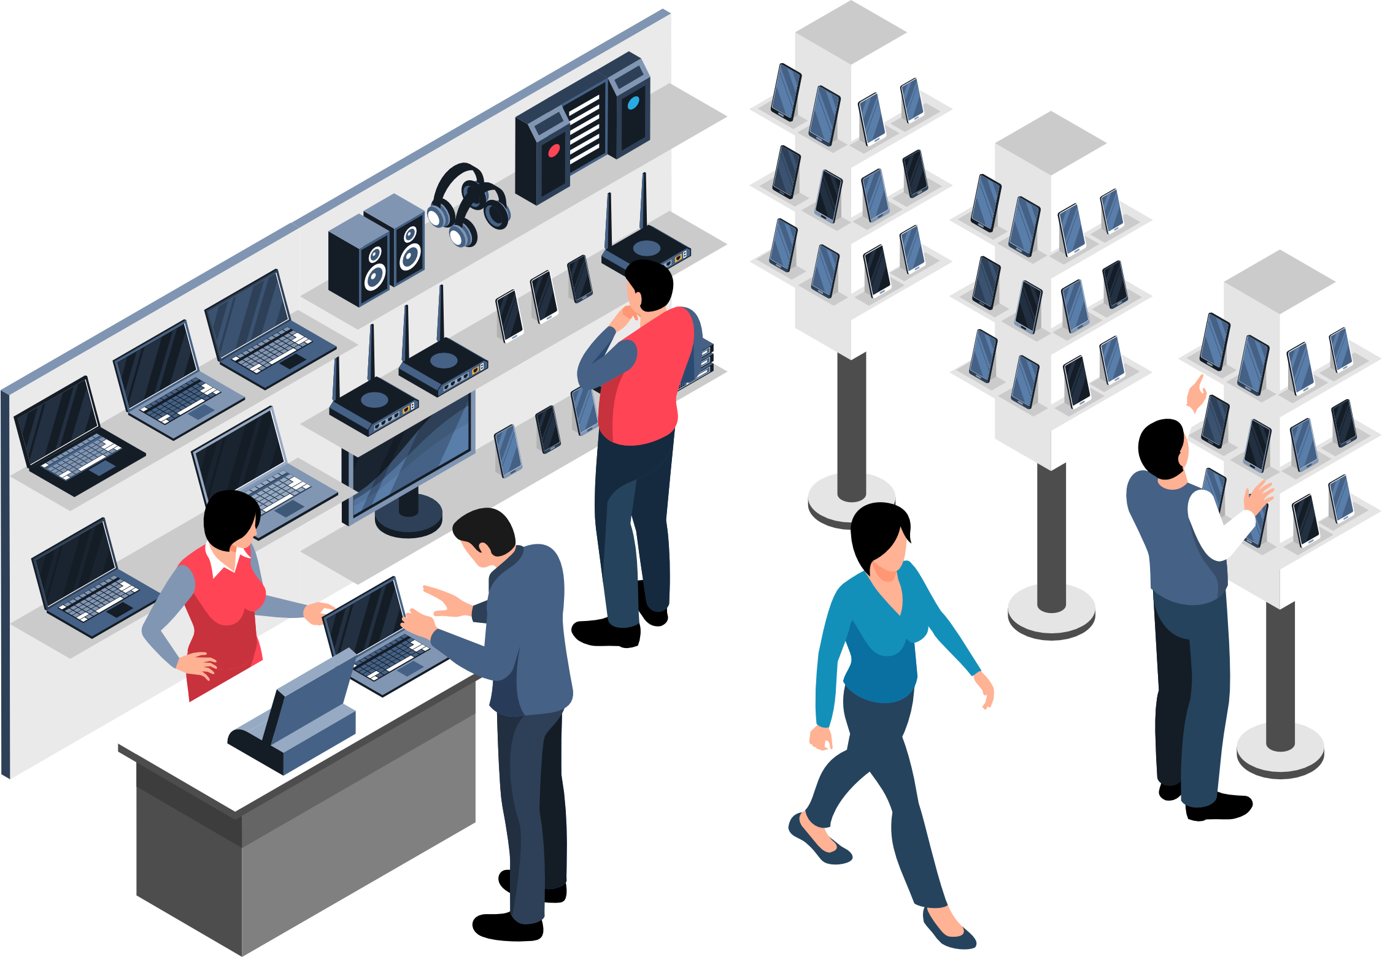



Key Industry Challenges in Telecom Retail
Despite high walk-in traffic, many telecom stores underuse simple digital tools that could improve service quality and the overall customer journey, resulting in missed sales and a subpar in-store experience.
Long wait times, abandoned purchases
No pre-qualification of customer concerns
No centralized transparency of store performance and capacity
Disconnected online and offline experience

Slide 3
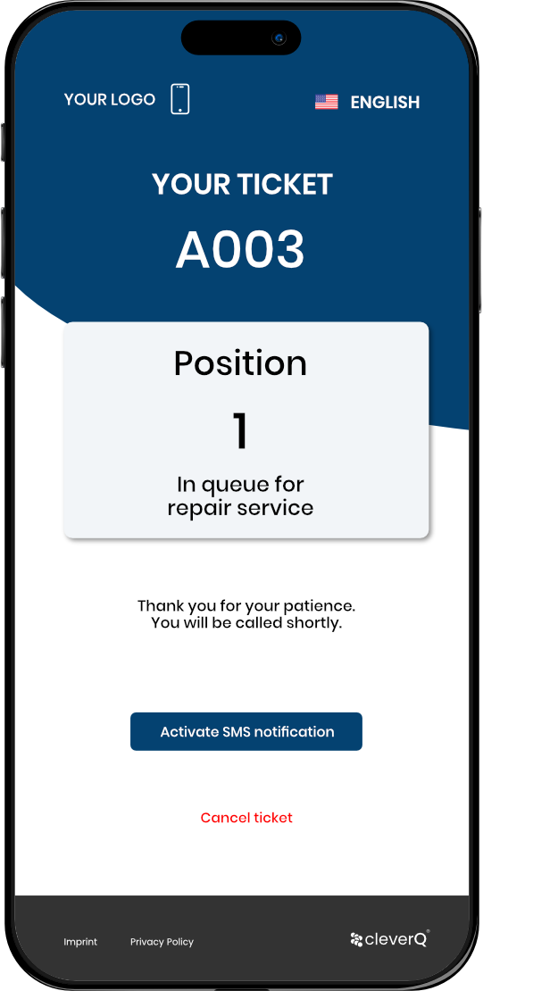
Our Solution
Smart Customer Flow for Mobile Stores
cleverQ digitizes the entire customer journey, from appointment scheduling to in-store service – optimizing wait times, staff allocation, and customer satisfaction.
Digital queue & ticketing system
Flexible appointment booking
Pre-selection of service needs
Real-time status updates
Omnichannel integration

Slide 4
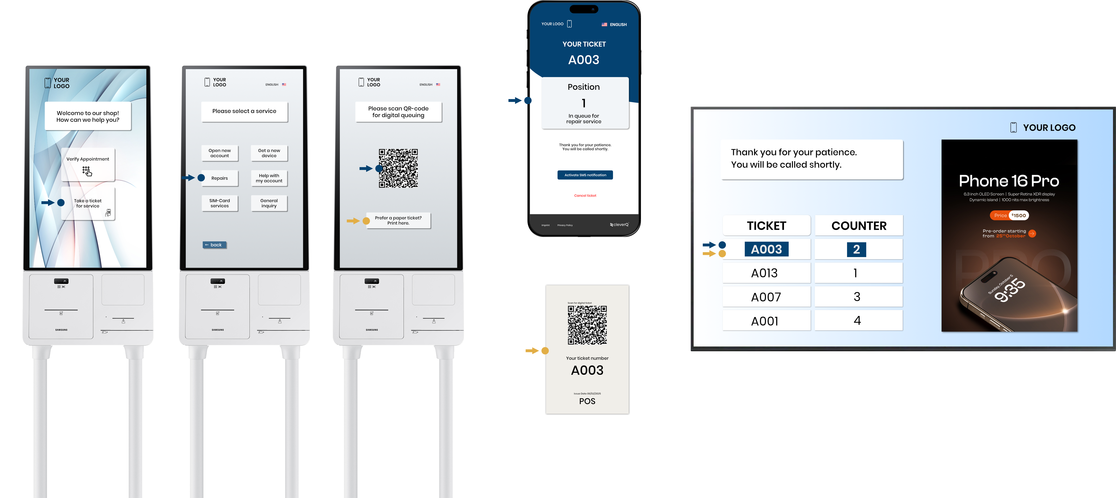
Our Solution
Digital queue & ticketing system
YOUR ADS

Slide 5

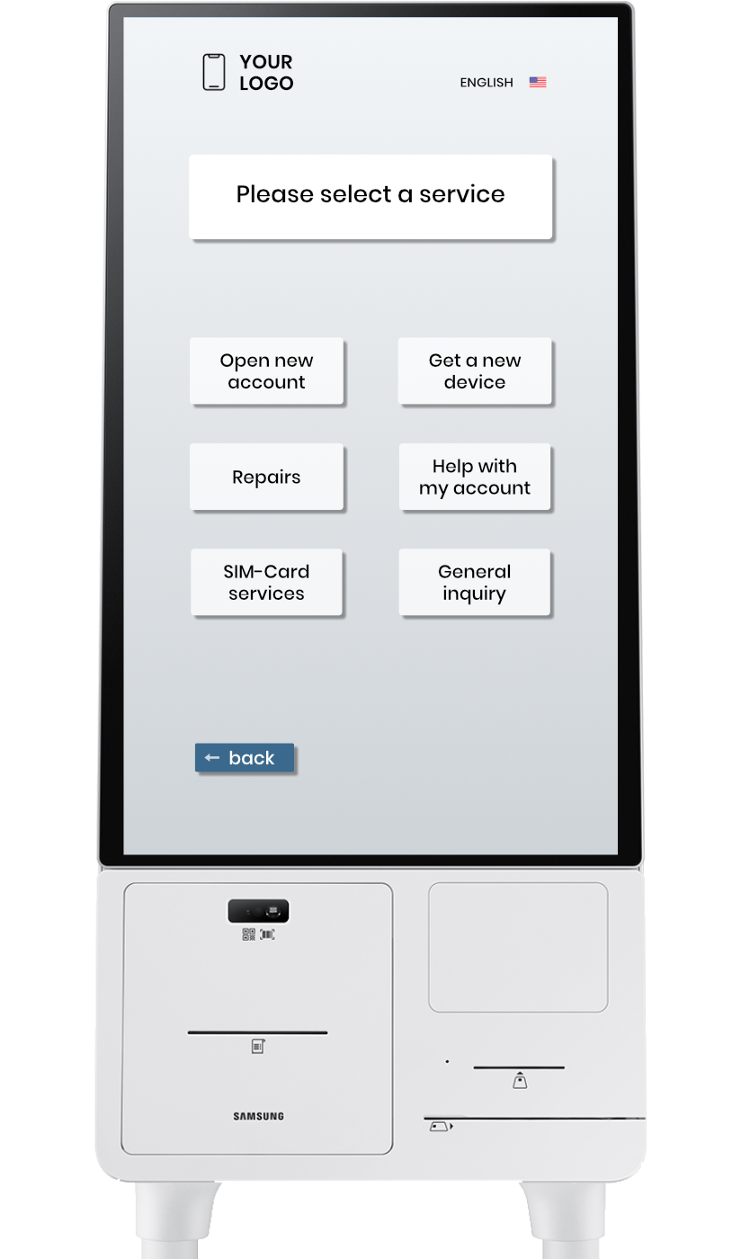



Our Solution
Pre-selection of service needs and smart customer routing
Purchase advice
Repairs
Account Services

Slide 6

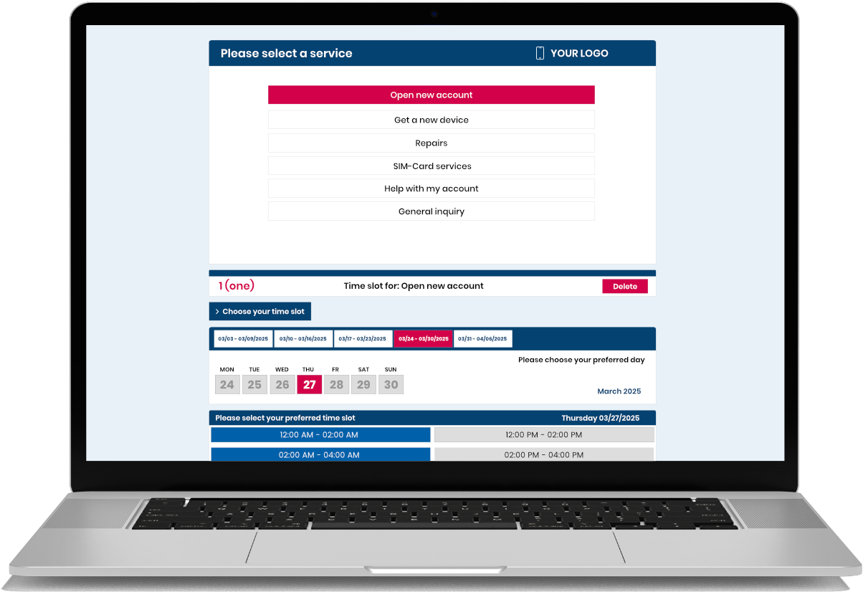
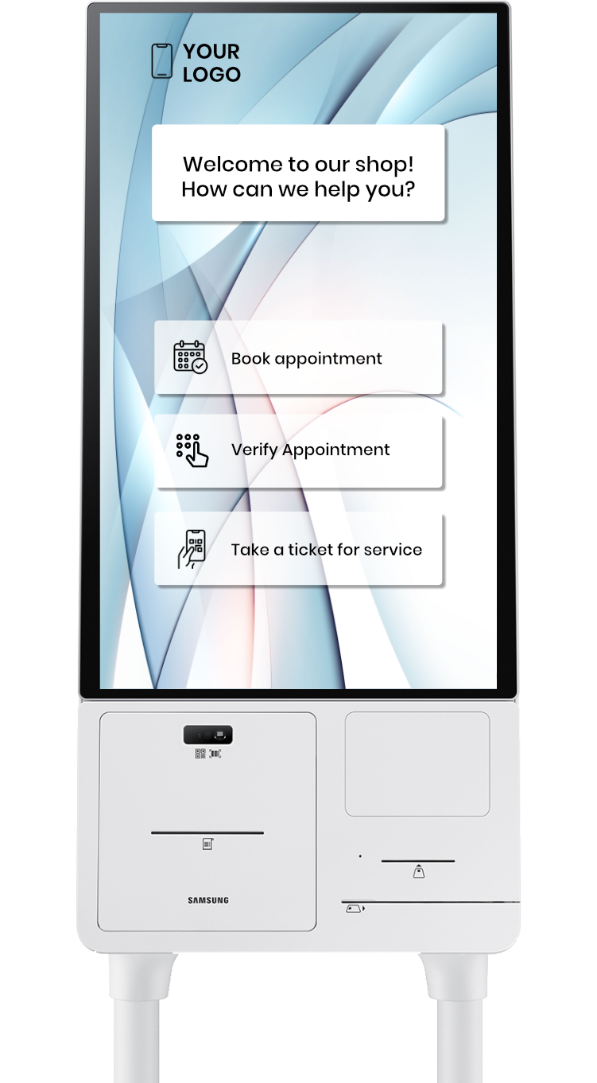
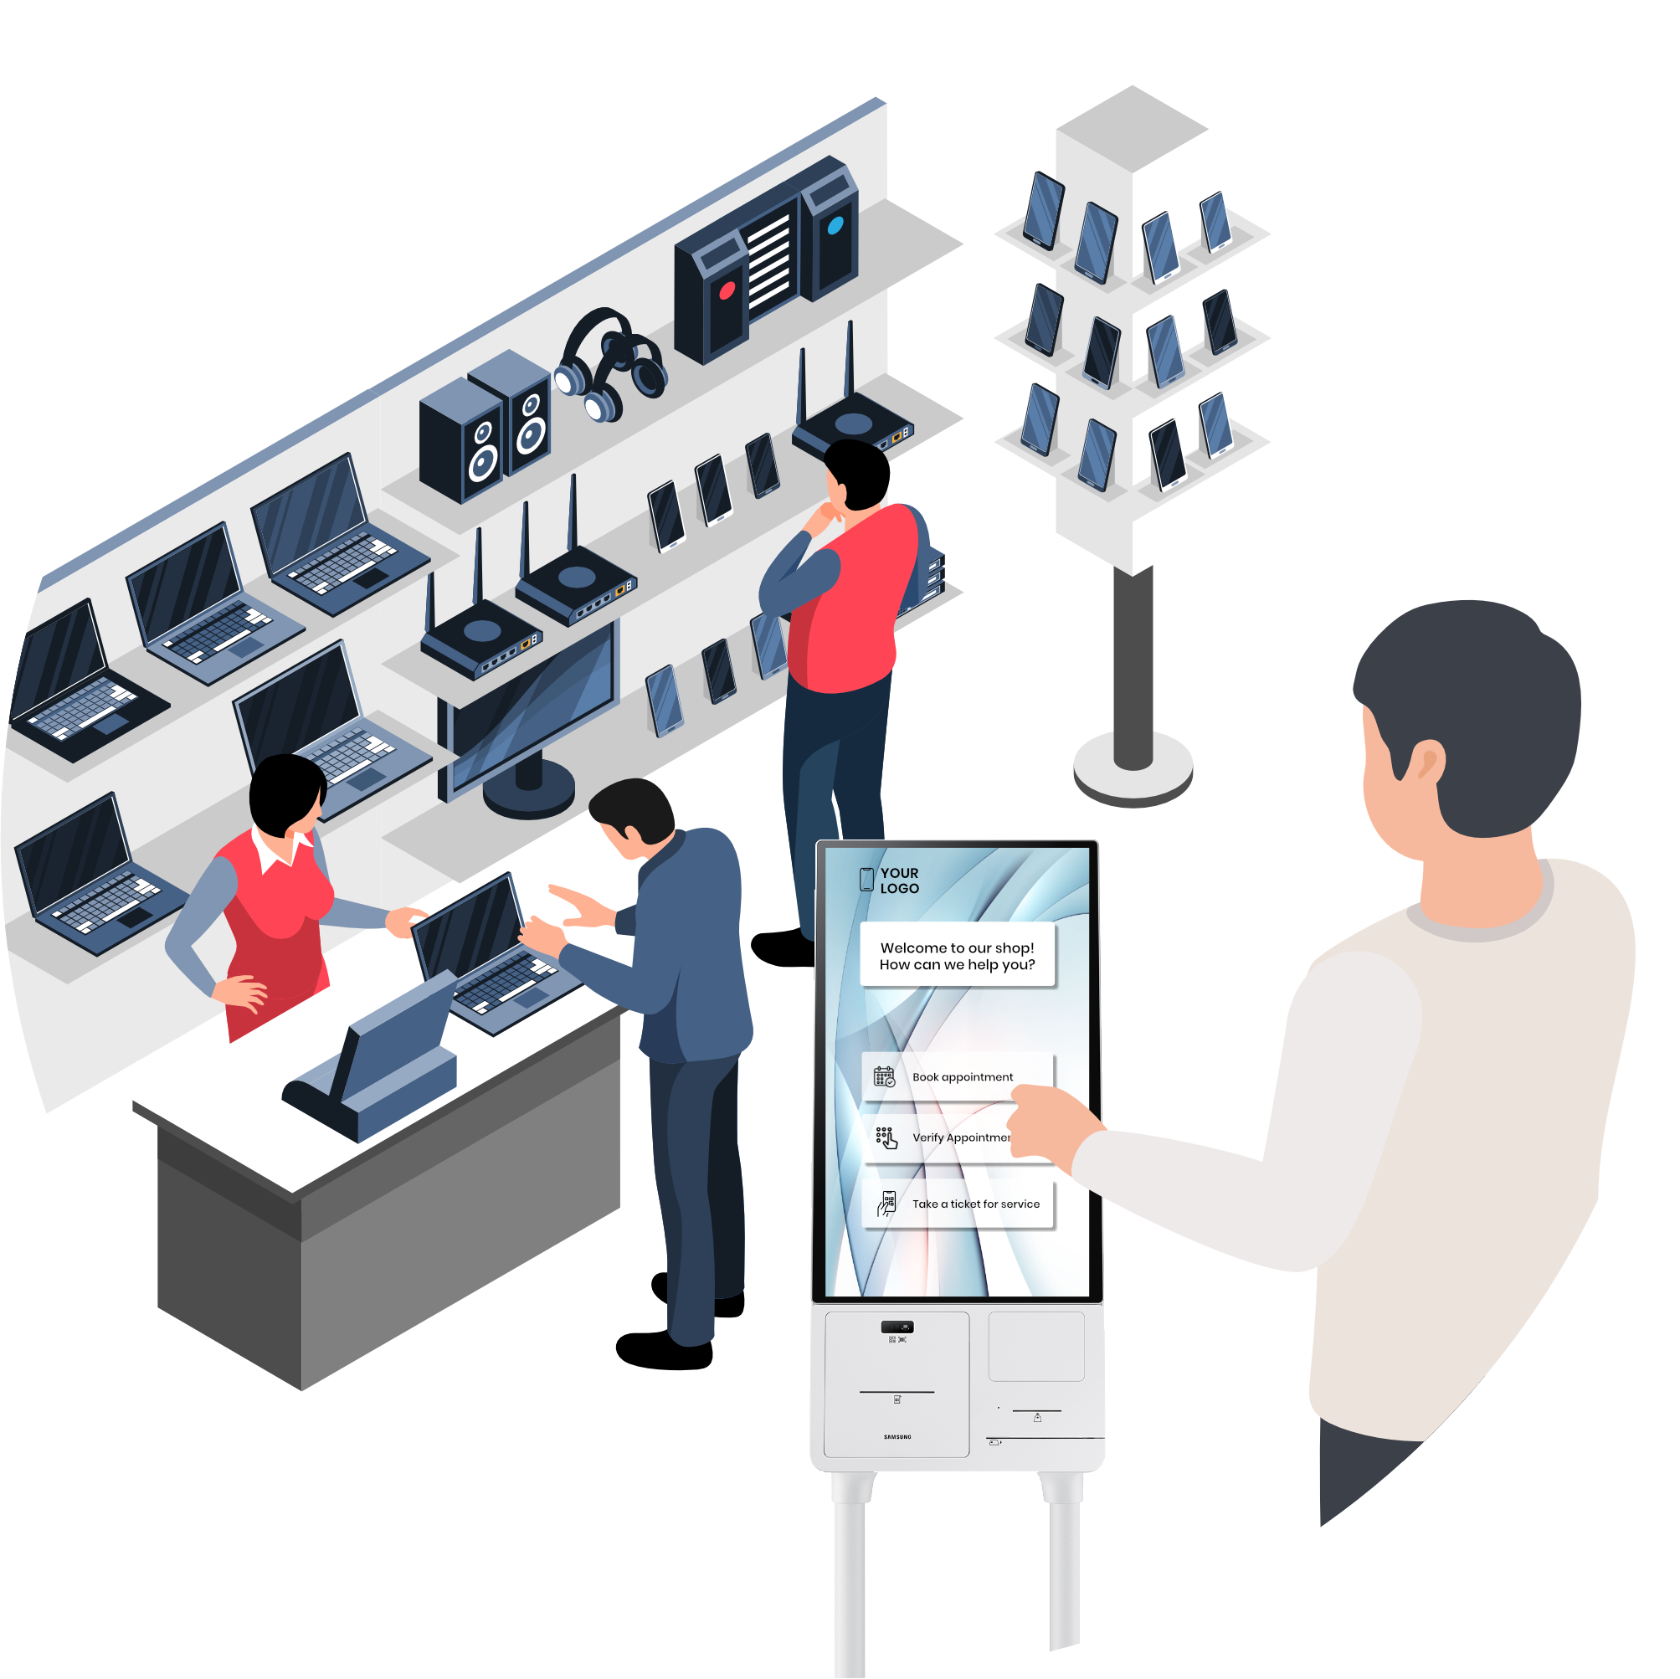
Our Solution
POS/Online appointment booking

Slide 7
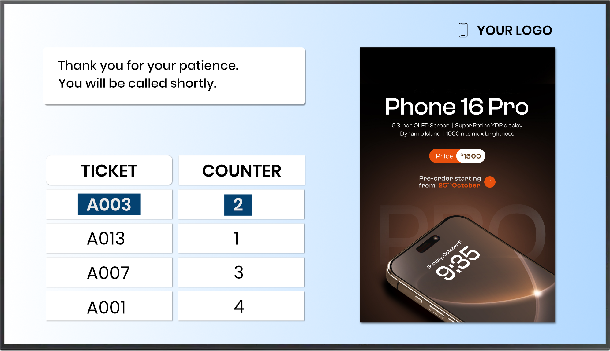
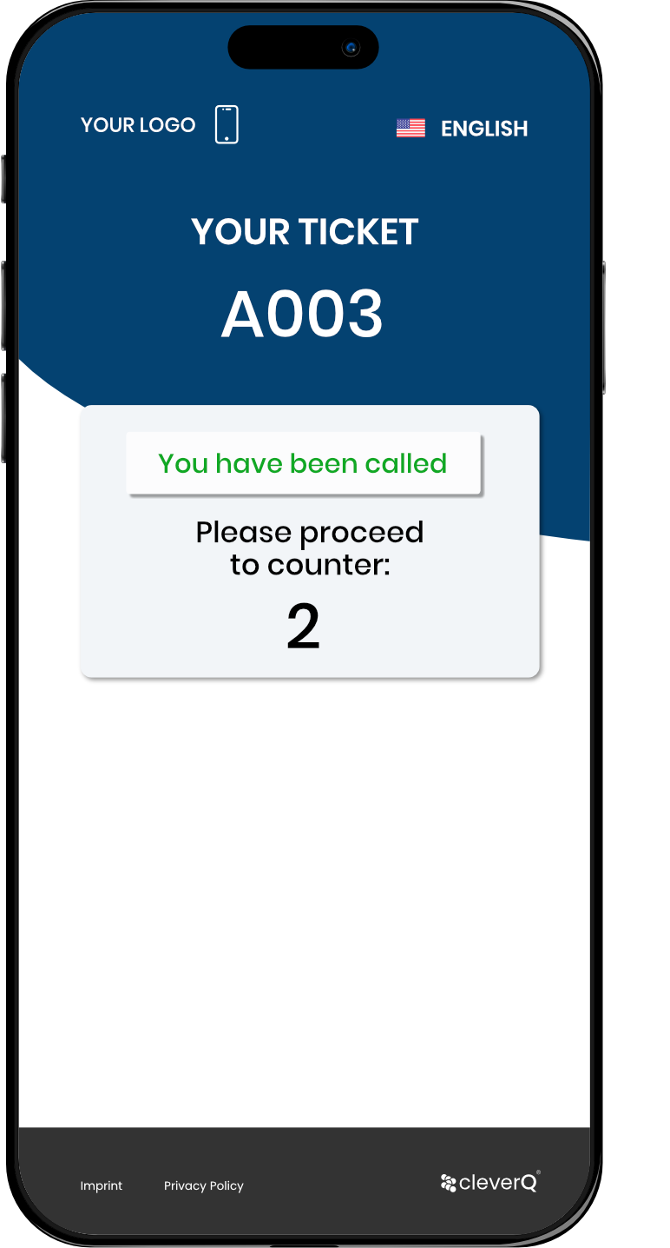
Our Solution
Real-time status updates
Customers can follow their spot in the queue live, on in-store screens or on their smartphone.
Instead of waiting in line, they’re free to explore the store or browse your products.
Once the call is triggered by your staff, the customer is automatically notified via smartphone and on-site displays – and guided directly to the correct service point.
YOUR ADS

Slide 8
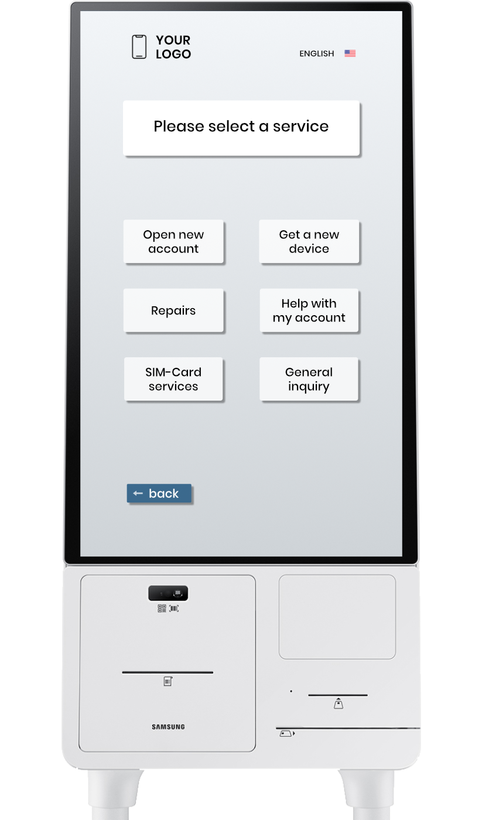
Our Solution
Omnichannel Customer Journey
With cleverQ’s omnichannel integration, customers start their journey online and check in on-site via kiosk or QR code. Staff can view all relevant details in real time, ensuring efficient call-ups and personalized service. This creates a seamless and consistent experience from web to store.

Slide 9
Our Solution
Digital Signage integration
cleverQ’s queuing system connects effortlessly with your existing digital signage. It allows you to display customized call-up information alongside promotional content — all in one smooth, integrated setup.
Customer call-ups on screens
(number/name + counter or advisor)
Display of wait times and status updates
Promotional content alternating with queue information (e.g., current phone offers during wait time)
Personalized greetings upon call-up (optional)
YOUR ADS

Slide 10
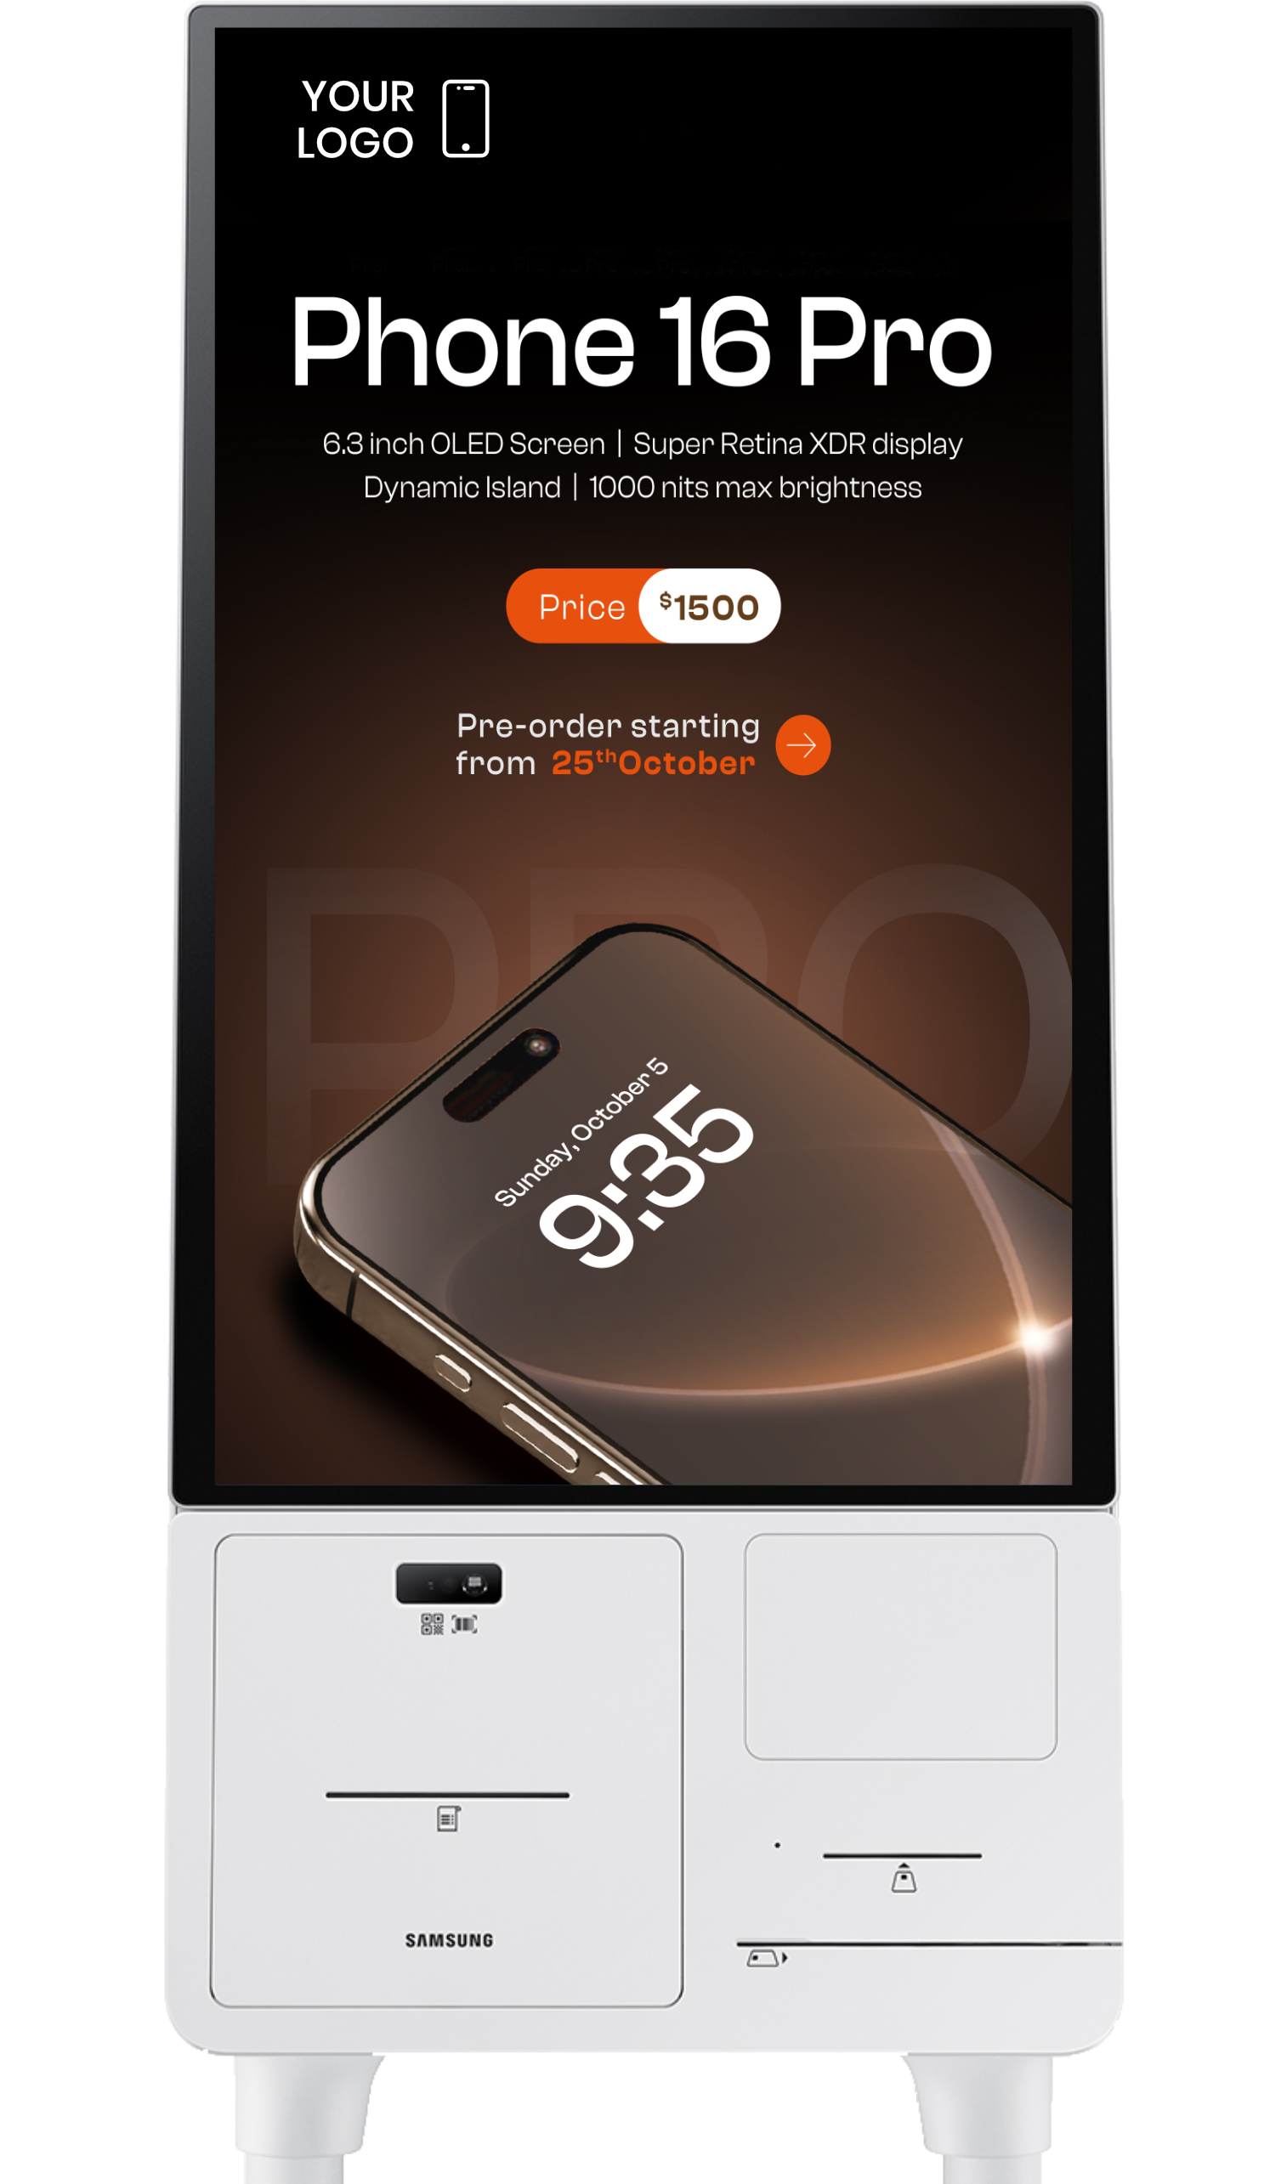
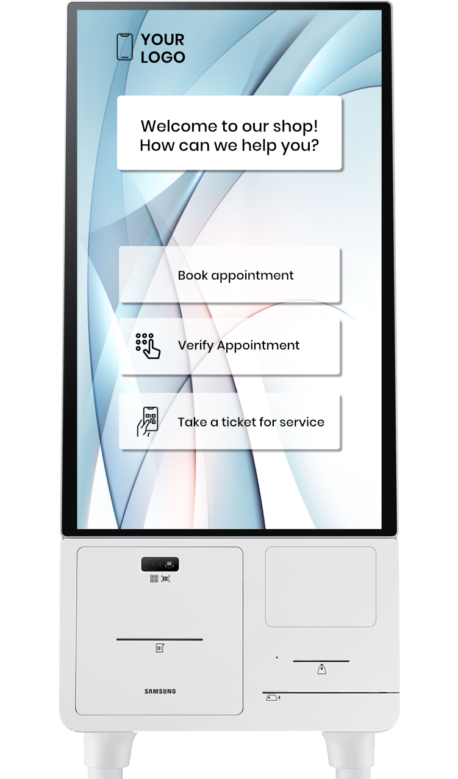

Our Solution
Automatic Queuing activation/deactivation
The cleverQ queuing system can be activated or deactivated either automatically based on store-capacity or manually by staff.
When the queuing system is deactivated, the kiosk terminals can automatically switch to digital signage mode, allowing them to display promotional or informational content.

Slide 11
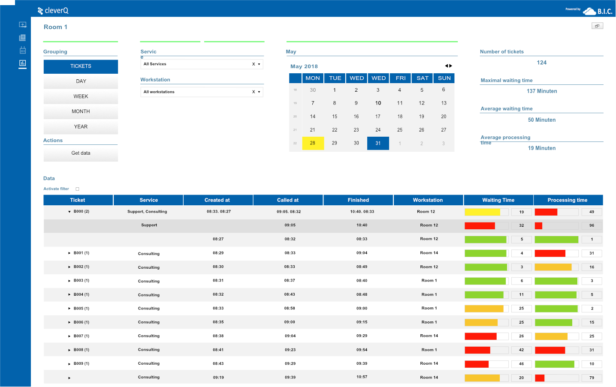
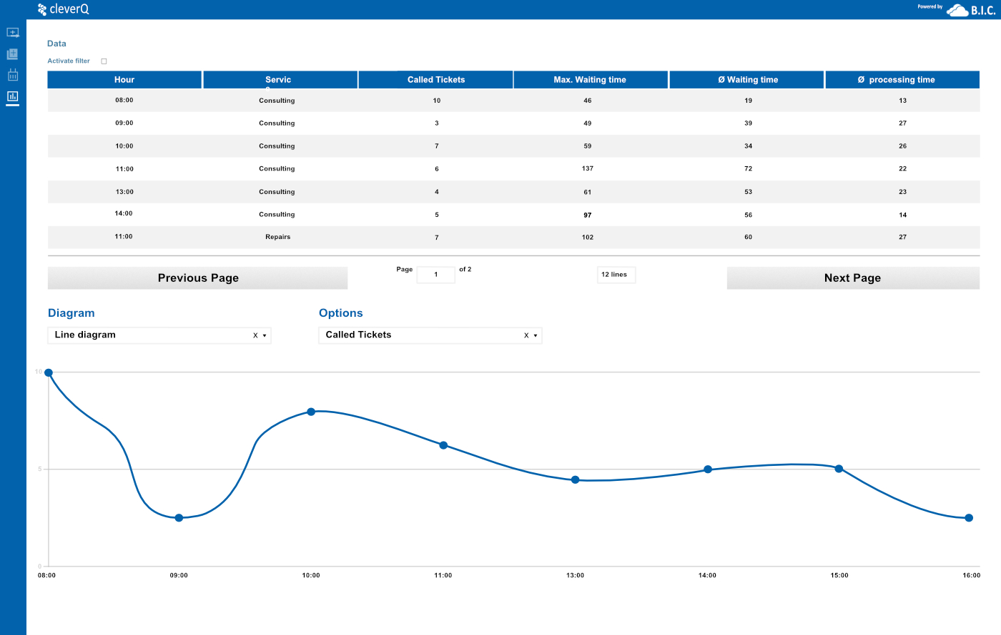
Our Solution
Powerful reporting engine to analyze all relevant KPIs
With cleverQ’s advanced reporting engine, managers gain data driven overview of operational performance. From staff planning, service optimization to quality assurance
Waiting times by store, weekday, and time of day
Number of customers per service type (e.g., contract consultation vs. device repair)
Processing time per employee
No-show rate for appointments
Comparative reports across all locations

Slide 12
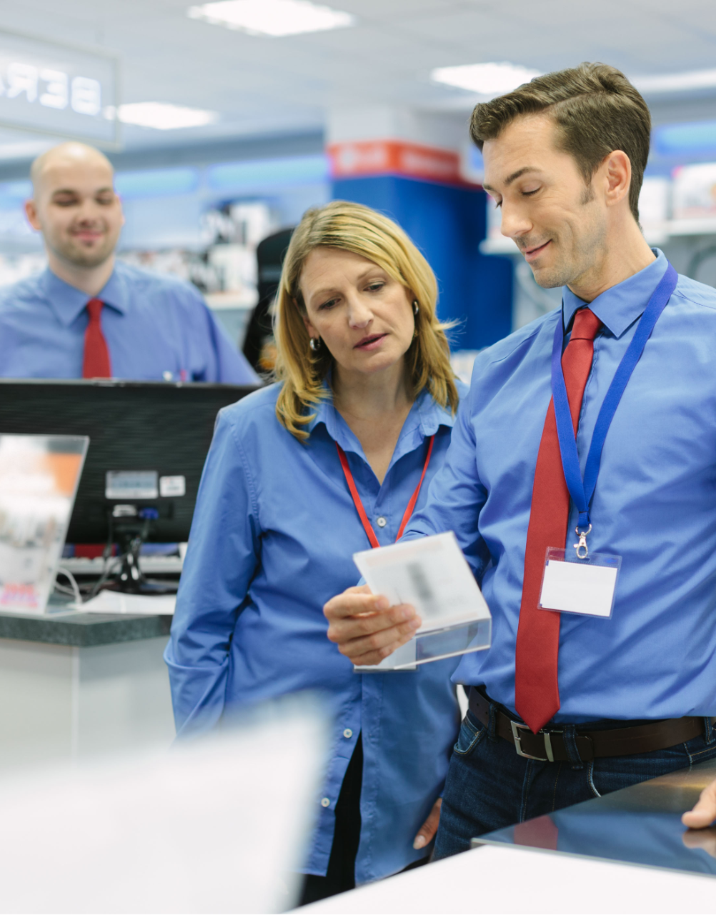
cleverQ is a tool for creating satisfied, engaged teams.
Our holistic solution approach is not only focused on improving service quality for customers, but also explicitly designed to enhance workflows and the working environment for employees.

Slide 13
cleverQ is a tool for creating satisfied, engaged teams.
Less Stress in Daily Work
Clear queue logic instead of spontaneous decisions
No conflicts due to unclear order
Structured processes reduce emotional pressure
Sustainable Employee Retention
Predictable processes & transparent workload
Positive customer feedback boosts motivation
Less overload = lower employee turnover
More Focus on Customer Service
Organized queuing systems improve concentration
No disruptions from the waiting area or side inquiries
Higher service quality & efficiency
Competitive Edge in the Talent Market
Fewer sick days due to reduced stress
Lower recruitment & onboarding costs
Stronger employer brand

Slide 14
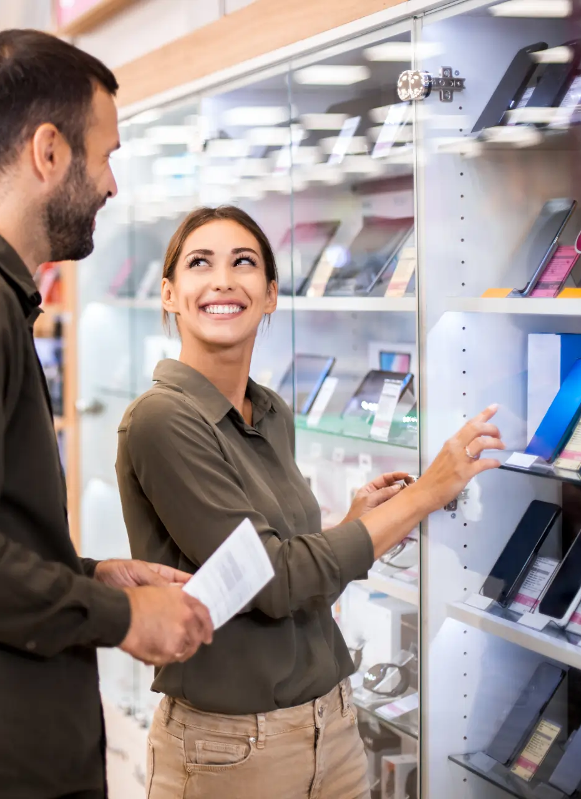
Delivering measurable value at every touchpoint:
With cleverQ, telecom retailers can streamline operations, improve customer satisfaction, and gain deeper insights – all while offering a seamless and modern service experience across channels.
Reduced waiting times & improved customer satisfaction
Targeted service through pre-selection of customer needs
Enhanced in-store experience via digital signage integration
Transparent KPIs for greater efficiency and planning reliability
Omnichannel experience through smart integration of online and in-store touchpoints

Slide 15

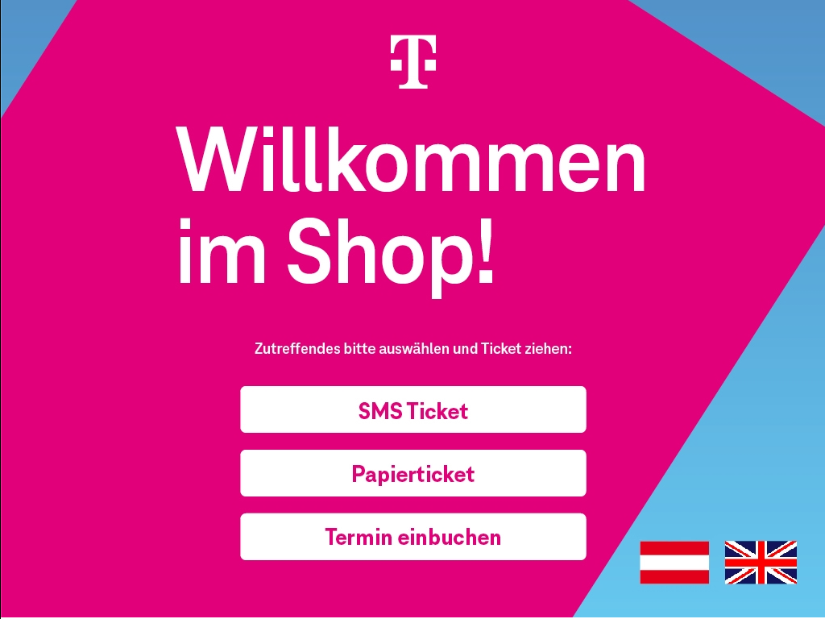
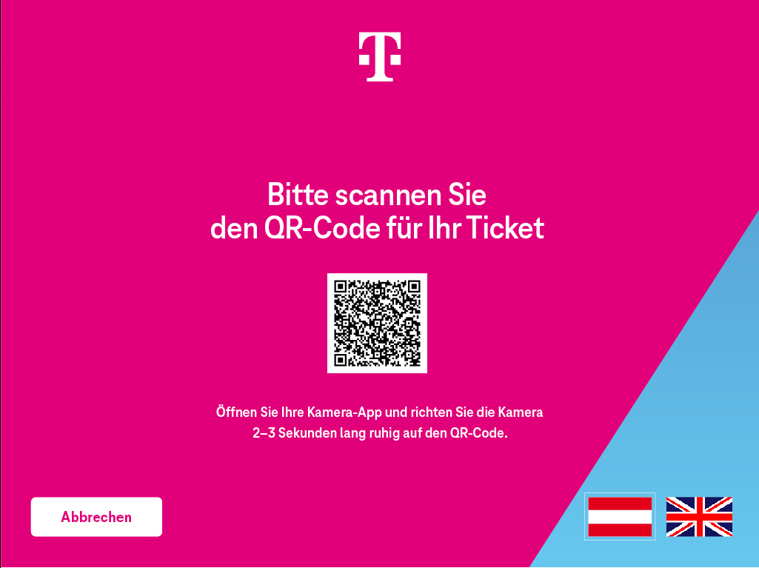
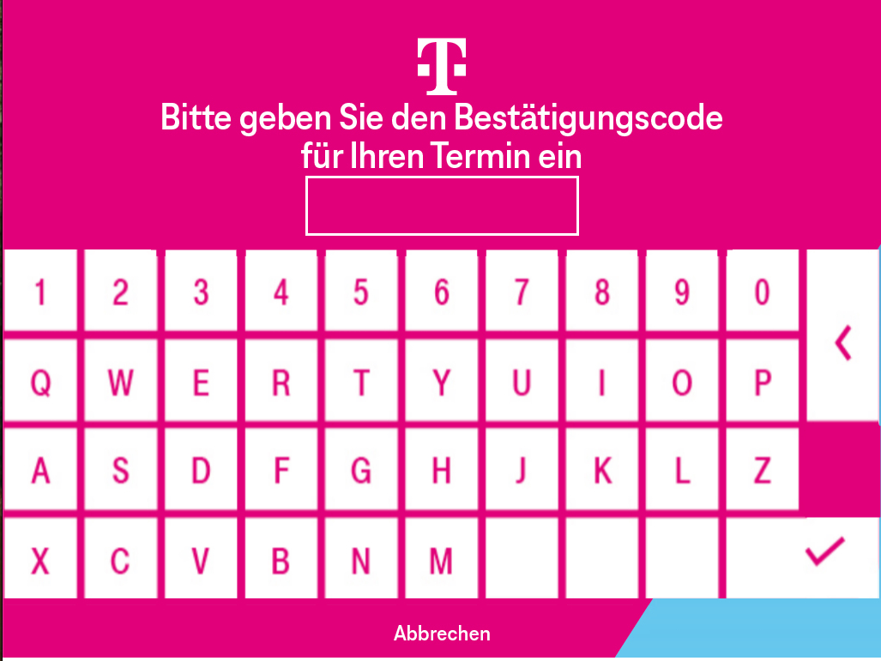
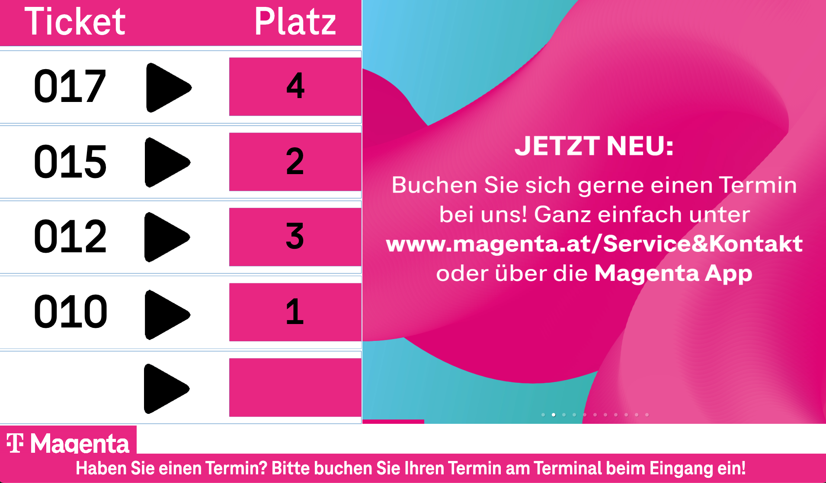
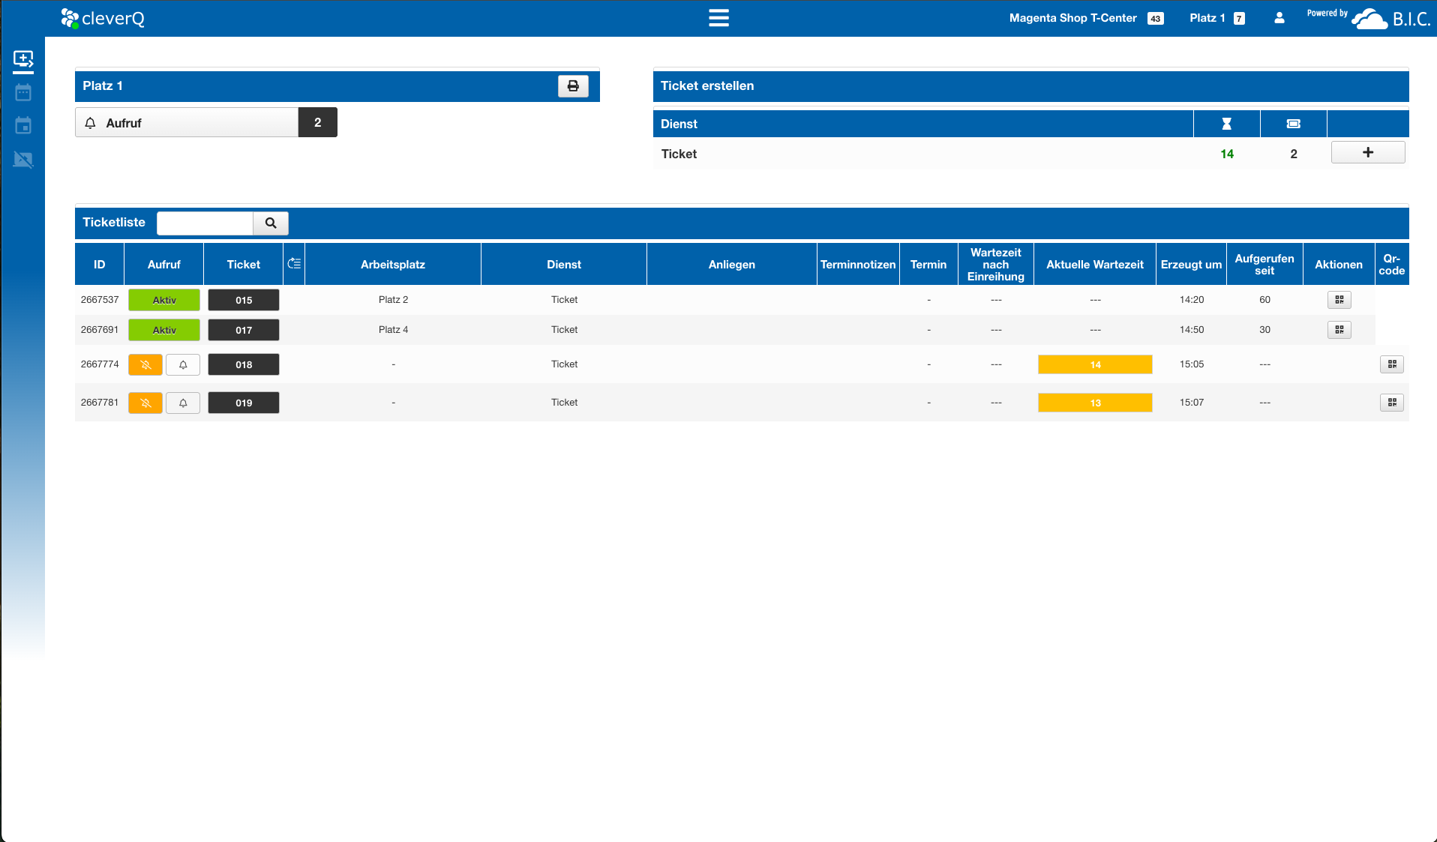


Case Study Magenta
Magenta uses our solution at a total of 70 locations throughout Austria to manage customer traffic and increase customer satisfaction.
70 locations throughout Austria
Smart Queuing
Appointment booking
Data analytics

Slide 16
Case Study Magenta
Customers have the convenience of booking appointments for various services, while walk-in customers can easily obtain a service ticket on-site at a kiosk, either in paper form or digitally via a QR code.
The staff seamlessly manage the flow by always calling the next customer, with cleverQ automatically prioritizing both appointments and walk-ins.
For customers, this system offers the advantage of a stress-free experience, allowing them to explore other products in the store or make the most of their waiting time, perhaps by enjoying a relaxed coffee at the nearby café instead of standing in line.
The staff on-site benefit as well, as they can work efficiently without stress, ensuring no customer feels overlooked.
Moreover, Magenta Management can conduct comprehensive evaluations across all locations, enhancing personnel planning and optimizing resource allocation.
70 locations throughout Austria
Smart Queuing
Appointment booking
Data analytics

Slide 17
Customer Journey in Telecom Retail
Digital tools for smarter customer flow, reduced wait times, and improved in-store service experience.
B.I.C. GmbH
Am Farmböddel 7a
D- 24623 Großenaspe
www.cleverq.de
info@cleverq.de
+49 (0)4327 25398 30
cleverQ Inc.
851 Ne 1st Ave Miami, FL 33132-1842
(Paramount Miami World Center)
www.cleverq.us
info@cleverq.us
786-709-9550

