Slide 1



Unlocking new markets with cleverQ Strategic market opportunity through the partnership of Axis and cleverQ in a $1.2B+ industry
www.cleverq.us | info@cleverq.us | 786-709-9550 851 Ne 1st Ave Miami | FL 33132-1842 | (Paramount Miami World Center)

Slide 2

Queue Management Market Key Market Facts
Market Size 2024: USD 1020.18 Million
Projected Market Size: USD 1543.71 Million by 2030
CAGR Range: ~5.5% – 7.5% → Stable, consistent growth
Source: www.marketgrowthreports.com

Slide 3

Queue Management Market Key Market Facts
North America leads with 38% market share; U.S. dominates with 87% of deployments.
56,000+ entities in U.S. use queue systems; Canada adoption rising in retail and government.
U.S. banks: 7,800+ branches with cloud queues, reporting 31% fewer customer complaints.
19,000+ healthcare institutions use queue systems for triage and appointments.
Source: www.marketgrowthreports.com

Slide 4

Opportunities & Challenges & how to address them
Customer Pain Points | Solution (Axis + cleverQ) | Added value for the customer
Uncontrolled access to service areas leads to overload. | Access control by appointment or ticket-based entry | Better management of visitor flow (no access without appointment/call).
Waiting times are non-transparent for customers. | People counting and waiting area optimization | Transparent and fair waiting times.
Staff planning is often based only on ticket numbers, not on actual customer flows. | Video analytics + queue data for accurate staff planning | Efficient real time staff planning based on the actual number of people.
Growing security demands based on high visitor traffic | Combined use of Axis cameras, access control and cleverQ SOS module | Increasing Security and reducing workload

Slide 5
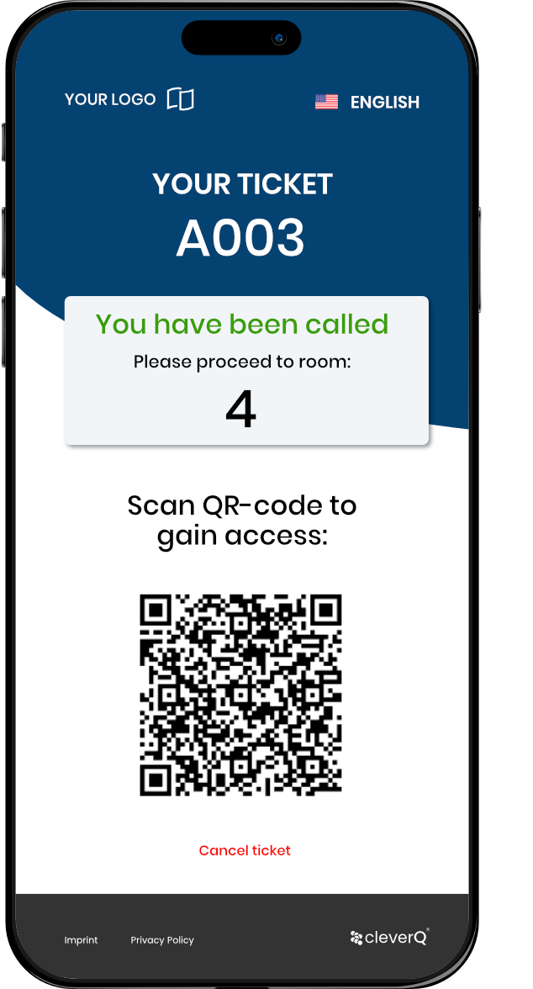


Access Control by appointment or ticket-based entry
Workflow
Combination of Axis Access Control and cleverQ queuing and appointment booking
QR-code on tickets unlocks areas only when called (e.g., consultation room, lab, service counter).
Customers receive a QR code as appointment confirmation.
Access is granted only for the appointment time or up to XX minutes beforehand.
Professional, scalable setup for secure visitor access

Slide 6
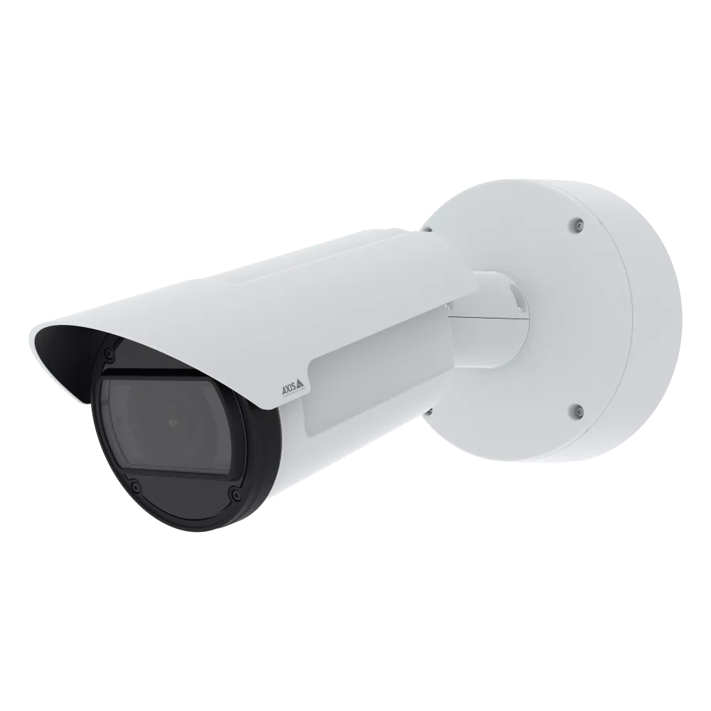
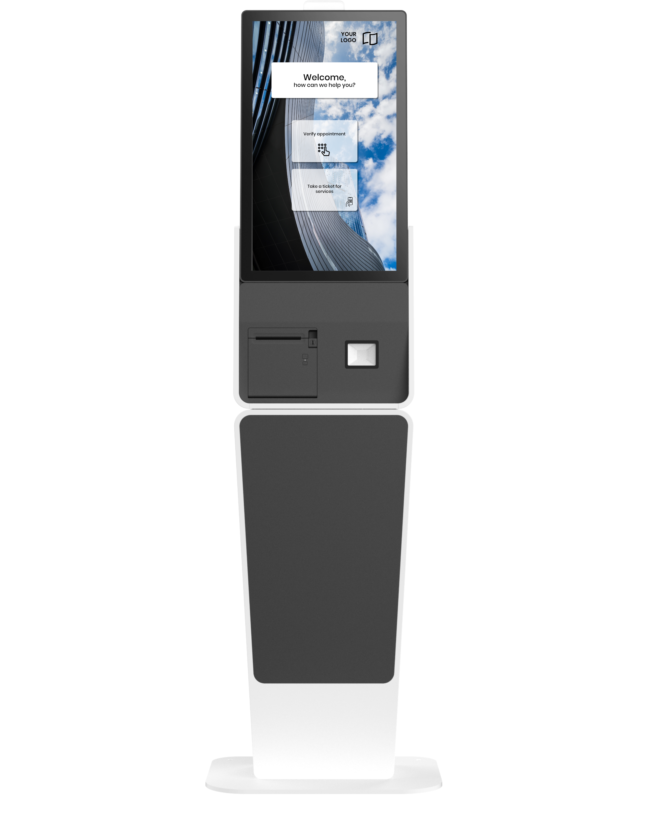
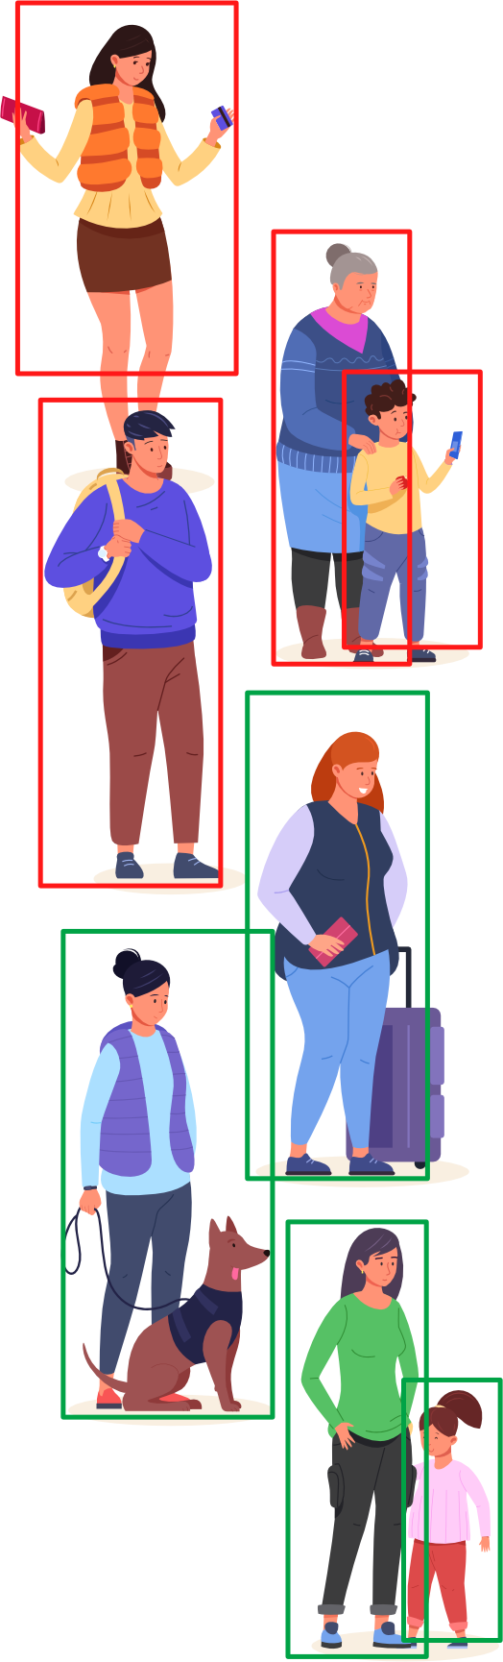
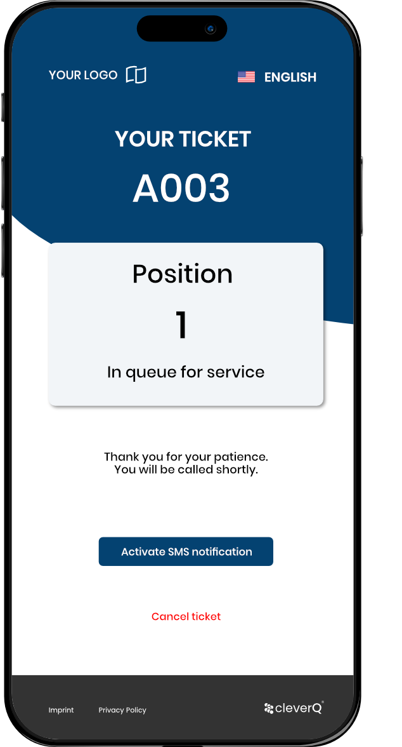
People counting and waiting area optimization
Workflow
Axis cameras capture real-time visitors counts in defined zones.
Kiosk queuing system auto-activates/deactivates based on predefined occupancy thresholds.

Slide 7


Actual customer count Ticket-to-visitor reconciliation
Workflow
Axis cameras count individuals present in the waiting area
cleverQ data tracks number of issued tickets
Cross-checking identifies discrepancies (e.g., families/groups with one ticket)
Reliable customer count forms the basis for fair queuing and staff planning
Improved forecasting for peak times and resource allocation
8 Actual Customers
8 Issued tickets
10 Visitors

Slide 8

Automatic Queue Detection in Crowds
Workflow
Axis cameras analyze crowd movement and density in real time
Video analytics distinguish between random gatherings and actual queues
cleverQ integration transforms detected queue into a structured digital queue
Dynamic kiosk activation if queues exceed thresholds
Staff alerted to manage additional counters or waiting areas

Slide 9
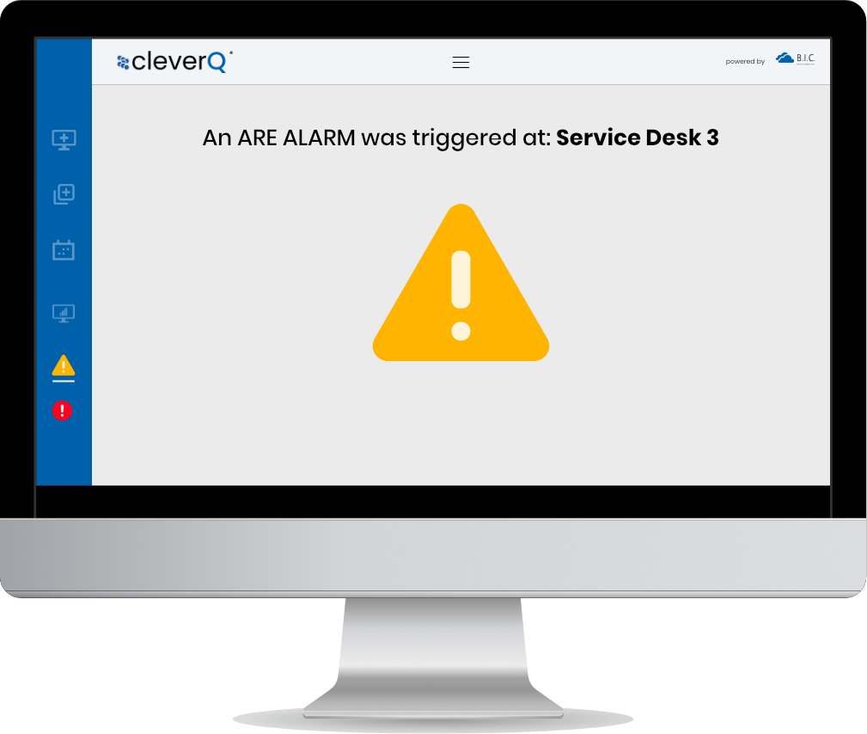
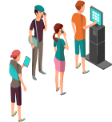

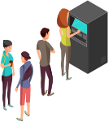

On-Demand Video Feed
Workflow
One-click access to live video feeds of multiple areas
Real-time monitoring of waiting rooms, service counters, or entrance zones
Instant reaction when areas become overcrowded
Flexible response: open additional counters or redirect visitor flow
Quick support requests if problems or incidents occur

Slide 10


Increasing Security with cleverQ SOS module and Axis cameras
Workflow
SOS triggers from cleverQ app or kiosk activate instant alerts
Axis cameras provide live video feed of the incident
Automatic linking of SOS event with corresponding camera view
Faster response times and higher situational awareness
Integrated system enhances both visitor and staff safety

Slide 11

Benefits for Axis Sales
Extension of the Axis portfolio with a complete Customer Journey Management solution
Cross-selling potential: Access Control + Video + cleverQ SaaS
Differentiation from competitors through real business value beyond security technology
Recurring SaaS revenues for partners

Slide 12
Application Scenarios
Scenario | Example | Benefit
Banks | Appointment-based access | Reduced counter workload, better use of consultation rooms
Hospitals / Labs | Access only when called (triage link) | Less crowding, smoother patient flow
Government Offices | Entry only with active ticket | Increased security and orderly waiting areas
Retail / Telco | Camera detects overcrowding | Automatic activation of additional kiosks/counters
Grocery Stores | Fresh food counters with ticketing | Fair, transparent service order and less congestion
Public Transportation | Boarding zones with QR/ticket check | Safer, more efficient passenger flow

Slide 13
Capturing Growth in Queue Management Potential to combine Video analytics and queue management in a growing $1.2B+ sector.
www.cleverq.us | info@cleverq.us | 786-709-9550 851 Ne 1st Ave Miami | FL 33132-1842 | (Paramount Miami World Center)

