Slide 1
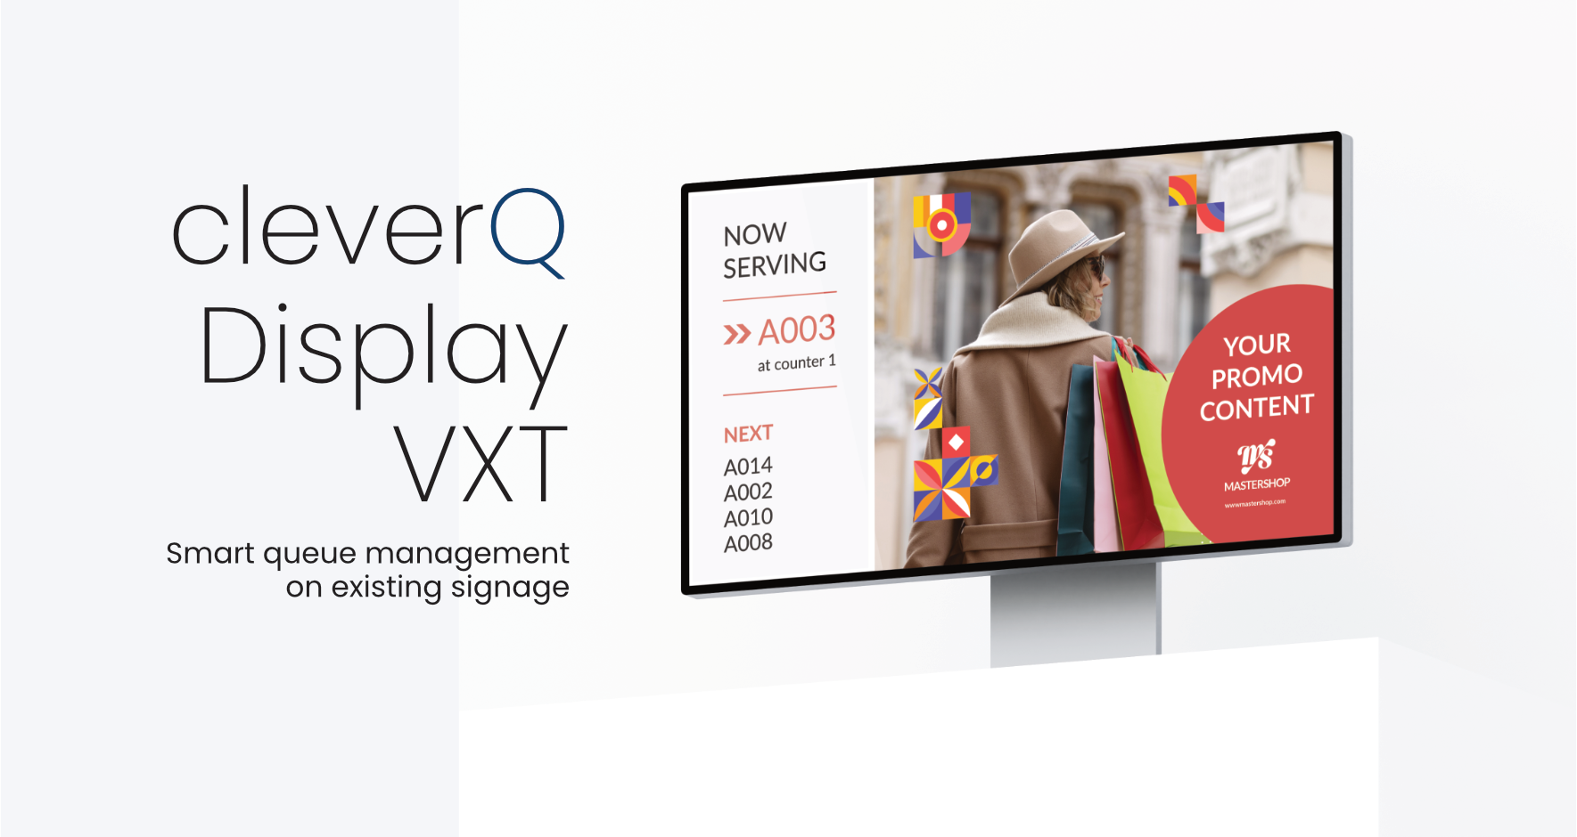



Slide 2
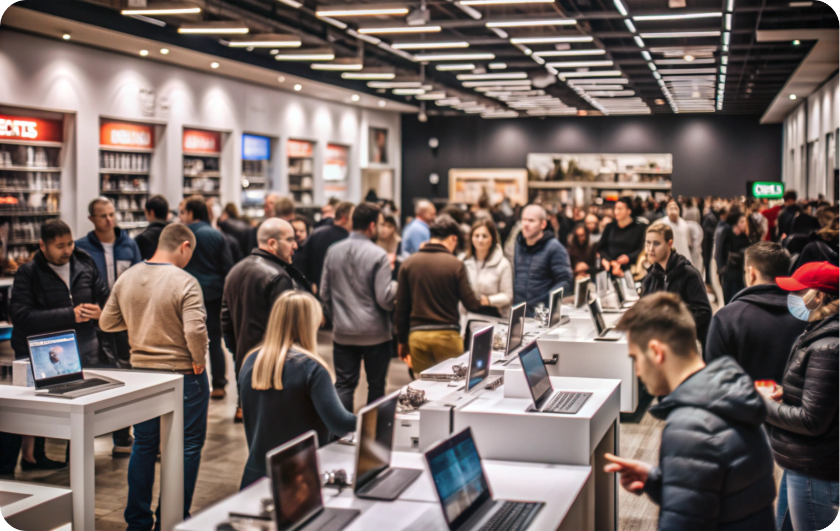

Stop Managing Screens.
Start Managing Customer Flow.
With the cleverQ VXT Widget, you integrate your call displays directly into the Samsung Digital Signage environment without additional hardware, separate monitors, or complex integrations.

Slide 3
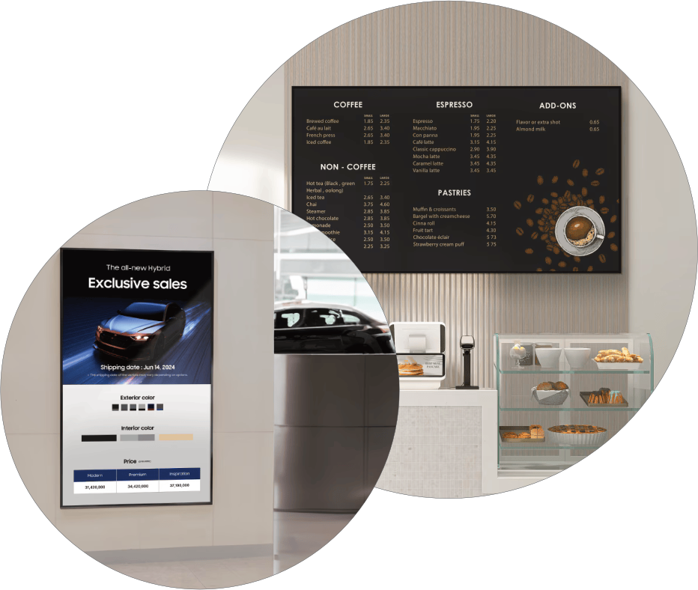
The Use Case
And why It matters
Many retailers use Samsung VXT primarily for product advertising, promotional campaigns, branding, and price communication.
It serves as a central platform for marketing content and in store messaging.

Slide 4
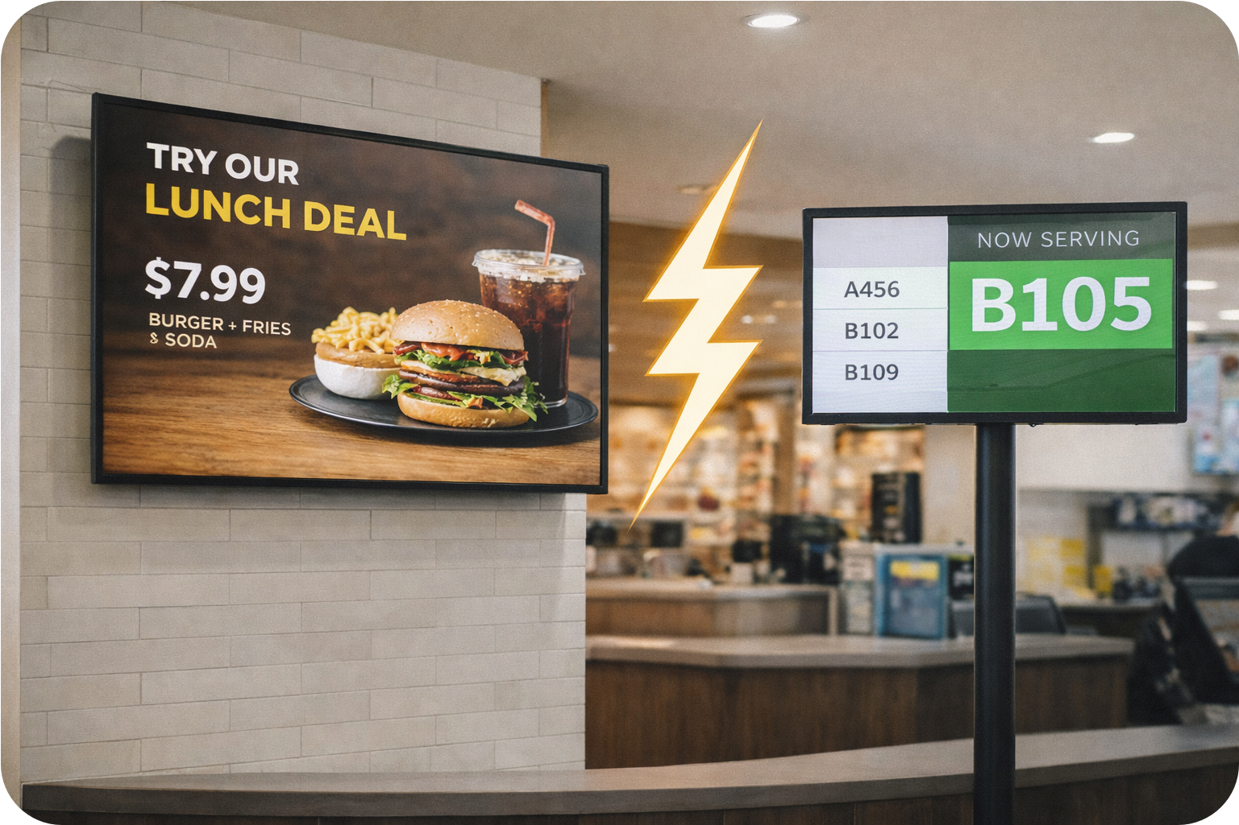
What happens when customers are called?
When customers are called, the experience often shifts away from the main display setup. In many cases, there is either a separate call system or no structured call system at all.
Separate call system or none at all
Additional screens expensive setup
Media break between marketing and service

Slide 5
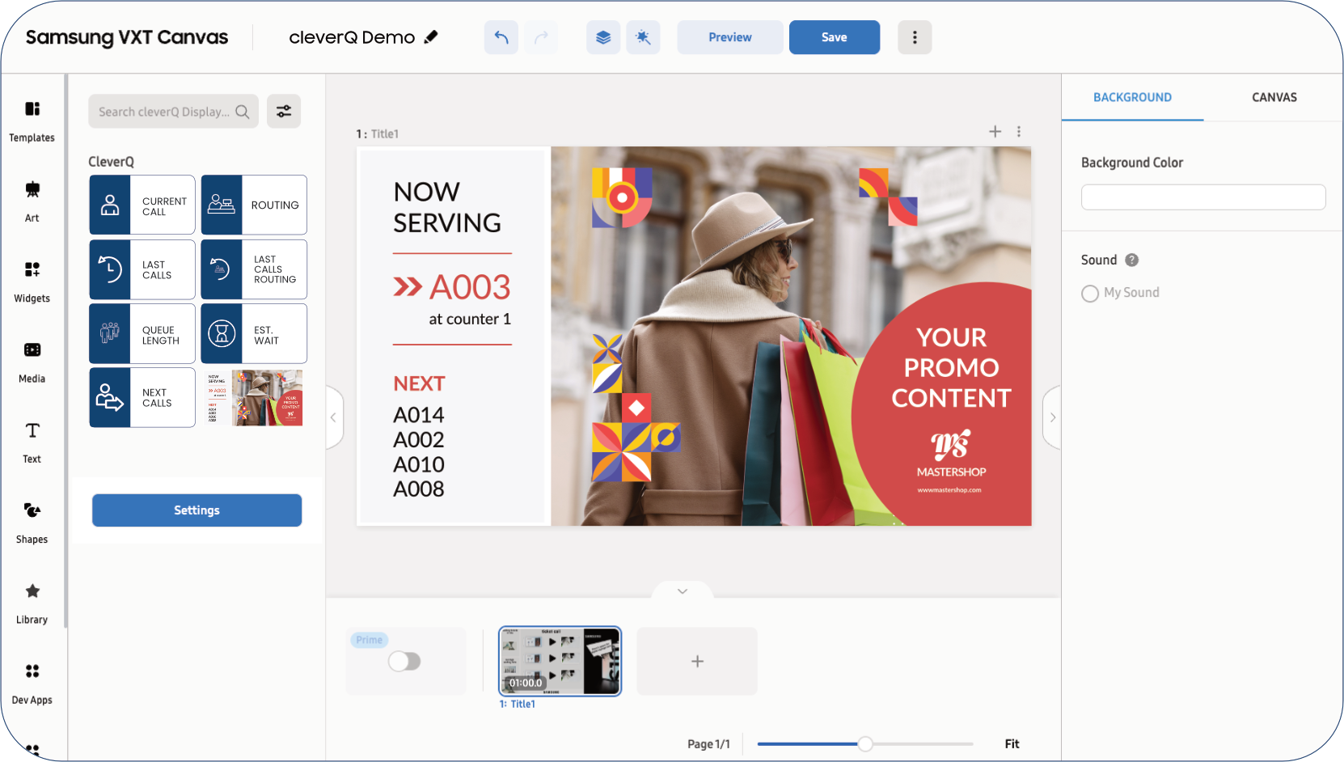
The Solution
cleverQ Display VXT
The cleverQ Widget integrates directly into Samsung VXT.
It enables full flexibility and centralized control via your cleverQ subscription.

Slide 6
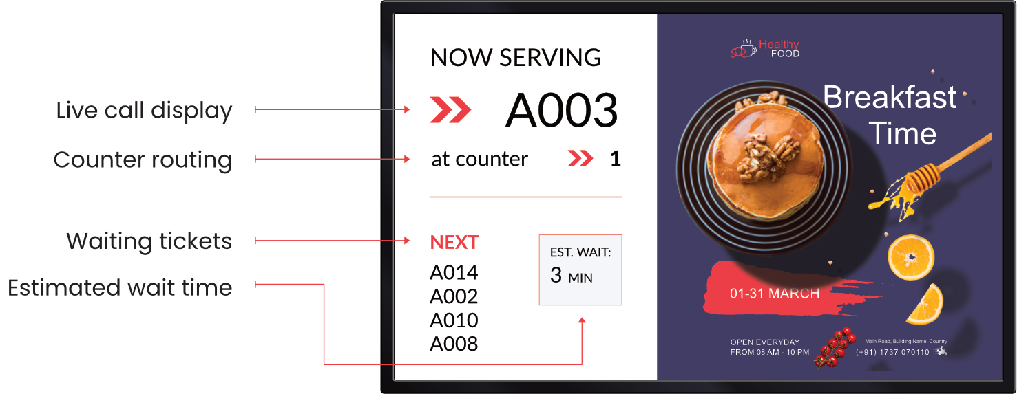
The Solution
cleverQ Display VXT

Slide 7
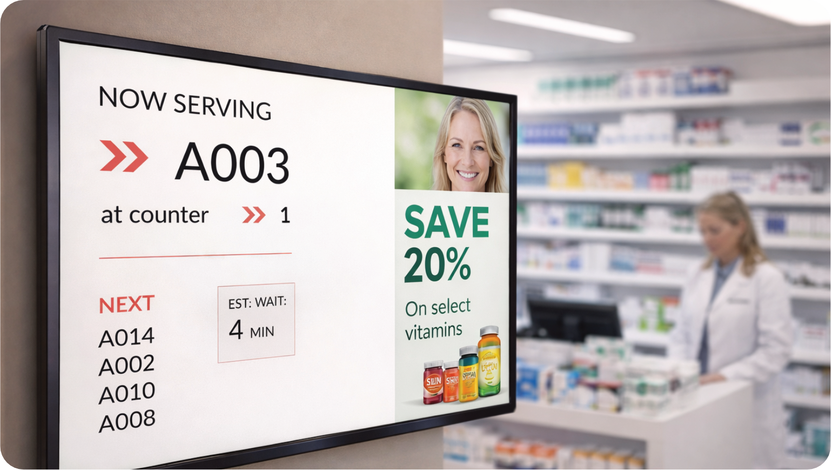
Typical Industries
Especially in telecom and retail environments, the value is significant.
Marketing combined with customer flow management increases efficiency and enhances the customer experience.
Retail stores | Telecom shops | Banks | Pharmacies Government offices | Service centers

Slide 8

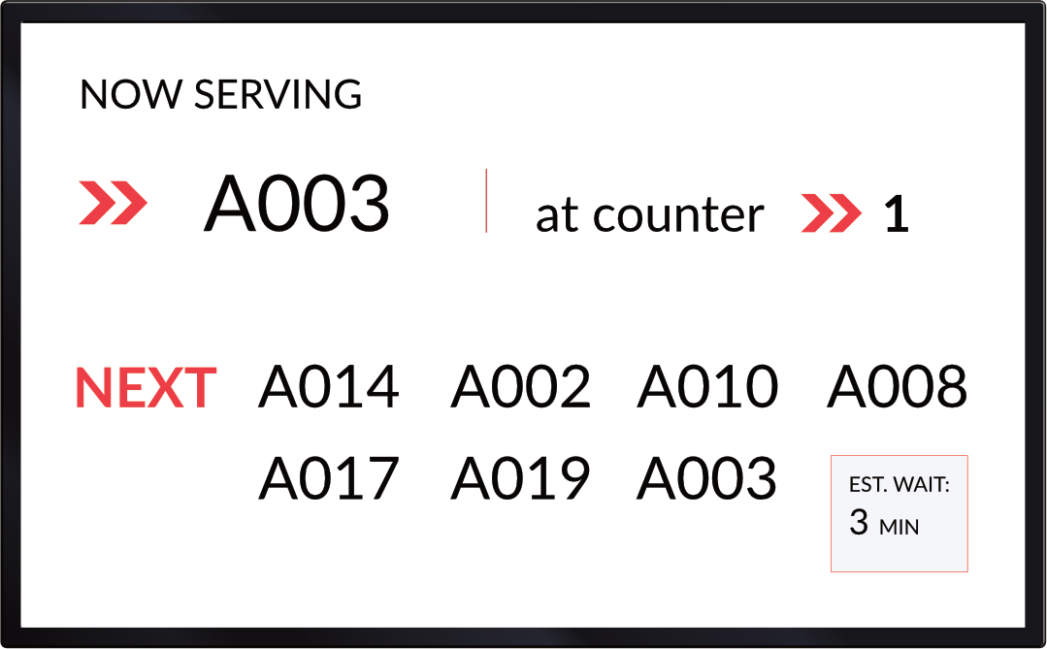


Your Benefits
No additional call display required
No media breaks
Centralized management
Higher screen efficiency
Elevated in store experience
Reduced perceived waiting time

Slide 9


Licensing Model
To use the Widget, customers require:
Samsung VXT license
cleverQ subscription
cleverQ Display VXT Widget add on
Special Offer
Customers who book the VXT Widget receive an exclusive VXT discount on their cleverQ subscription. This makes the integration not only functionally seamless, but also commercially attractive.
Display VXT

Slide 10
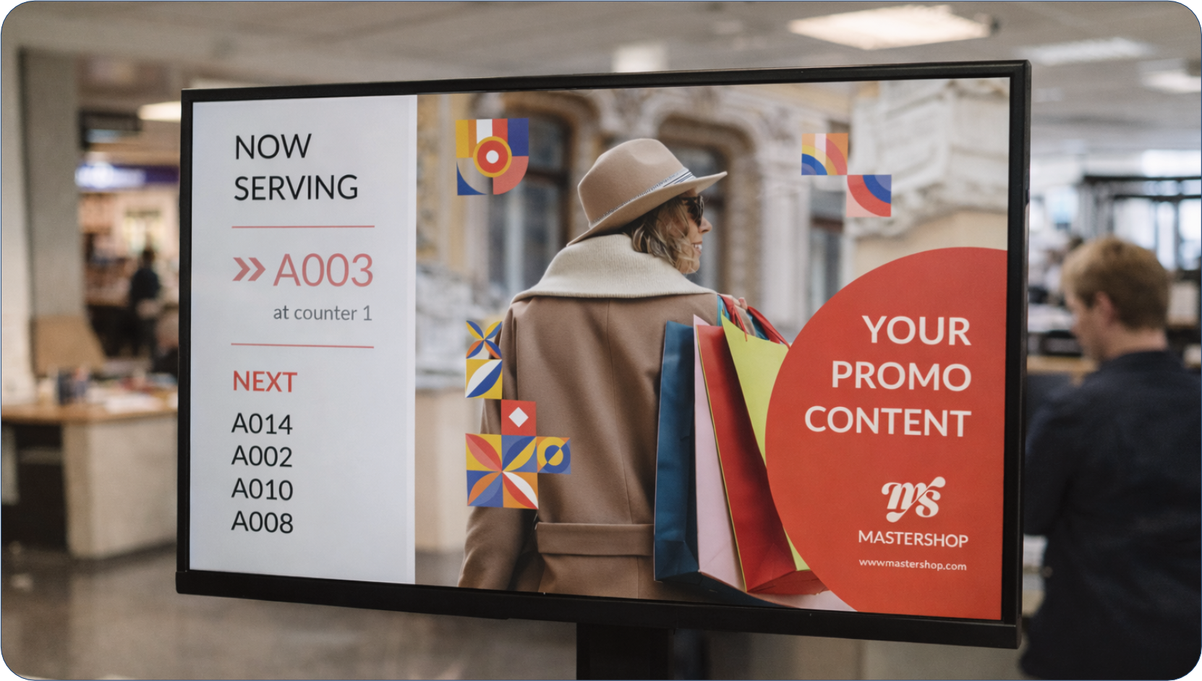
Sales Positioning
The cleverQ Display VXT Widget is ideally positioned as:
A strategic add on for existing Samsung VXT customers
An upsell opportunity for retail and digital signage integrators
A bundled solution together with Samsung displays
A functional extension for existing cleverQ customers

Slide 11
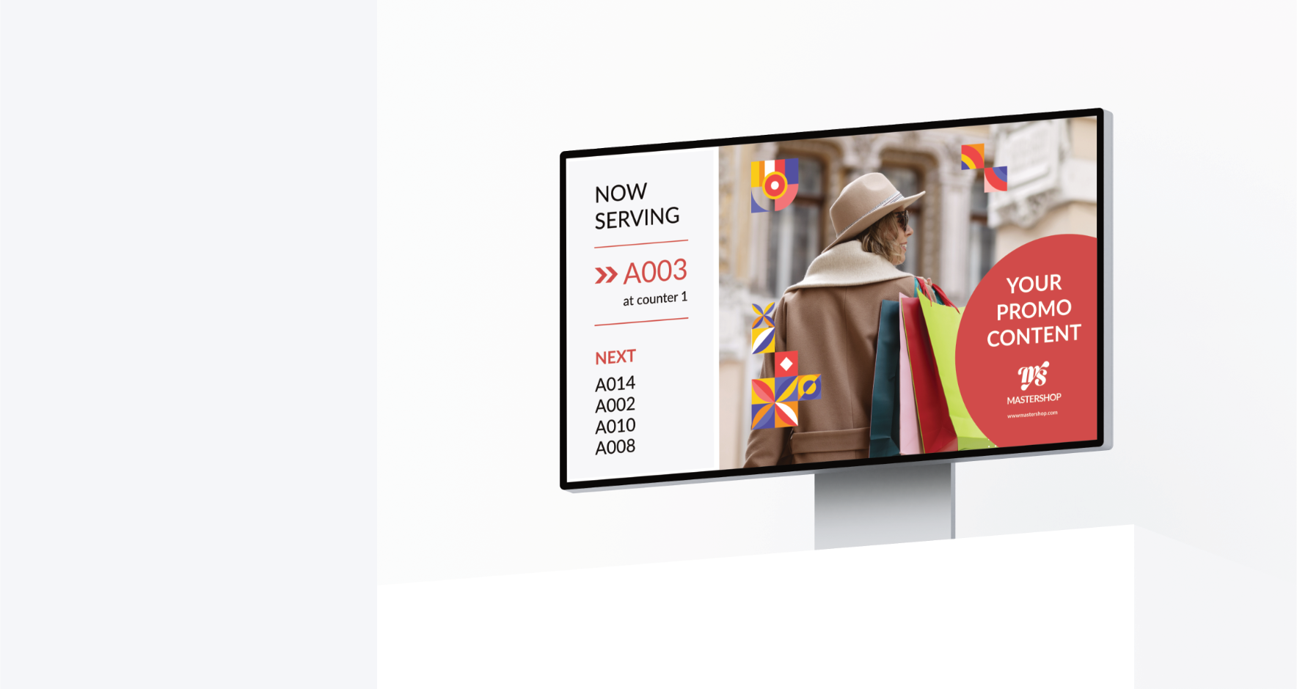
cleverQ Display VXT
The unified solution for signage and smart queuing.
www.cleverq.us | info@cleverq.us | 786-709-9550
851 Ne 1st Ave Miami | FL 33132-1842 | (Paramount Miami World Center)

