Slide 1
Transforming Customer Flow Into Business Value
www.cleverq.us | info@cleverq.us | 786-709-9550
851 Ne 1st Ave Miami | FL 33132-1842 | (Paramount Miami World Center)

Slide 2

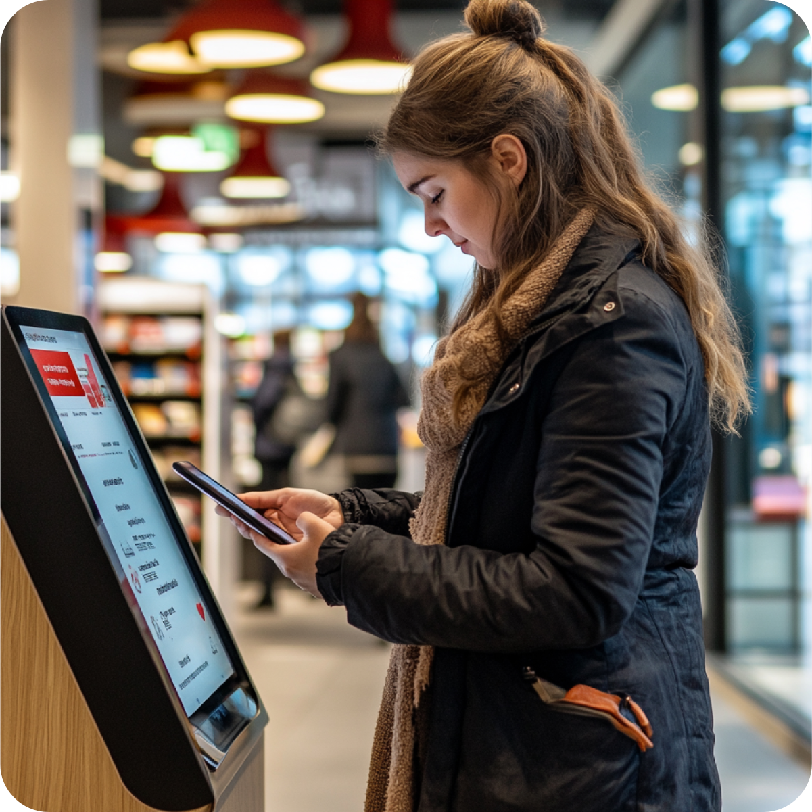
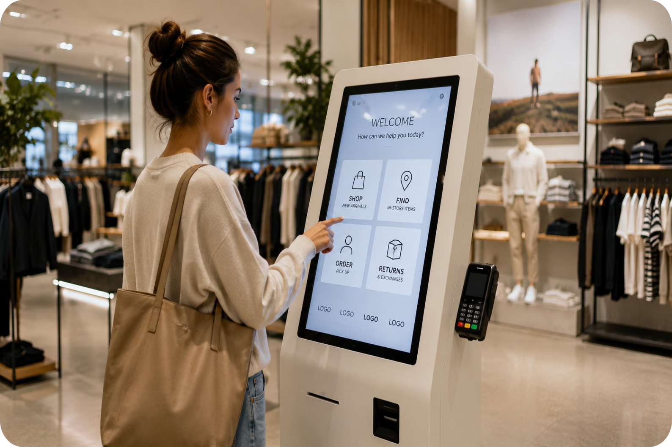
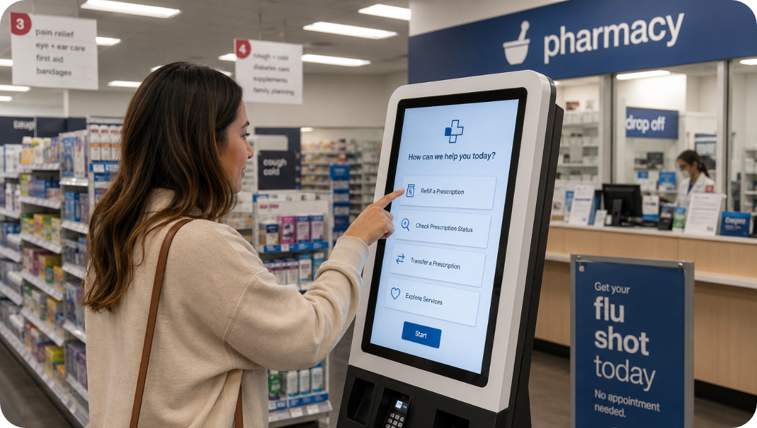
Every Enterprise Deployment
Is a Software Revenue Opportunity
We want to help our Partners drive additional hardware value and recurring software revenue through intelligent Customer Flow Solutions.

Slide 3
The Value We Create for Your Customers
Becomes a Revenue Opportunity for you
Improve Customer Experience
Reduce Operational Pressure
Modernize Service Environments
Add Operational Visibility
Faster, transparent, and modern service interactions.
Help staff manage customer demand more efficiently without increasing complexity.
Add mobile, self-service, and intelligent customer interaction workflows to existing infrastructure.
Gain insights into customer flow, service demand, and peak traffic patterns.
Increase Revenue
Reduce customer abandonment and improve service throughput in high-traffic environments.

Slide 4
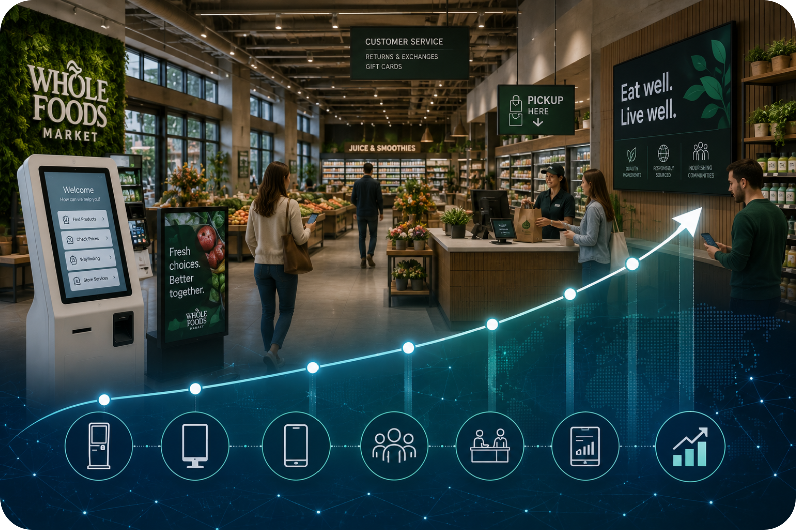
The Business Opportunity Behind Customer Flow Optimization
$143B+ Global self-service technology market projected by 2035
10%+ Expected annual growth across self-service and interactive kiosk markets
(Source: https://www.precedenceresearch.com/self-service-technologies-market)
Retailers Continue Investing in:
Self-service, digital customer interaction, mobile engagement, and operational automation technologies.

Slide 5




Hidden Costs of
Unmanaged Customer Flow
Lost Revenue | Reduced Throughput | Increased Operational Pressure | Outdated Customer Experiences
Long wait times are no longer just a customer issue. They directly impact operational performance and revenue generation.

Slide 6
Our Solutions for
Modern Service Environments
Customer Interaction
Service Operations
Enterprise Intelligence
Enterprise Deployment
Mobile Check-In
QR Workflows
Kiosk Software
SMS Notifications
Walk-In Management
Appointment Management
Customer Calling
Service Orchestration
Analytics & Reporting
Multi-Location Management
IoT Divice Monitoring
(Securus)
API-Driven Integration
Rapid Rollouts
Infrastructure Compatibility
Centralized Device Management

Slide 7
The Measurable Impact
of Customer Flow Manamgenet

Slide 8

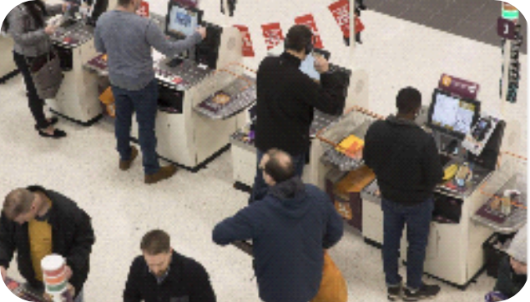
Realistic estimated annual improvement ranges for retailers
Based on industry studies, queue-management deployments, and operational consulting benchmarks
Typical Impact
10–40% reduction in wait times
1–5% increase in completed purchases
5–15% increase in customer satisfaction
2–10% revenue improvement annually
Large retailer:
$500M annual sales
2% recovered sales from fewer walkouts
Equals $10M/year additional revenue
Major chains sometimes justify queue systems entirely from:
Reduced abandonment
Increased repeat visits
Labor scheduling optimization

Slide 9

The Biggest Financial Drivers
The largest gains usually come from:
Customers not leaving
Serving more customers with the same staff
Improved scheduling
Digital appointment adoption
Premium/VIP customer handling
Real-time analytics
Cross-selling while customers wait
For large enterprises, queue management is increasingly viewed less as “line control” and more as:
Customer journey orchestration
Operational analytics
Labor optimization infrastructure

Slide 10
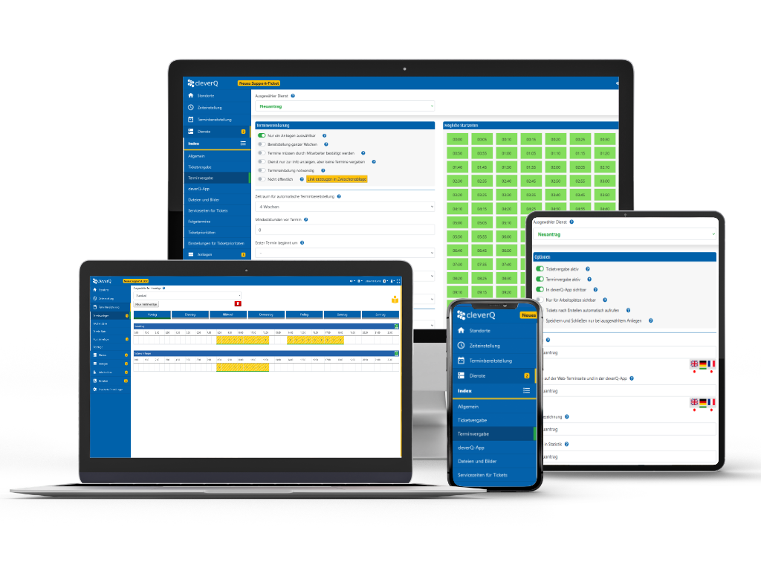
How we do it?
Simple

Slide 11
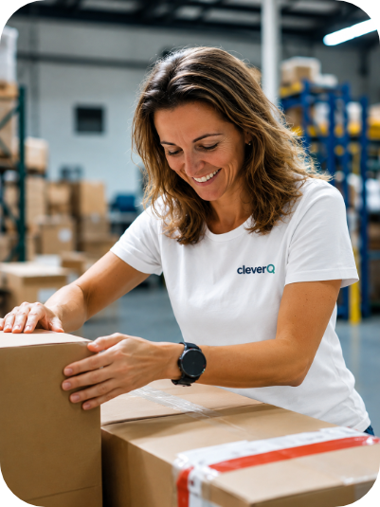
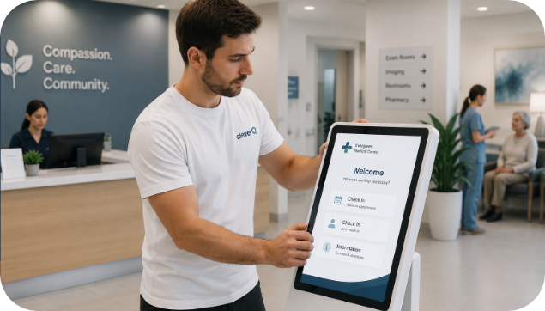
Average Installation:
Equipment shipped to customer
System connected to internet
Remote installation of cleverQ
Customization if needed remotely
Set up base operations on computer
Full local support after sales (installation)

Slide 12
Next Action
Identify Current Customers that would pilot cleverQ for free
Team up with the cleverQ Team to present solution
Determine actionable goals and ROI for a successful pilot
Install cleverQ
Work with customer for success
After proven ROI deploy all sites

Slide 13

Marketing Material Portal:
Media Hub Link:
https://www.cleverq.de/media-hub/
The cleverQ Media Hub gives centralized access to all relevant marketing and product assets in one place.
Presentations & pitch decks
Product images & deployment showcases
Videos
Logos & branding files
Flyers, datasheets & whitepapers
Documentation & project resources

Slide 14
Advanced Add-On Ecosystem
Add-On | Description | Features | Link
cleverQ Qwantum (Partnership with MAGTEK) | Intelligent customer flow and verification solution. | Identity verification, workflow orchestration, customer routing, process transparency, enterprise scalability | https://www.cleverq.us/from-chaos-to-efficiency/
Indoor Navigation | Smart indoor wayfinding and accessibility solution. | Interactive navigation, accessible routing, visitor guidance, digital directions, location assistance, facility mapping | https://www.cleverq.de/en/modules/accessible-indoor-navigation/
AI Avatar Assistant | AI-powered multilingual customer assistant for Self Service Workflows | Voice interaction, multilingual support, digital guidance, self-service assistance, conversational interface | https://www.cleverq.de/en/modules/avatar/
Securus Device Monitoring | IoT Monitoring Plattform | Real-time monitoring, remote diagnostics, alert management, device status tracking, uptime optimization | https://www.securus-m.de/en/
Multilingual Voice Output | Automated multilingual voice announcement system | Automated ticket announcements, multilingual voice output, accessibility support | https://www.cleverq.de/en/modules/audio-output/
Statistics & Customer Surveys | Analytics and feedback platform for operational insights | Real-time dashboards, survey collection, KPI tracking, reporting, customer satisfaction analytics | https://www.cleverq.de/en/modules/statistics/

Slide 15
Transforming Customer Flow Into Business Value
www.cleverq.us | info@cleverq.us | 786-709-9550
851 Ne 1st Ave Miami | FL 33132-1842 | (Paramount Miami World Center)

